Slide 2
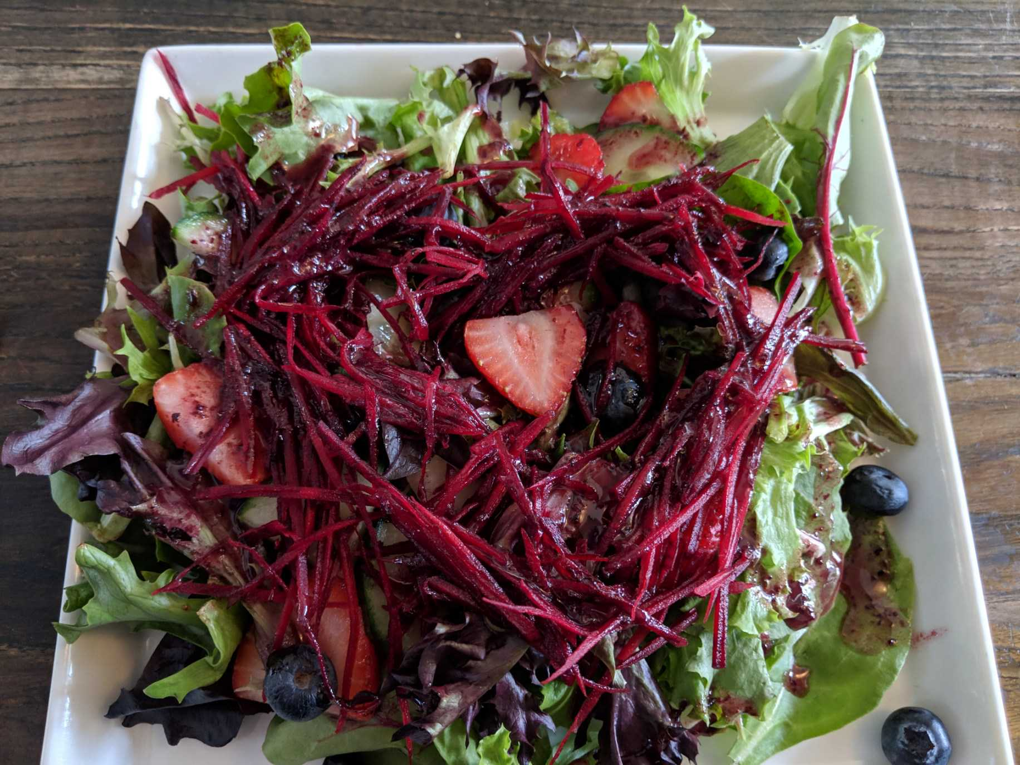
NishDish was established in May 2005 as a First Nations operated food catering business in Toronto Ontario

Slide 3
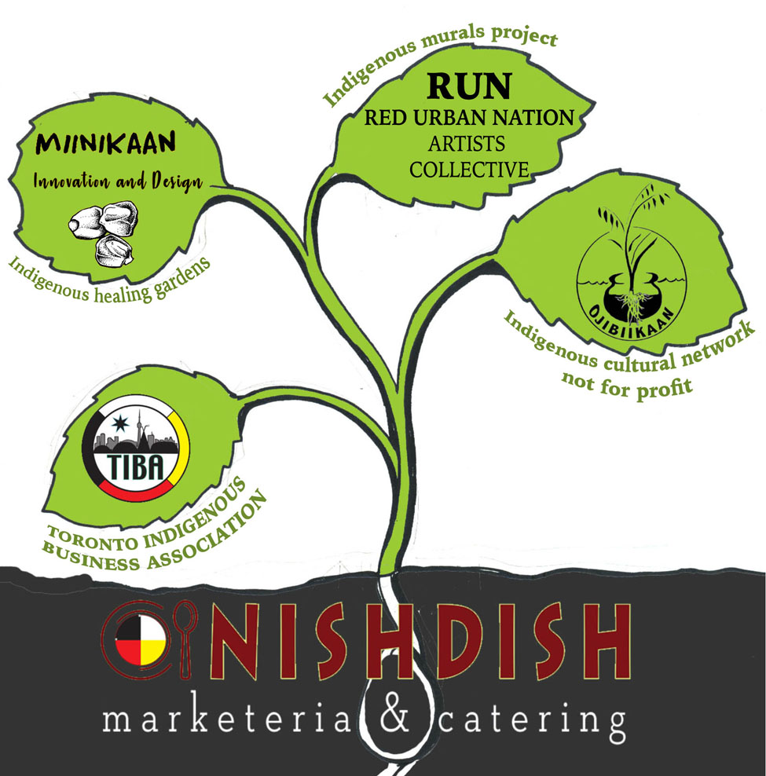
As a social entrepreneur, I was inspired to use the NishDish restaurant to grow many more opportunities for our community.

Slide 4
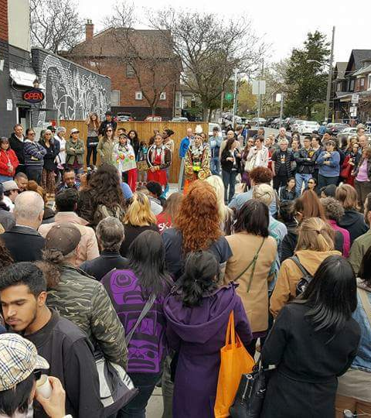
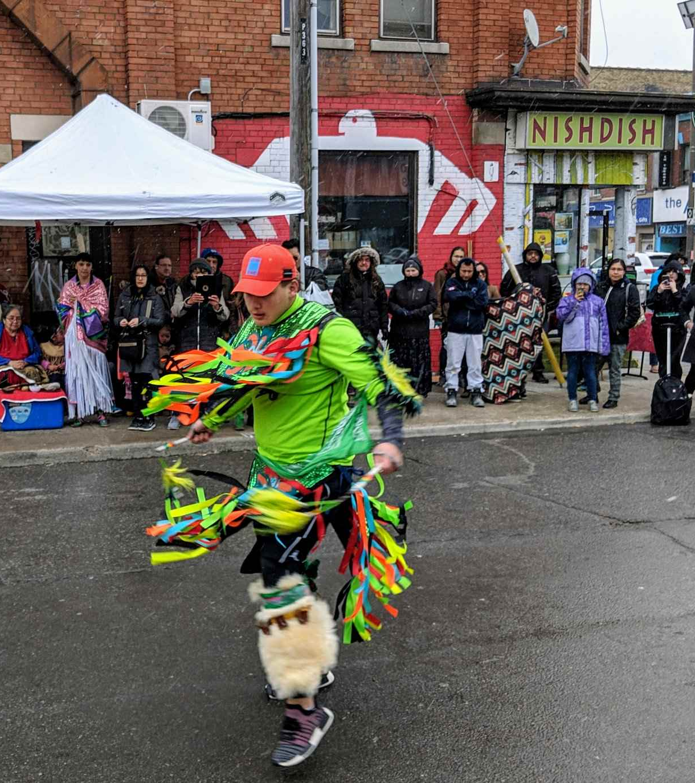
On April 29, 2017, NishDish Marketeria and Catering opens a public venue restaurant and breaks restaurant history

Slide 5
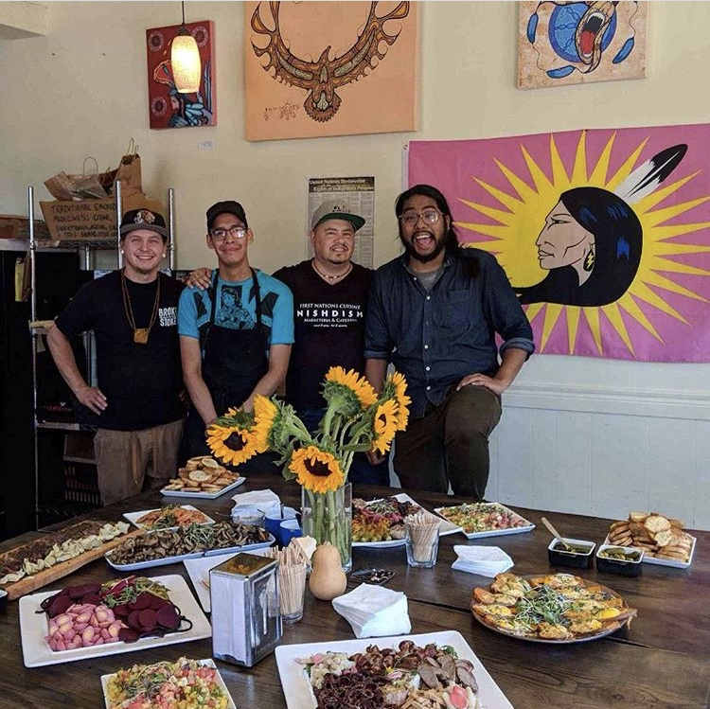

Slide 6
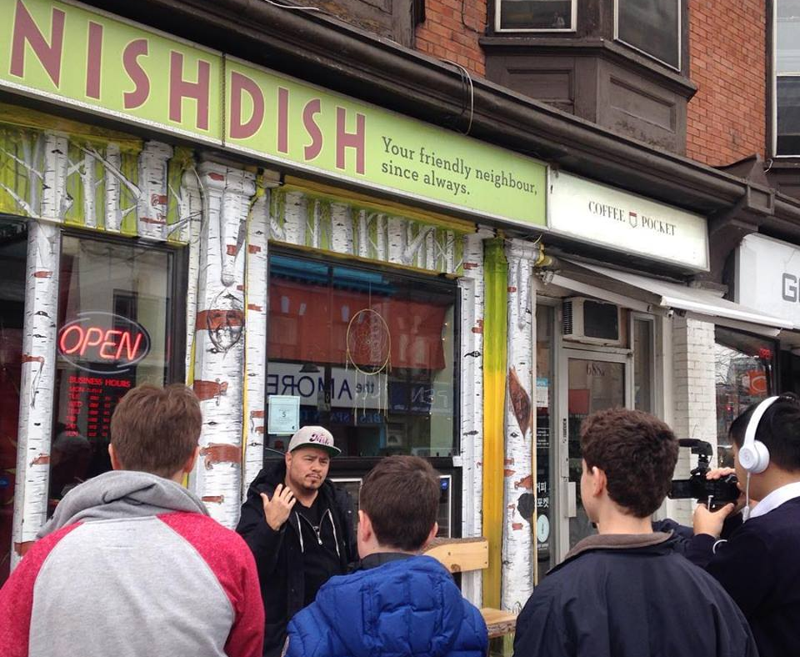
More than a restaurant: supporting the next 7 generations through our education in Indigenous Food Sovereignty and our agroecological practices and teachings

Slide 7
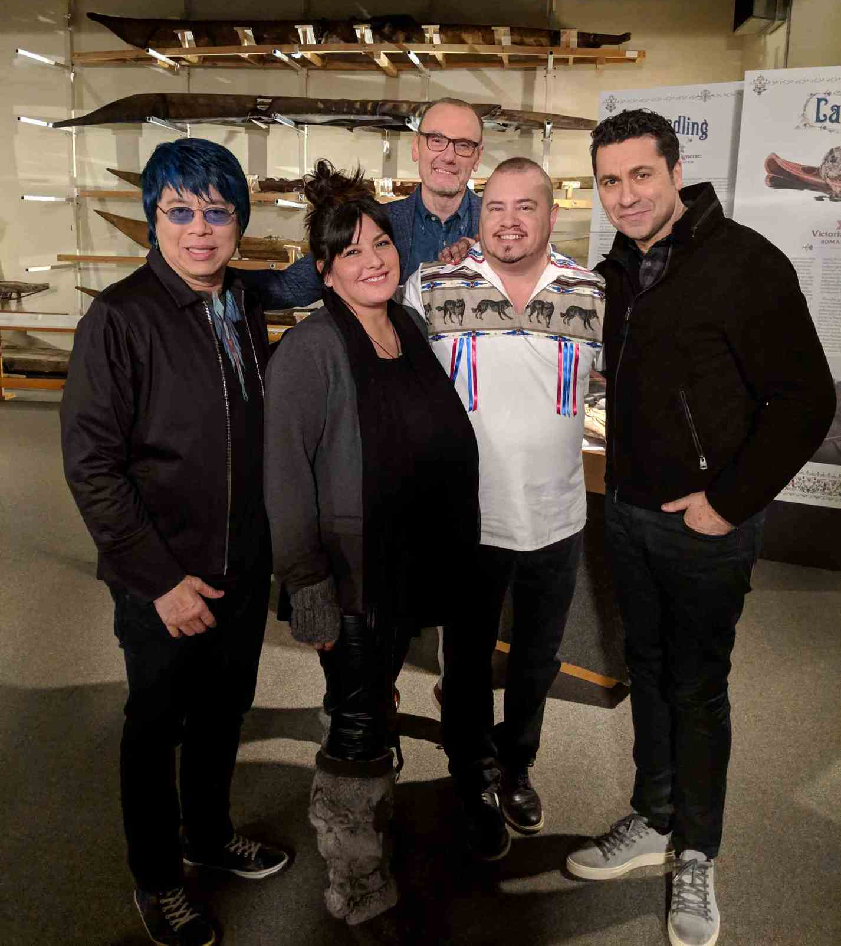
MasterChef Canada co-host Chef Johl Whiteduck in 2019.
Showcasing Indigenous cuisine to the whole nation and honoring the gift of Haudenosaunee White Corn

Slide 8
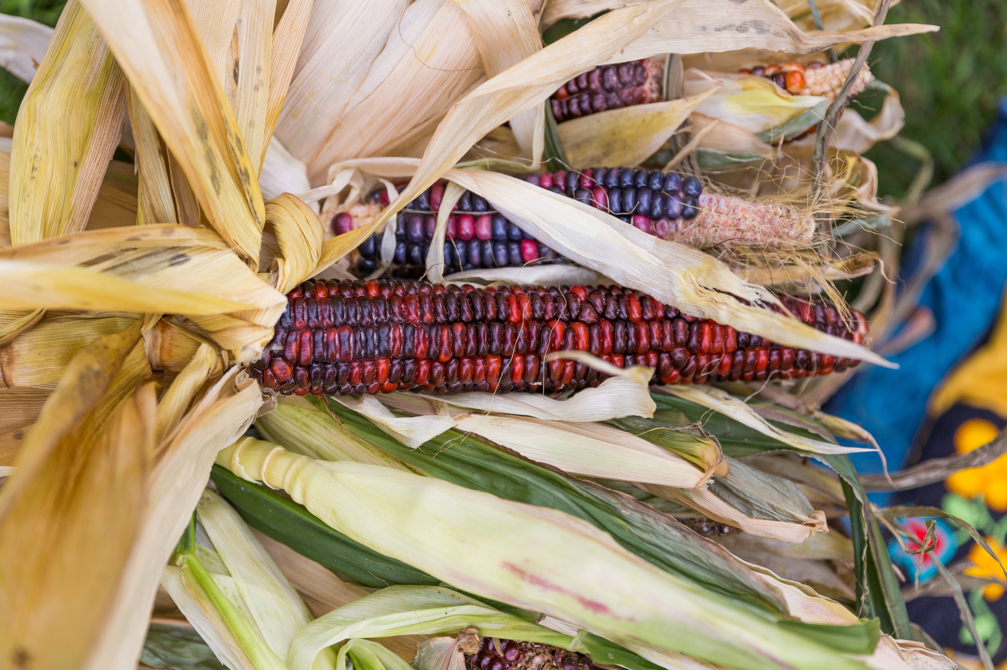
The Mohawk red flint corn harvest from Ashbridges Estate Three Sisters Garden (2018).
Ojibiikaan Indigenous Cultural Network not-for-profit became the new stewards of the garden projects.

Slide 9
Ashbridges Estate Three Sisters Garden build in 2018, an expansion of Ojibiikaan’s program the year before.
The ceremony of planting of the ancestral corn seeds.

Slide 10
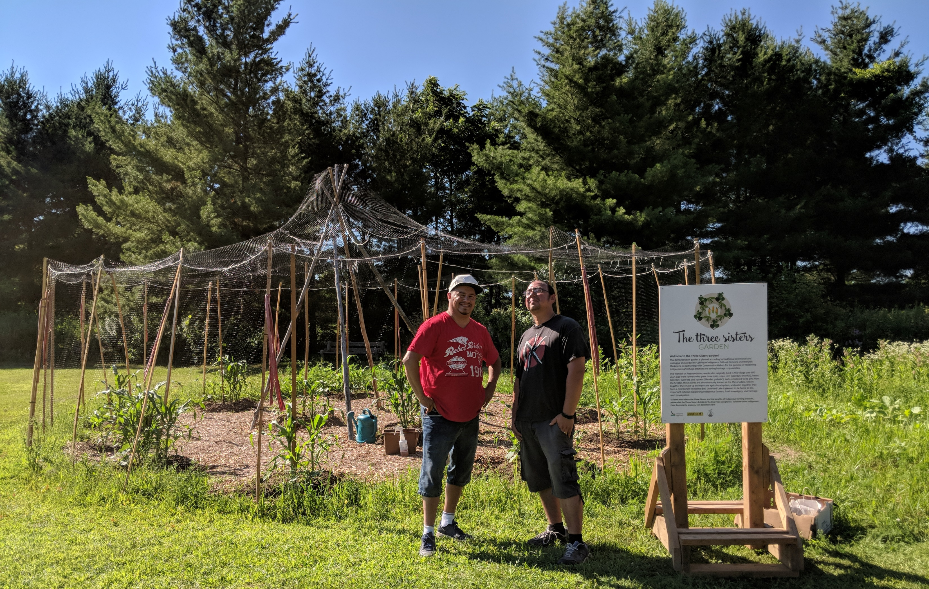
The Three Sisters garden project at Crawford Lake conservation area:
started in 2018 to honour and revitalize the Huron Wendat traditional planting and territory

Slide 11
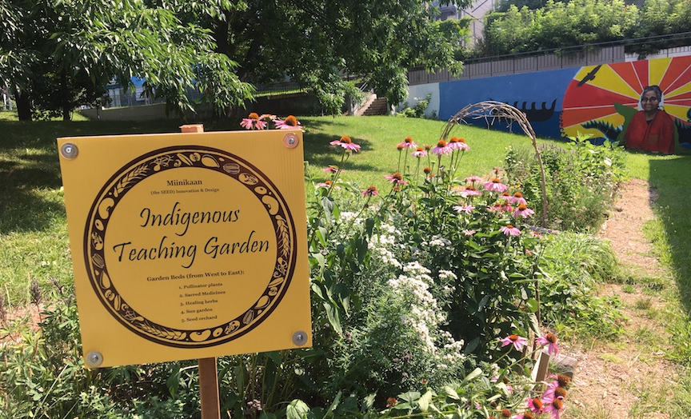
Miinikaan Innovation and Design a small business growing Indigenous healing gardens and teaching about the medicines and the seeds through ceremony

Slide 12
Living Monument garden designed and built by Miinikaan
Awarded the David Suzuki Foundation's Future Ground Prize (grand prize)

Slide 13
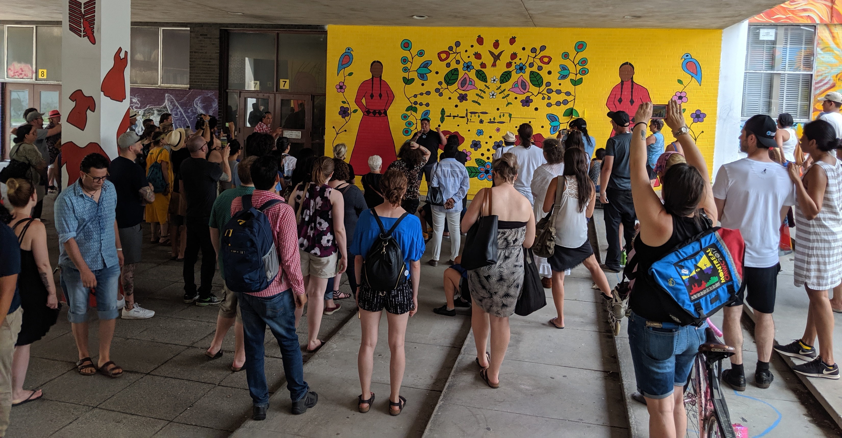
Indigenous Murals Project by RUN – Red Urban Nation Artists Collective also tells the story of our ancestral medicine teachings

Slide 14
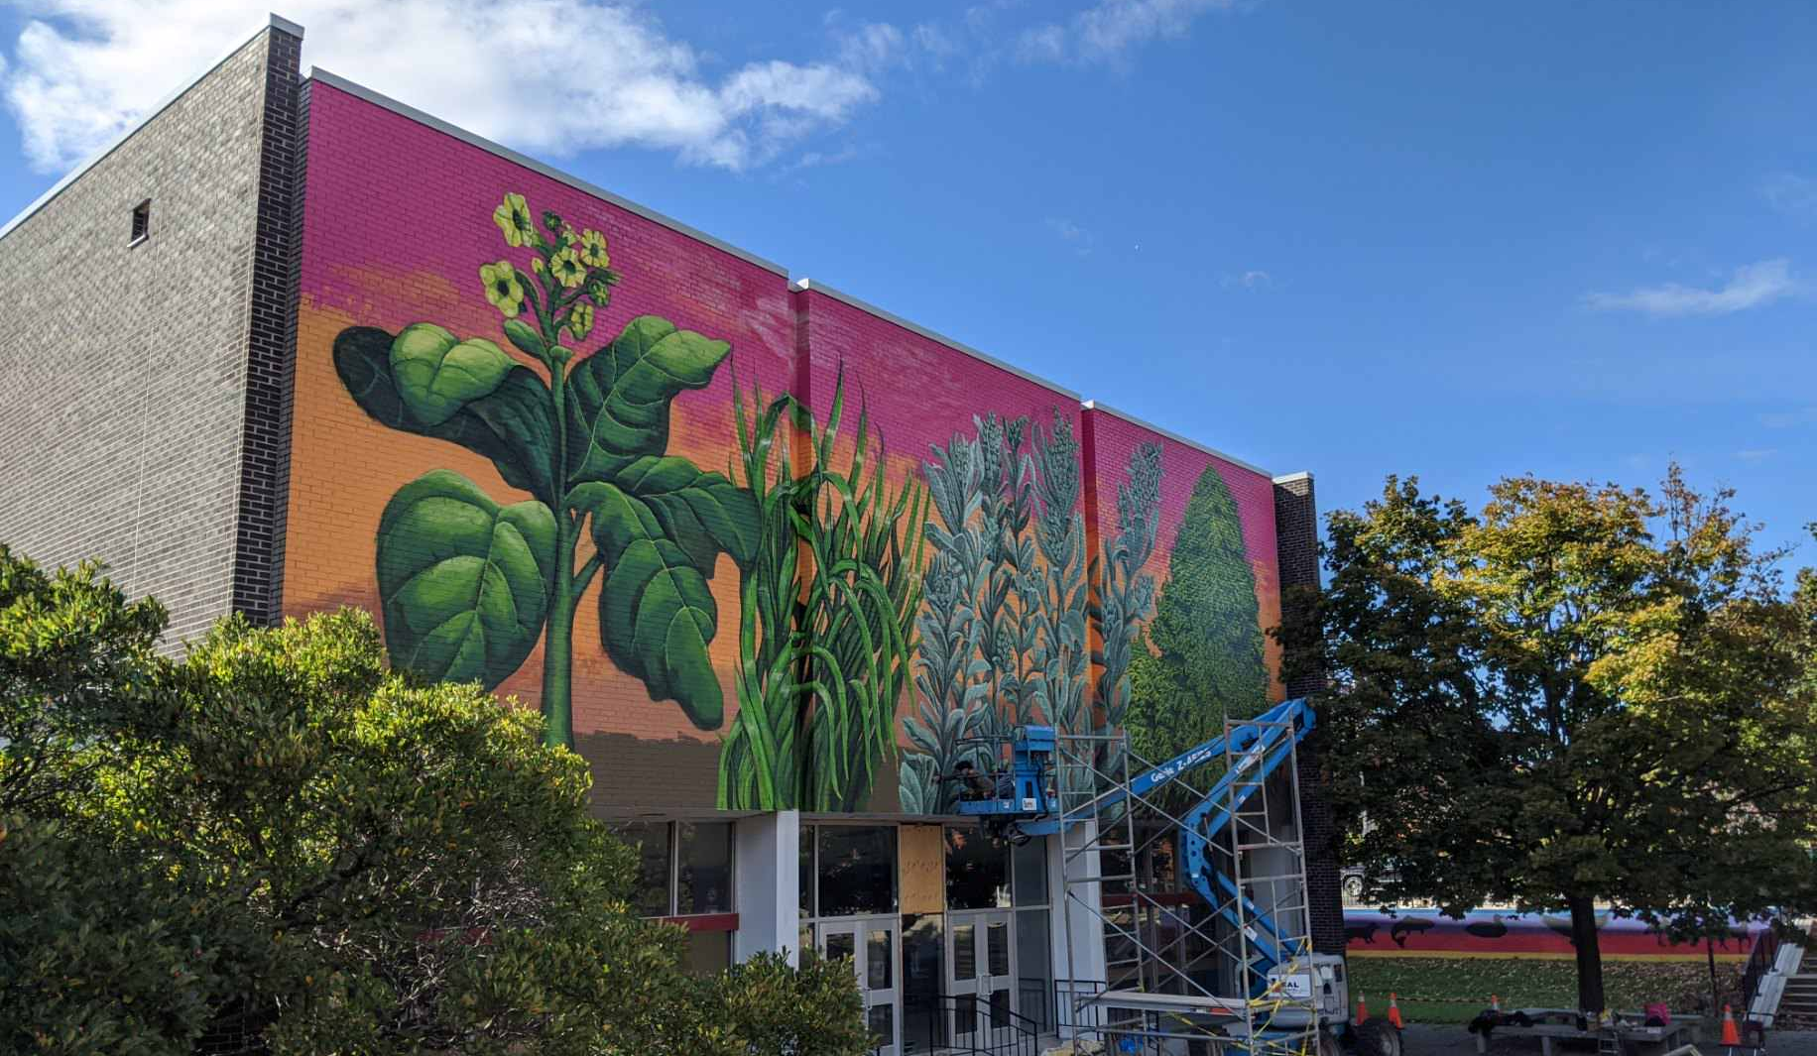

Slide 15
www.NishDish.com
Ojibiikaan Indigenous Cultural Network
www.ojibiikaan.com
Miinikaan Innovation & Design
www.miinikaan.com
R.U.N. : Red Urban Nation Artist Collective
@ red urban nation art
CHI-MIIGWECH!

