Slide 1
Taking Care of Our Land and Water in Food Production Youth Agricultural Forum – January 17th, 18th, 2023
Ontario Ministry of Agriculture, Food and Rural Affairs
Aquaculture & Aquaponics
Michael McQuire - Aquaculture & Aquaponics Specialist, OMAFRA

Slide 2
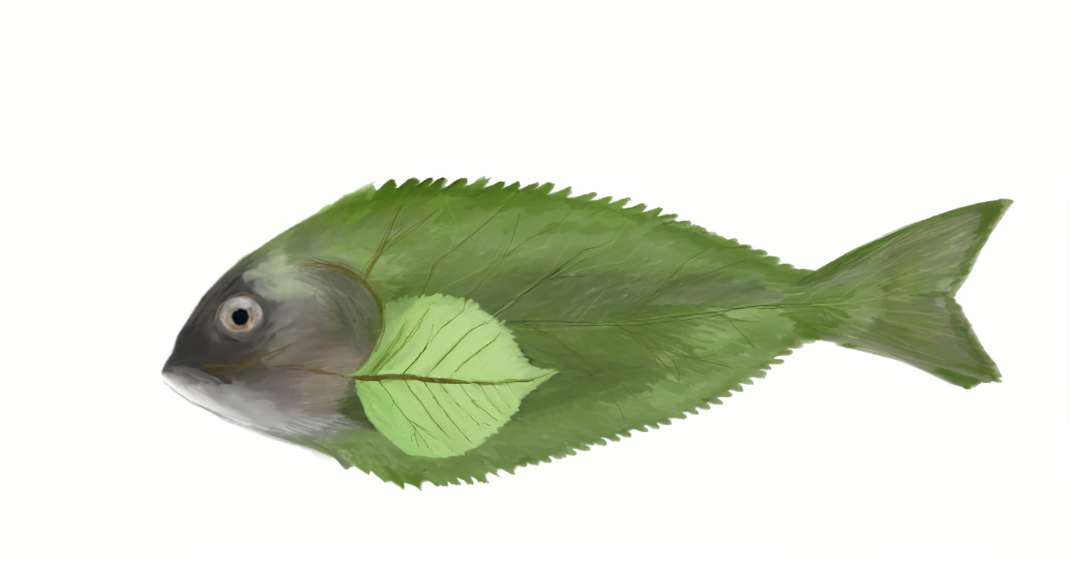
Presentation Outline
1) Aquaculture
What, why and where
Ontario aquaculture species
Fish farming systems
2) Aquaponics
What is aquaponics
Aquaponic system designs
Species selection
source:nx-food.com
source: Cole-Munro Foods

Slide 3
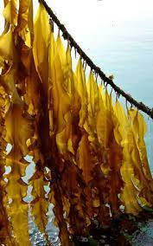
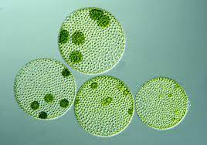
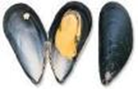
What is Aquaculture ?
Aquaculture is the cultivation of aquatic organisms under controlled conditions
Finfish
Atlantic Salmon (2)
Grass Carp (3)
Nile Tilapia (8)
Crustaceans
Whiteleg Shrimp (1)
Red Swamp Crayfish (5)
Mollusks
Mussels
Oysters
Manila Clam (10)
Aquatic Plants
Kelp
Seaweed
Algae
Chlorella minutissima
* ( # ) global rank in value by aquaculture species 2017
3
source: Top 10 species group in aquaculture 2017, FAO

Slide 4
Why Aquaculture ?
Supply & Demand
49%
Global seafood production in 2020 (wild capture + aquaculture): 178 MMT
Wild capture harvest in 2020: 90 MMT (51%)
Aquaculture production in 2020: 88 MMT (49%)
Global demand for seafood grows rapidly
Rise in population and consumption levels
Global per capita seafood consumption:
1960 = 9.9 kg seafood / person / year
2020 = 20.2 kg seafood / person / year
Wild capture fisheries harvest capacity has plateaued since 1990s: ~ 90MMT
By 2030 global seafood demand: 202 MMT
Increasing global seafood demand will need to be met through aquaculture
44%
20%
4%
5%
sources: State of the World Fisheries and Aquaculture, FAO, 2022
4

Slide 5
Where is aquaculture in Canada ?
Canadian aquaculture production, 2020 (tonnes) – 170,805
Provincial Leaders
British Columbia
Atlantic Salmon – 76%
P.E.I
Shellfish – 58%
Ontario
Rainbow Trout – 53%
Atlantic Salmon (71%)
Rainbow Trout (6%)
source: (Fisheries and Oceans Canada,2020)
Shellfish (18%)

Slide 6
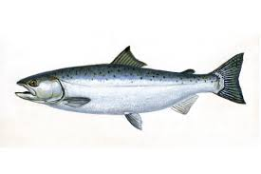
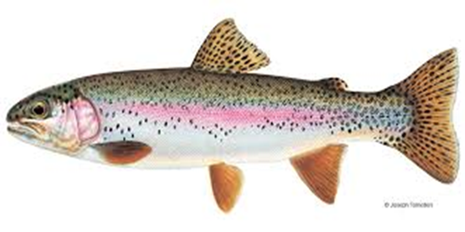
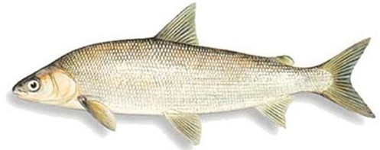
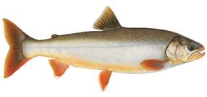
Ontario aquaculture production by species
Coho Salmon
Lake Whitefish
95%
Arctic Charr
Shrimp

Slide 7
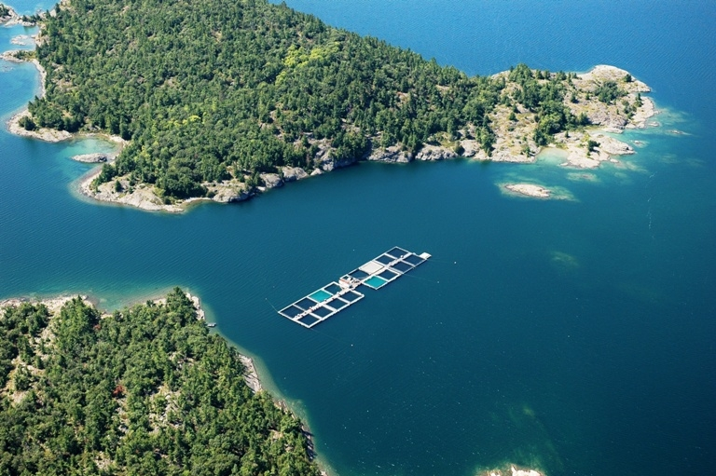
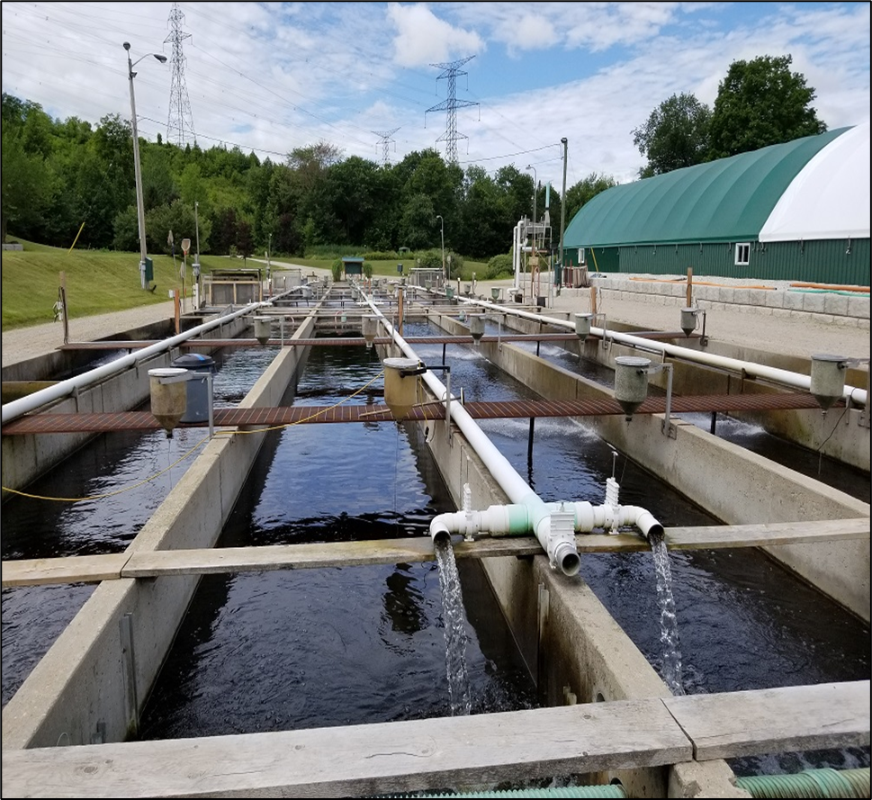
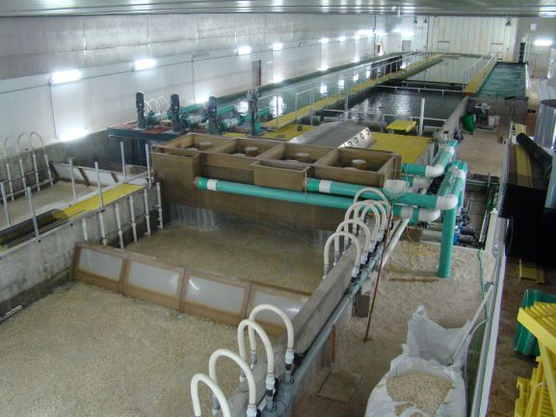
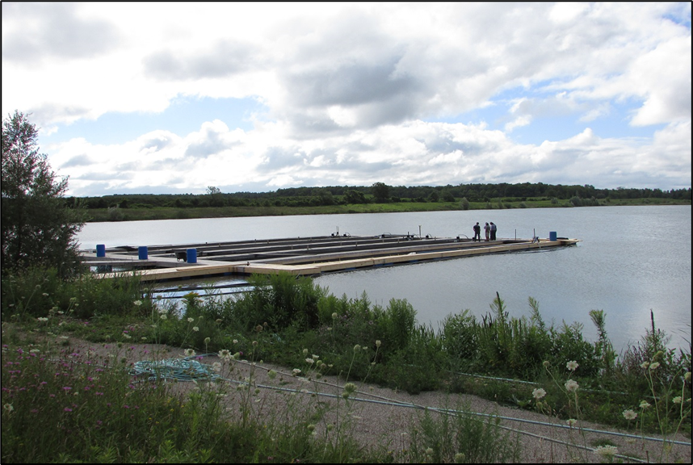
Finfish production systems – How are fish farmed ?
Open Water Net Pens
Land-based Flow-through Raceways
Cole-Munro Foods, Lake Huron, ON
Cedar Crest Trout Farms, Hanover, ON
Recirculating Aquaculture Systems (RAS)
Non-typical sites – Decommissioned Quarry
Watersong, Warren, MB
Izumi aquaculture, Cambridge, ON

Slide 8
What is aquaponics?
The combination of two growing systems into one complementary system
Aquaculture (RAS) Hydroponics
Fish provide nutrients for plants
Plants filter water for fish

Slide 9
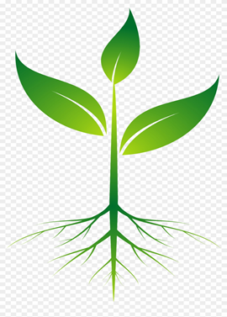
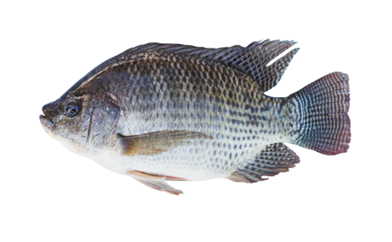
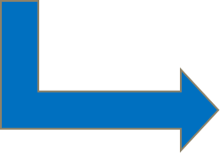
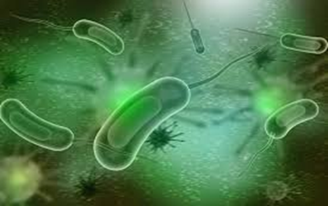
The symbiotic relationship between fish, plants and microorganisms
Plants
up-take Nitrate as a Nitrogen source essential for plant growth - reducing Nitrate levels in water returning to fish
Fish
metabolize food and excrete ammonia, CO2 and organic waste through gills, feces and urine
Microorganisms
Nitrifying bacteria oxidize Ammonia into Nitrite, then Nitrate
Microorganisms convert organic fish waste into available plant nutrients

Slide 10
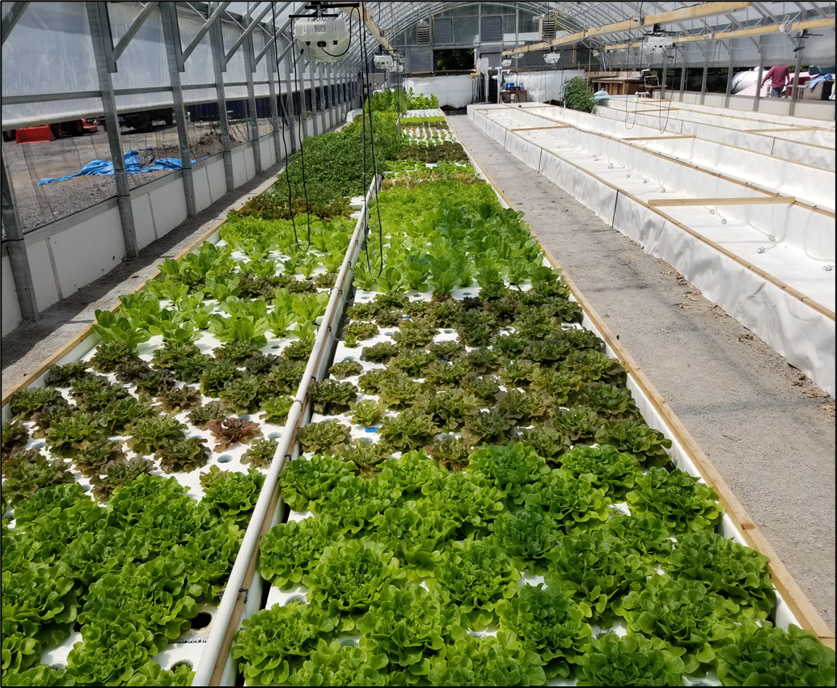
Aquaponic production systems
1) Coupled (single-loop system)
2) Decoupled (multi-loop system)
Plant production systems:
Nutrient film technique (NFT)
Deep water culture (DWC)
Media-bed technique
Ontario Sustainable Agriculture Inc., Markham, ON – coupled DWC system

Slide 11
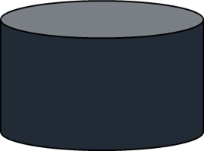
Coupled aquaponics system (single loop)
Single closed loop system with common water between fish and plants
Advantages → smaller footprint, lower start-up costs, less technically complex
Disadvantage → fish and plants require different environmental conditions (Temp, pH, nutrients)
→ difficult to achieve optimal growing conditions for both plants and fish
Rearing Tank
Solids Filter
Hydroponics
Biofilter
Sump Tank

Slide 12
Decoupled aquaponic system (multi-loop)
Independent recirculation systems for fish and plants connected via a bio-digestor
Nutrients made available to plants using a bio-digester and added to plant sump
Advantages → Optimize environmental conditions in both fish and hydroponic system
→ Maximize fish and plant productivity and animal welfare
Disadvantages → Larger footprint, greater infrastructure, larger capital investment
Rearing Tank
Bio-digestor
Solids Filter
Biofilter
Hydroponics
Fish Sump
Degassing
Plant Sump

Slide 13
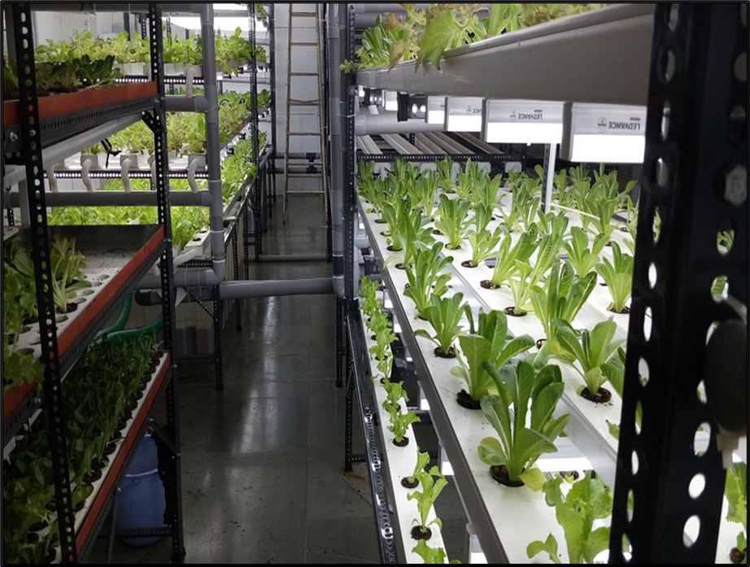
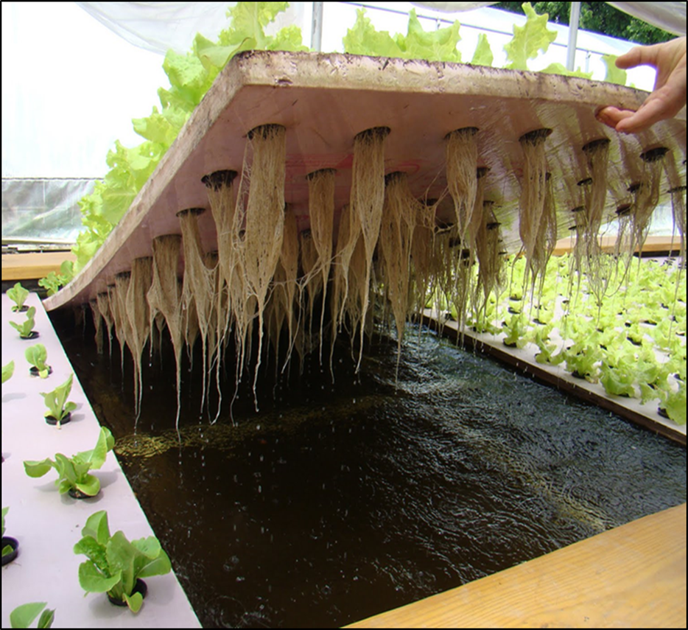
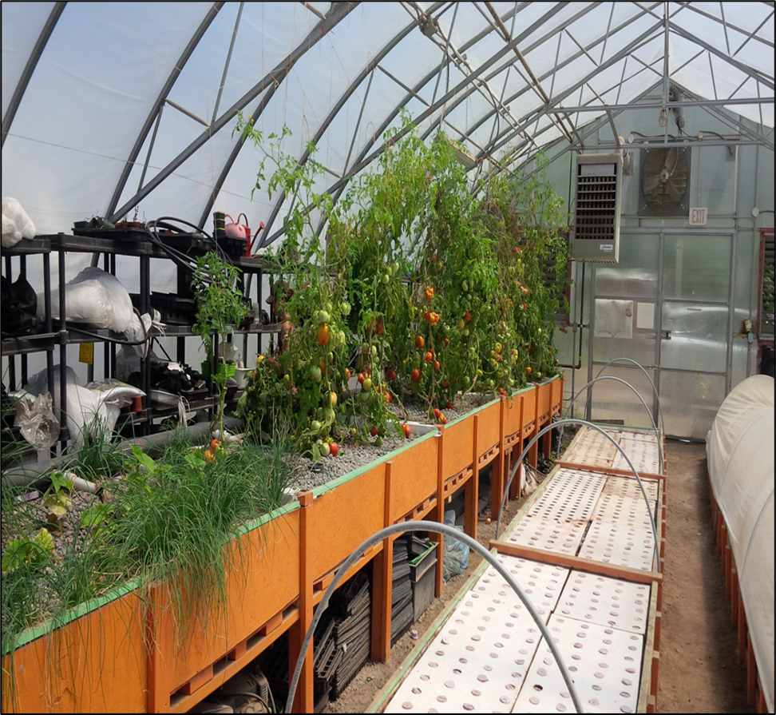
Aquaponics - Plant Production Systems
Nutrient Film Technique
Deep Water Culture (Raft)
Media Bed Technique
A thin film of water is continually pumped along the trough bottom – sub irrigated
Plants are supported on a polystyrene raft suspended in nutrient rich water
Inert media (sand, gravel, clay balls) support roots and microbes within a grow bed

Slide 14
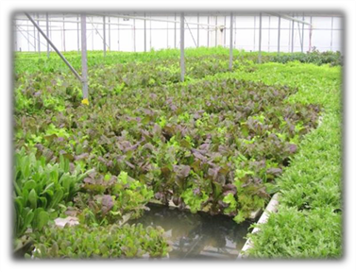
What to grow in aquaponics ?
Fish species
Plant species
Tilapia
Koi + Goldfish
Rainbow Trout
Catfish
Common Carp
Bluegill
Black Crappie
Pumpkinseed
Barramundi
Shrimp, crayfish & prawn
Leafy Greens → Lettuce, Bok Choi, Swiss Chard, Kale, Spinach, Collard Greens
Herbs → Chives, Basil, Parsley, Mint, Watercress, Arugula, Fennel, Chamomile
Fruits → Tomatoes, Cucumber, Peppers, Strawberries, Melons
Microgreens → Alfalfa, Radish, Clover
Edible Flowers → Sunflower, Marigold
Aquatic Plants → aquarium trade
Cannabis → vegetative & flowering cycles

Slide 15
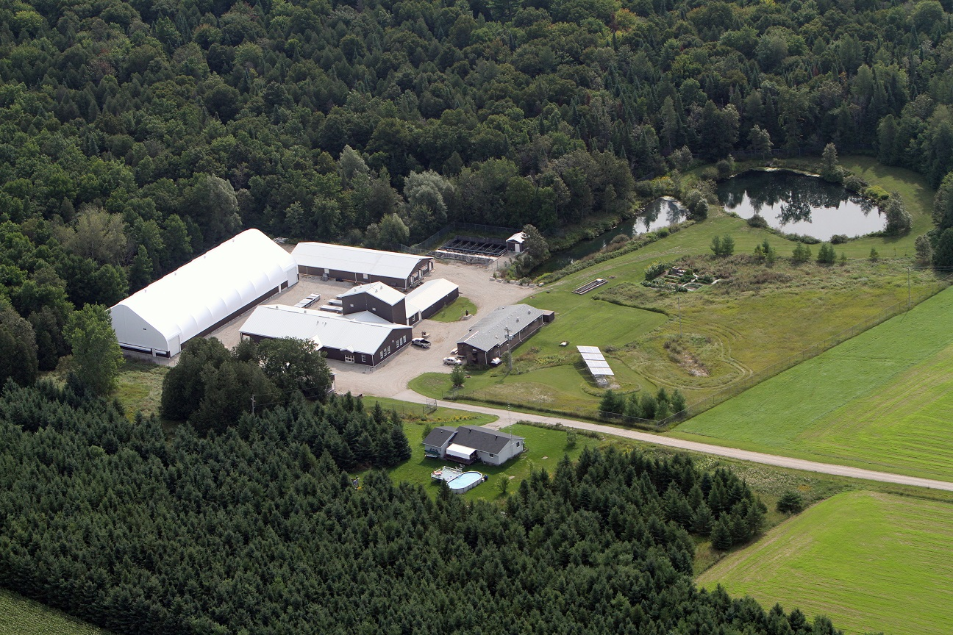
Educational Resources
Getting Started in Aquaculture & Aquaponics
In-person workshop offered at the Ontario Aquaculture Research Centre, Alma, ON (resumes April 2023)
Contact: aars@uoguelph.ca
Online course (free): Introduction to Aquaculture and Aquaponics (thinkific.com)
Fleming College
Aquaculture co-op program (in-person):
Aquaculture (Co-op) : Fleming College
Aquaculture Foundation (online):
Aquaculture Foundations : Fleming College
Ontario Aquaculture Research Centre, Alma, ON

Slide 16
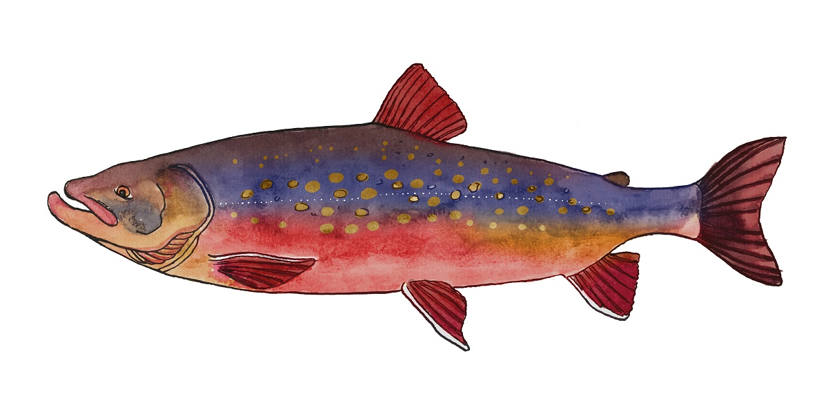
Questions ?
Michael McQuire – Aquaculture & Aquaponics specialist, OMAFRA
michael.mcquire@ontario.ca

