Slide 1
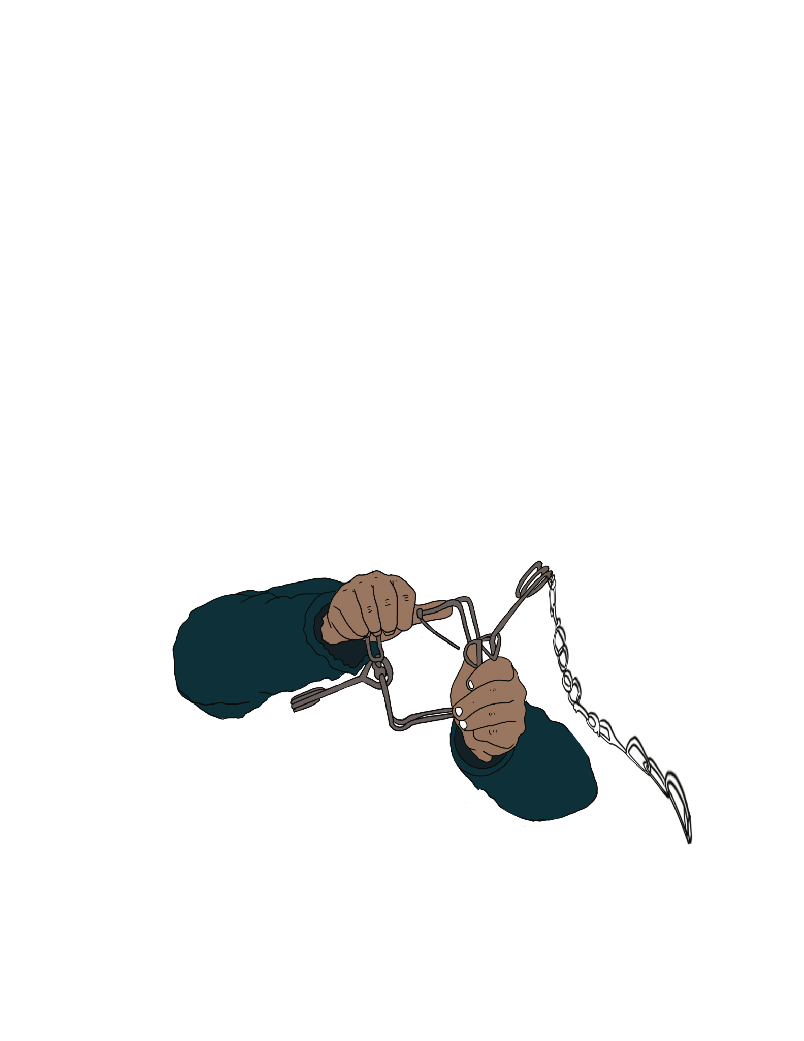
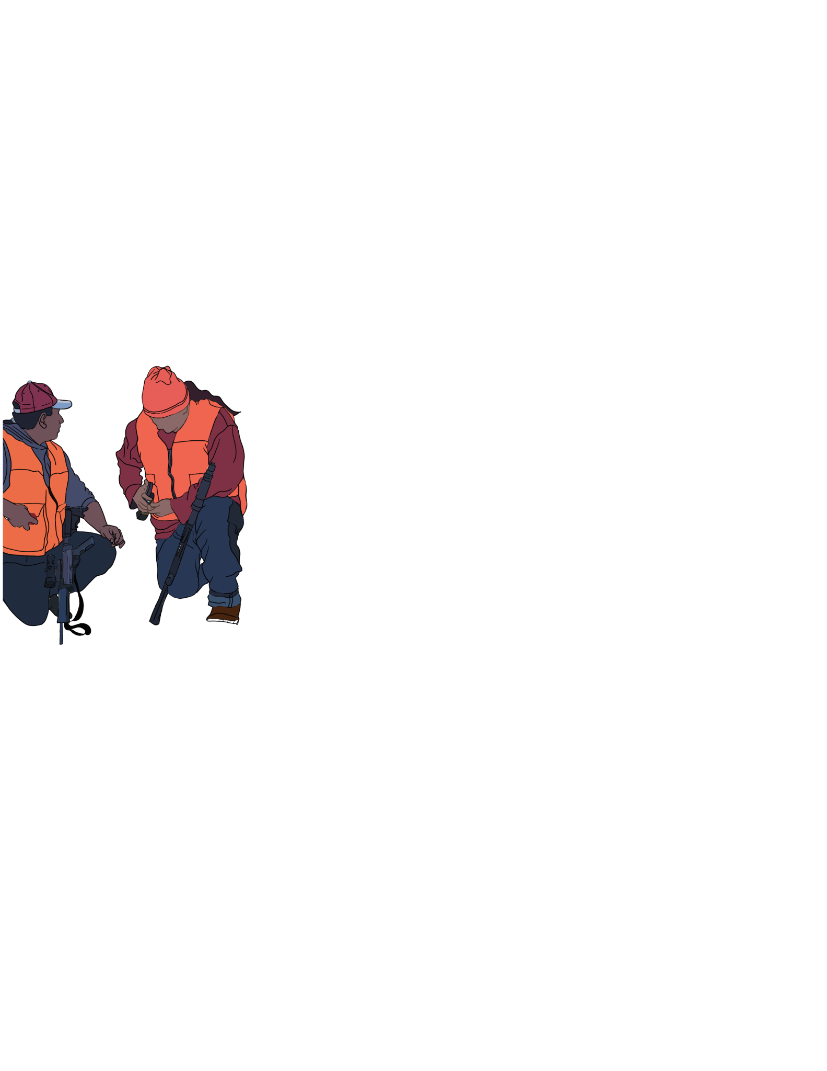
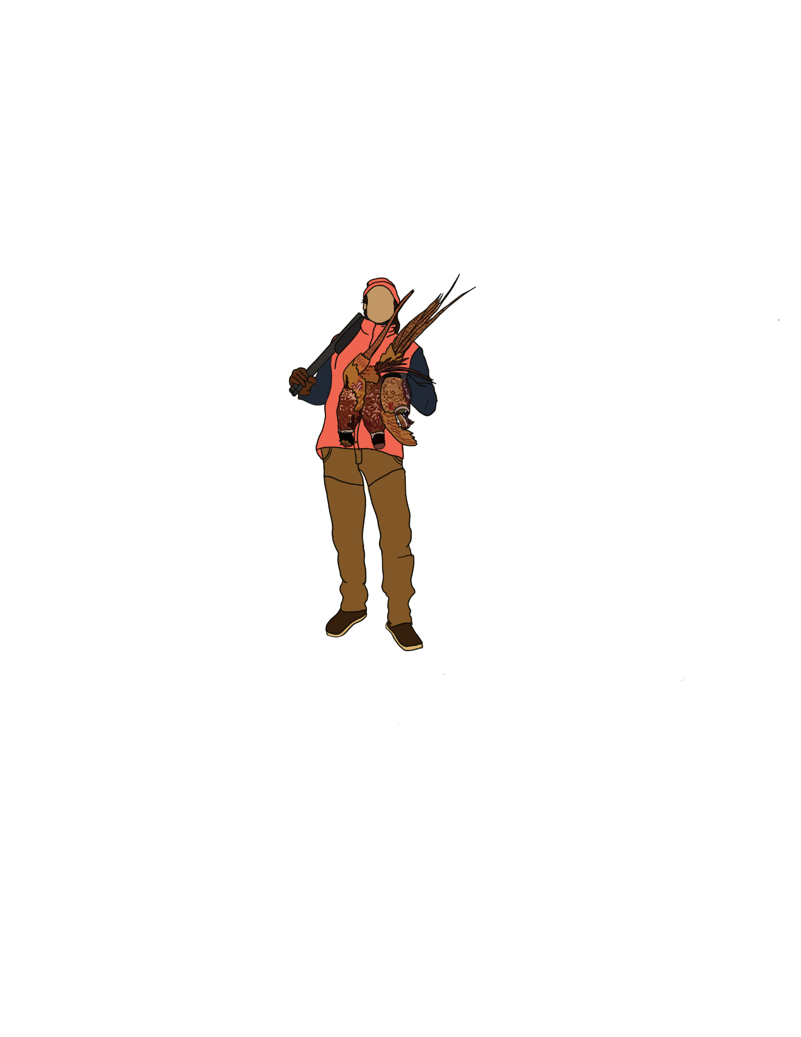
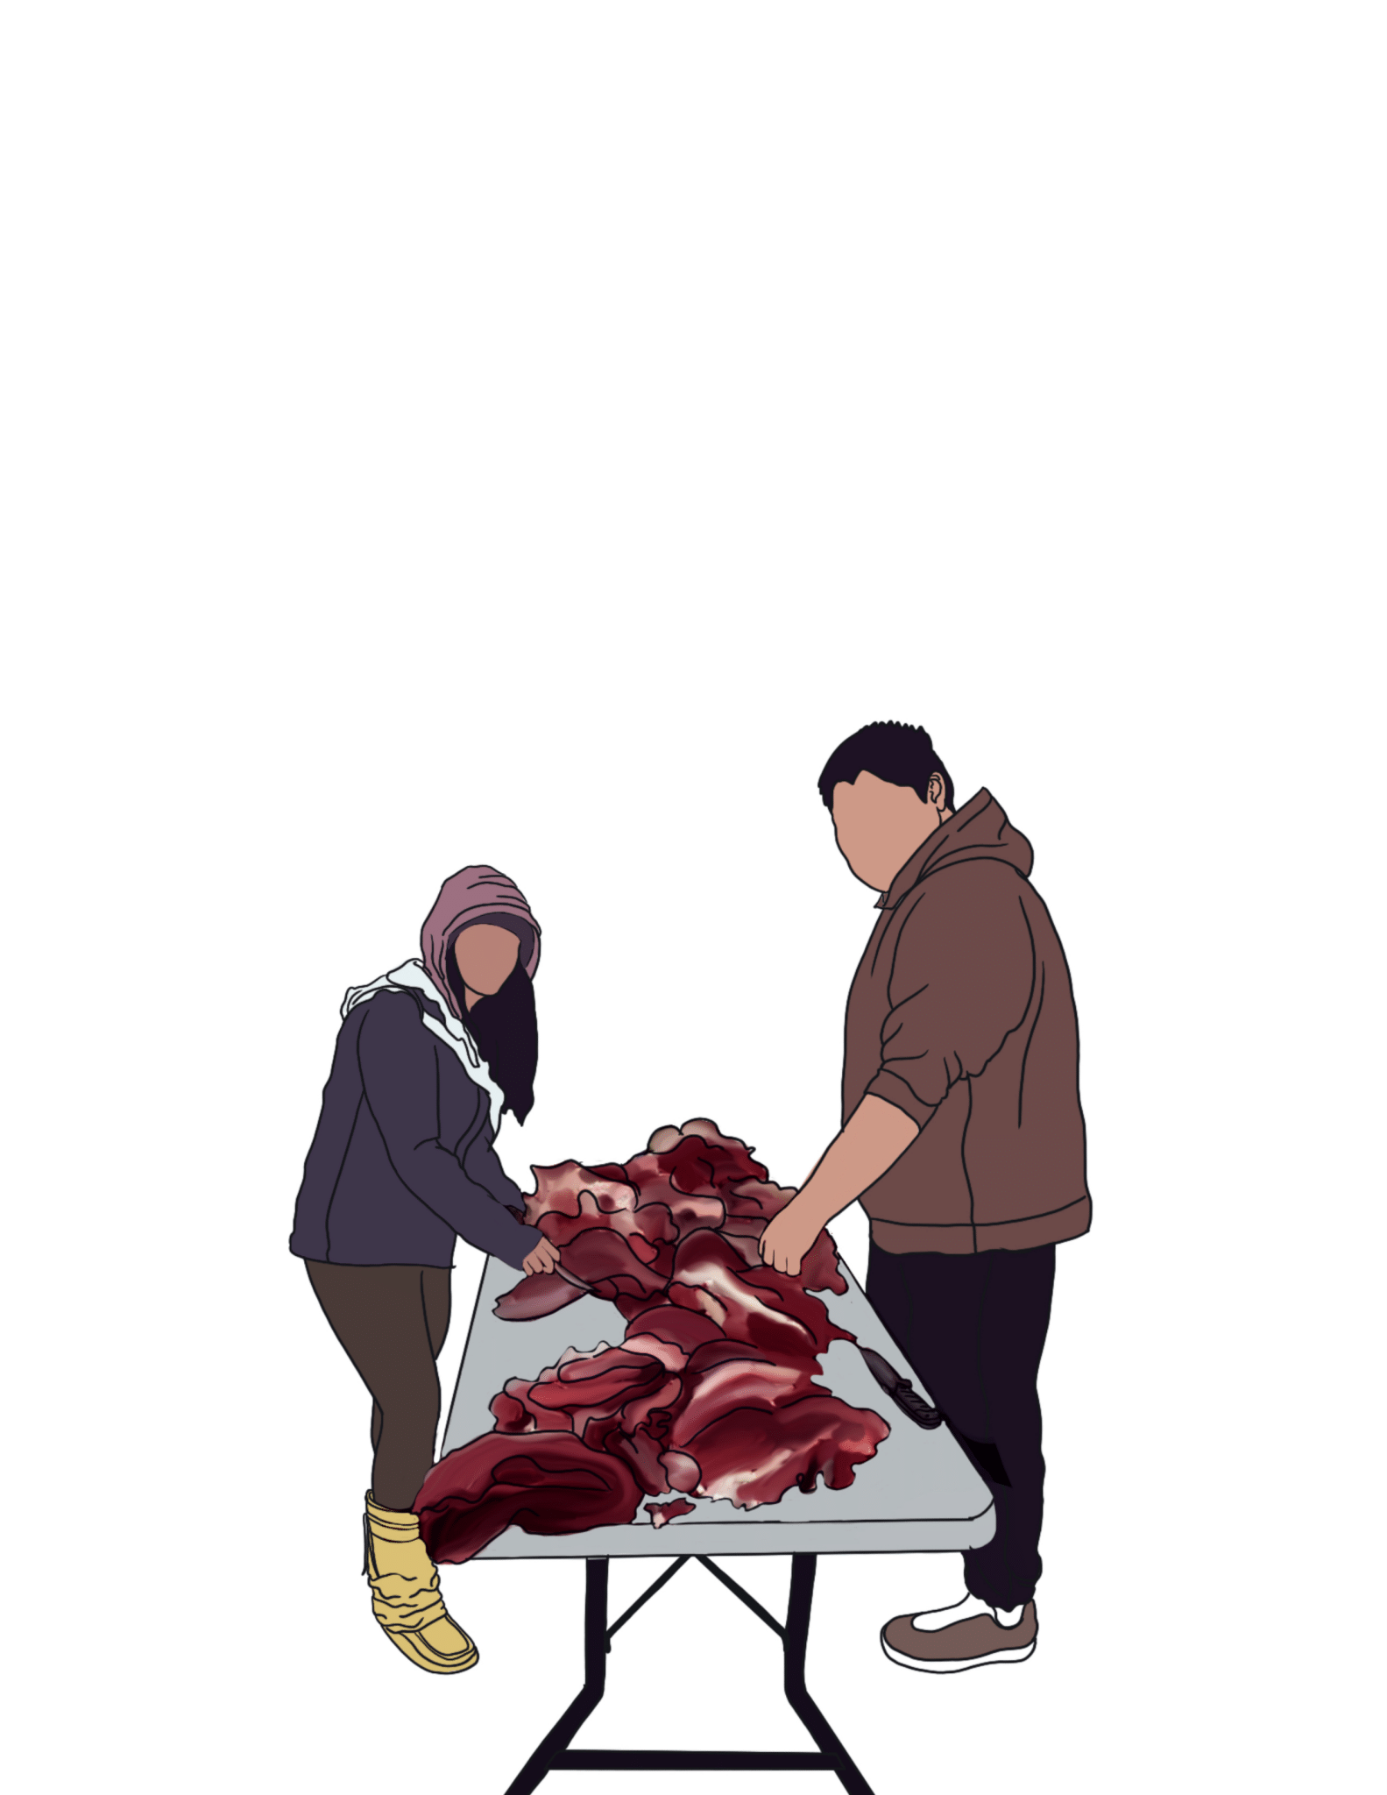
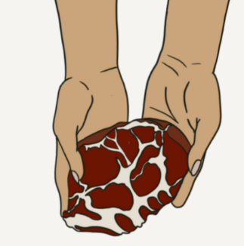
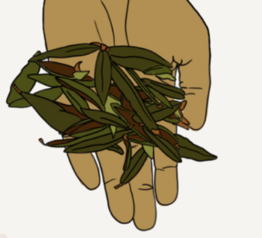
Indigenous Food Sovereignty
(Climate Justice/Land Back/Reclaiming Ancestral Ways of Being)

Slide 2
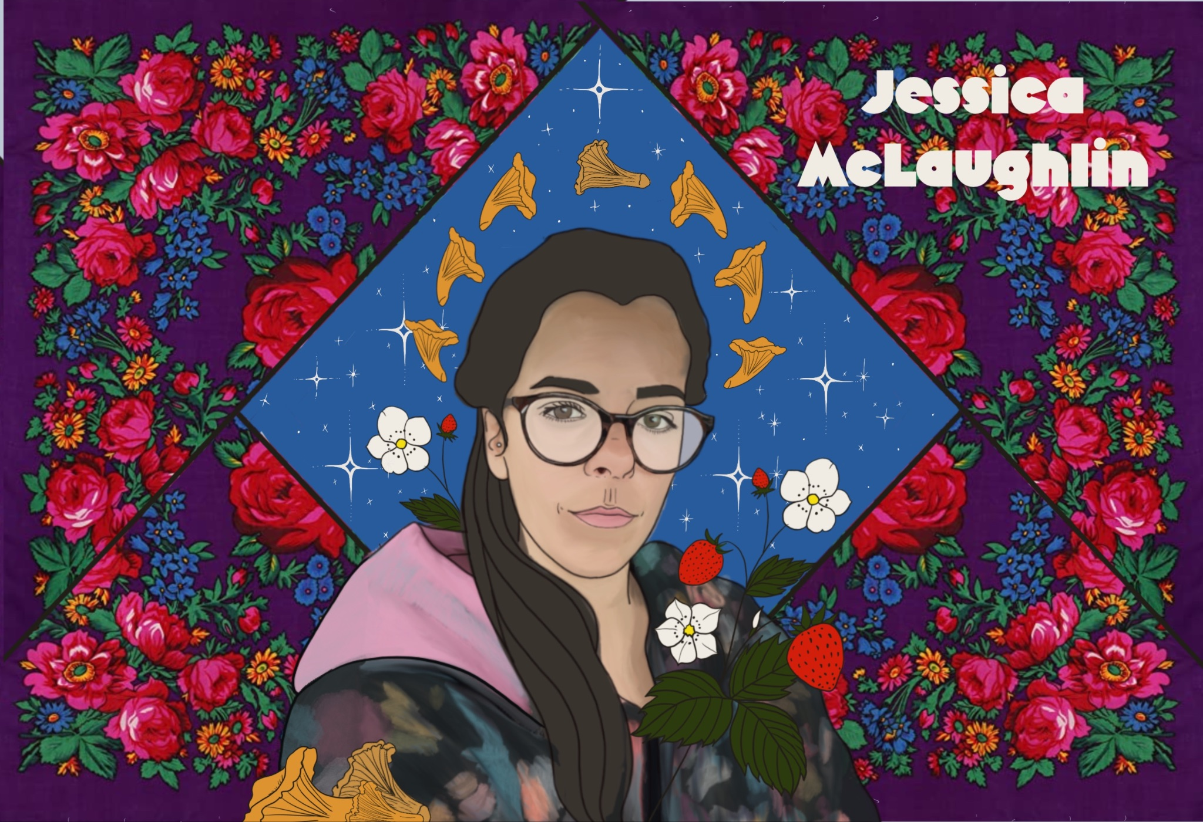
Boozhoo
Jessica McLaughlin
Long Lake #58 First Nation (Nakina, Ontario)
Thunder Bay, Ontario
Jaxon and Sage
B.A Political Science; HBSW Social Work (Lakehead University)
13 years working in Indigenous Food Systems in Northern Ontario
Co-Founder of the Indigenous Food Circle and Gaagige Zaagibigaa

Slide 3
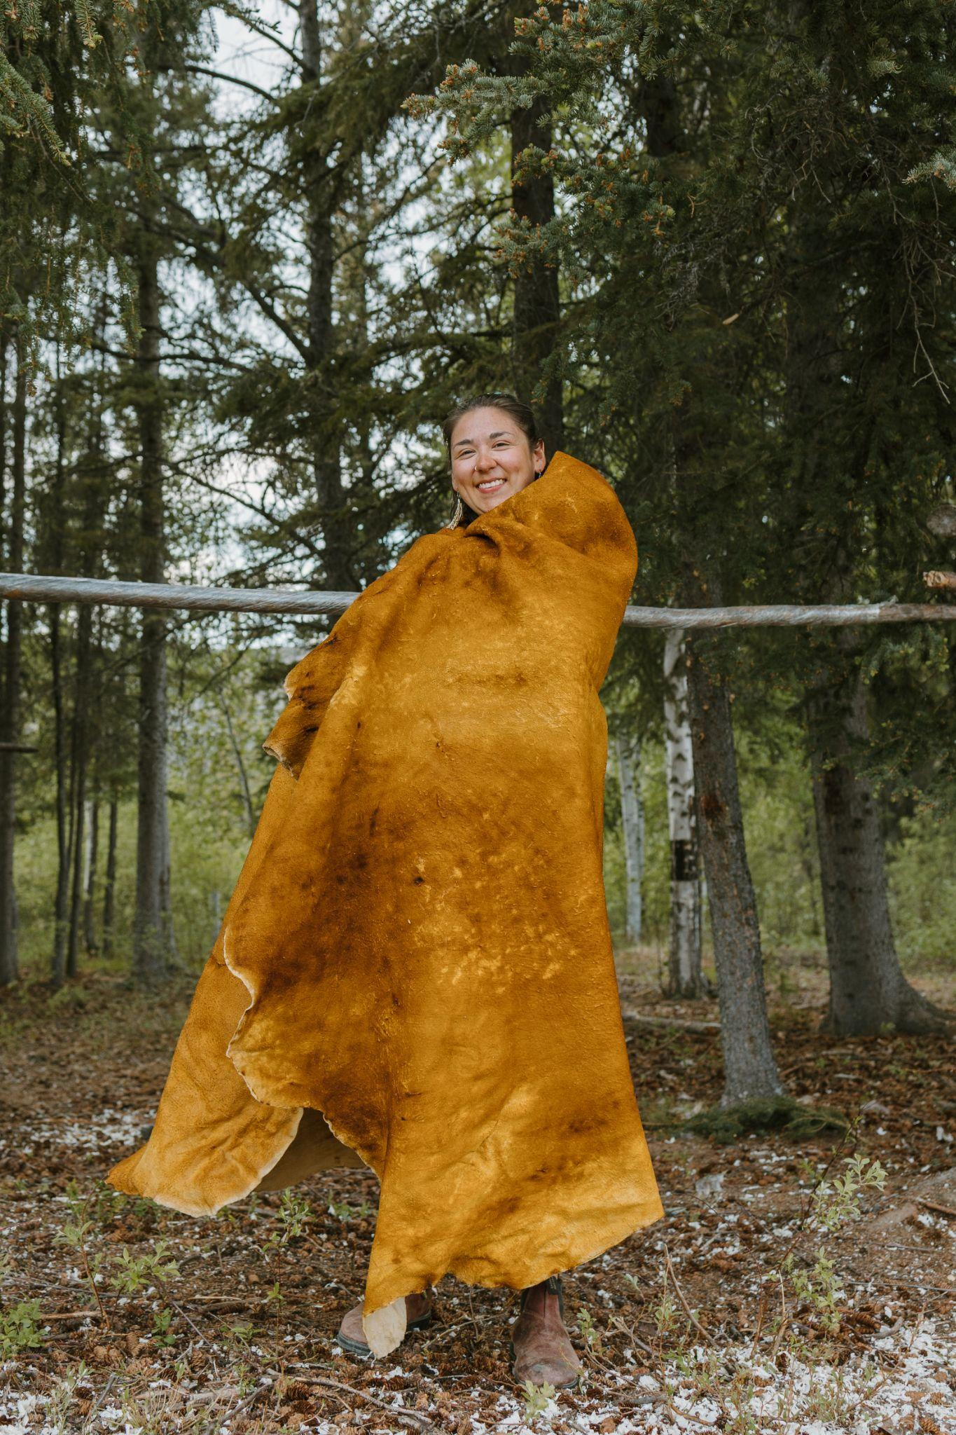
Boozhoo
Shelby Gagnon
Aroland First Nation
Thunder Bay, Ontario
Auntie
H.B.F.A, Fine Arts (Lakehead University)
Artist, Community Organizer, Hide Tanner
Projects Coordinator Indigneous Food Circle

Slide 4
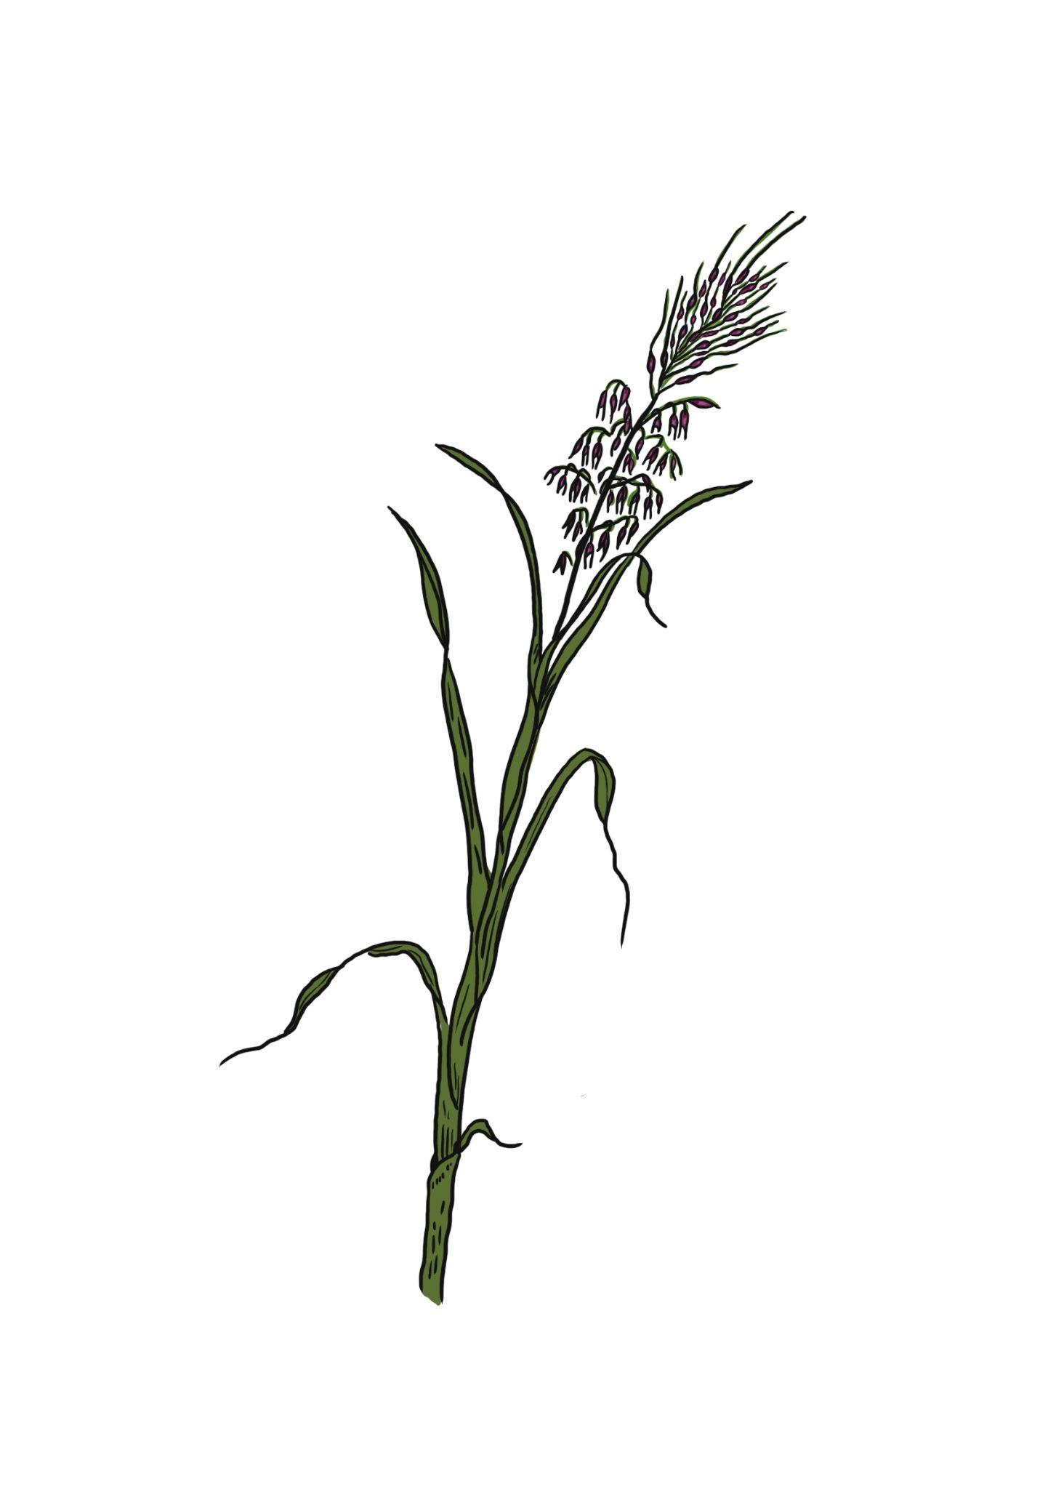
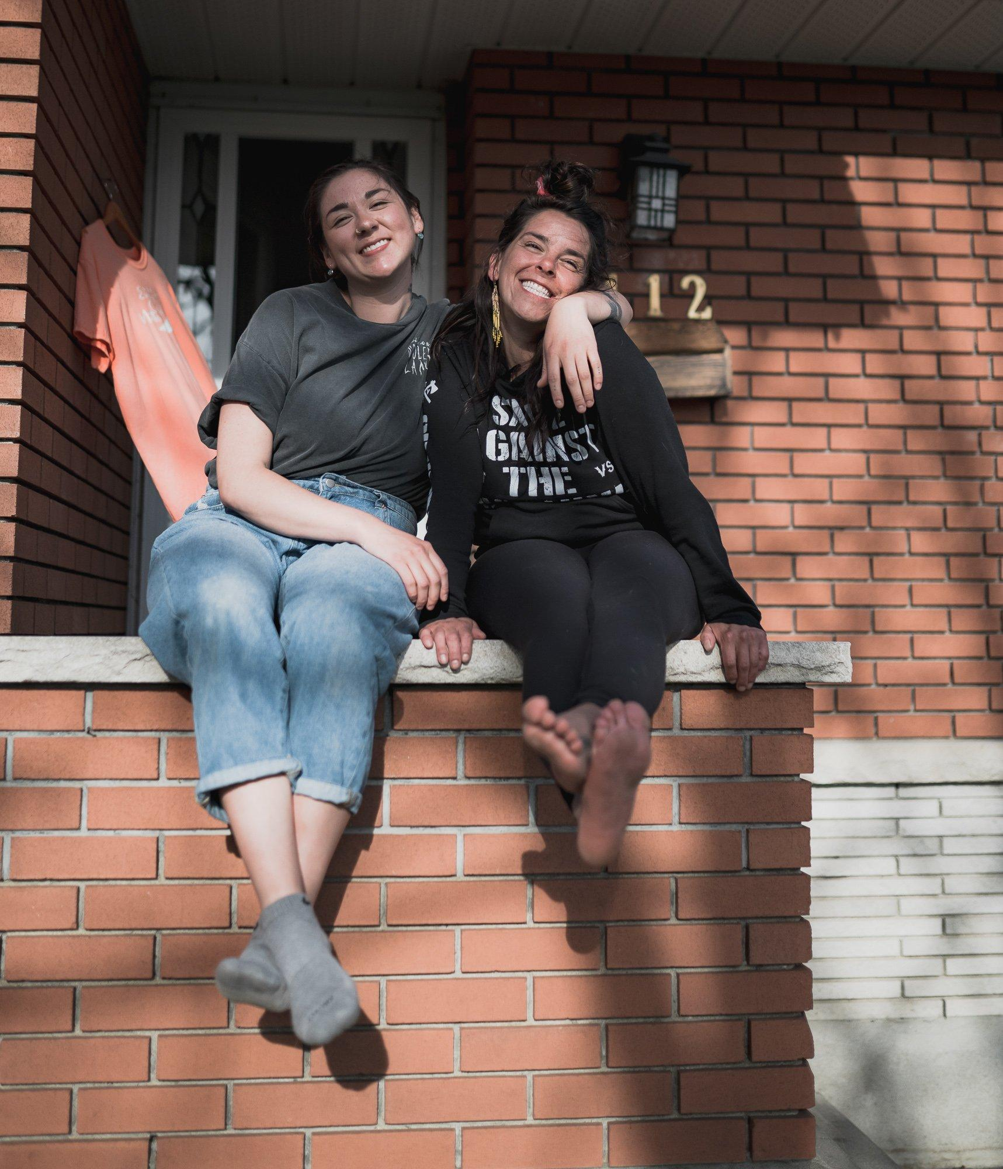
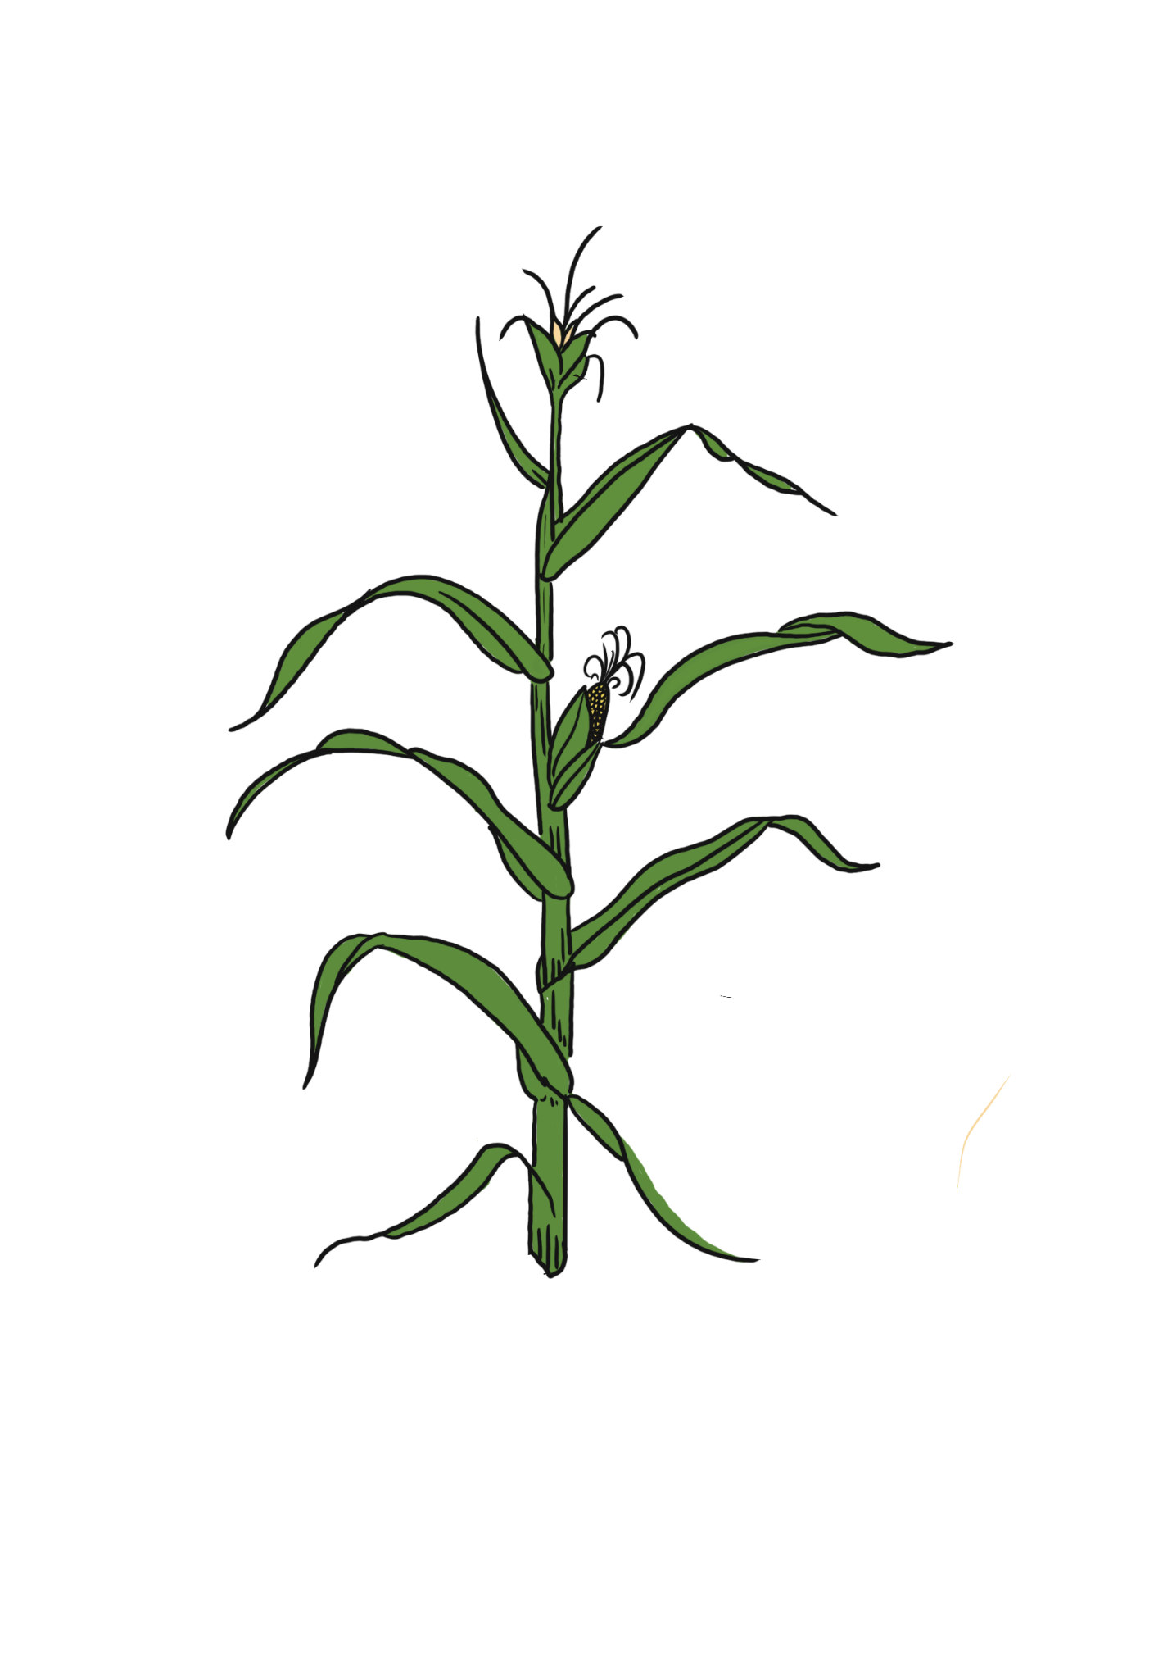

Slide 5
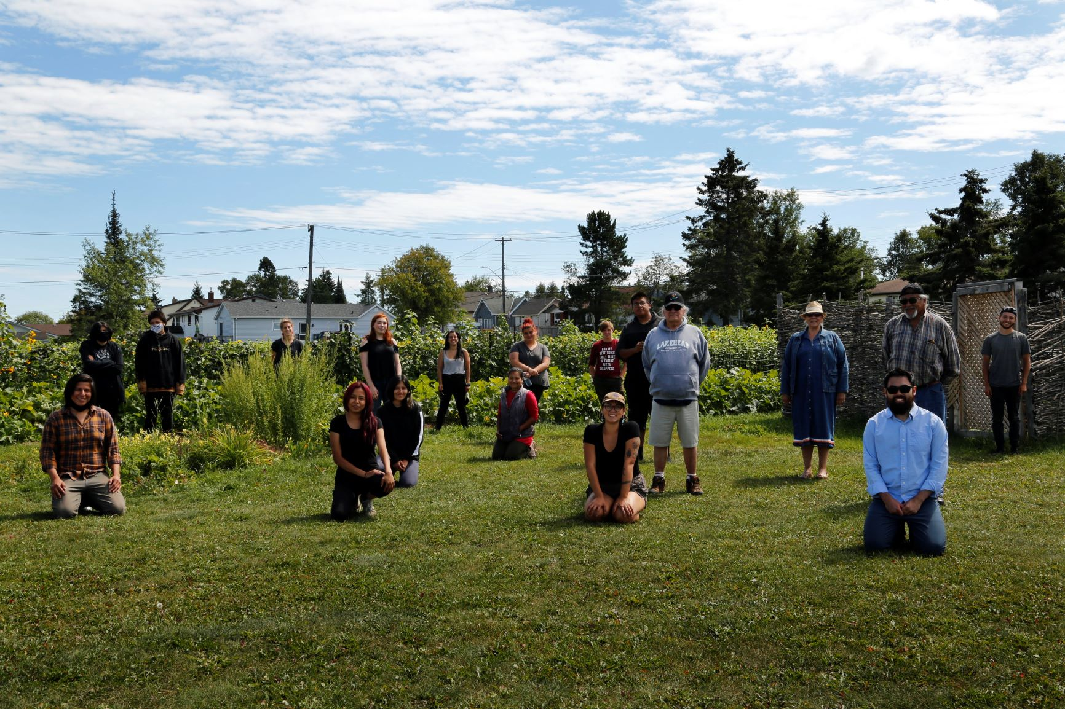
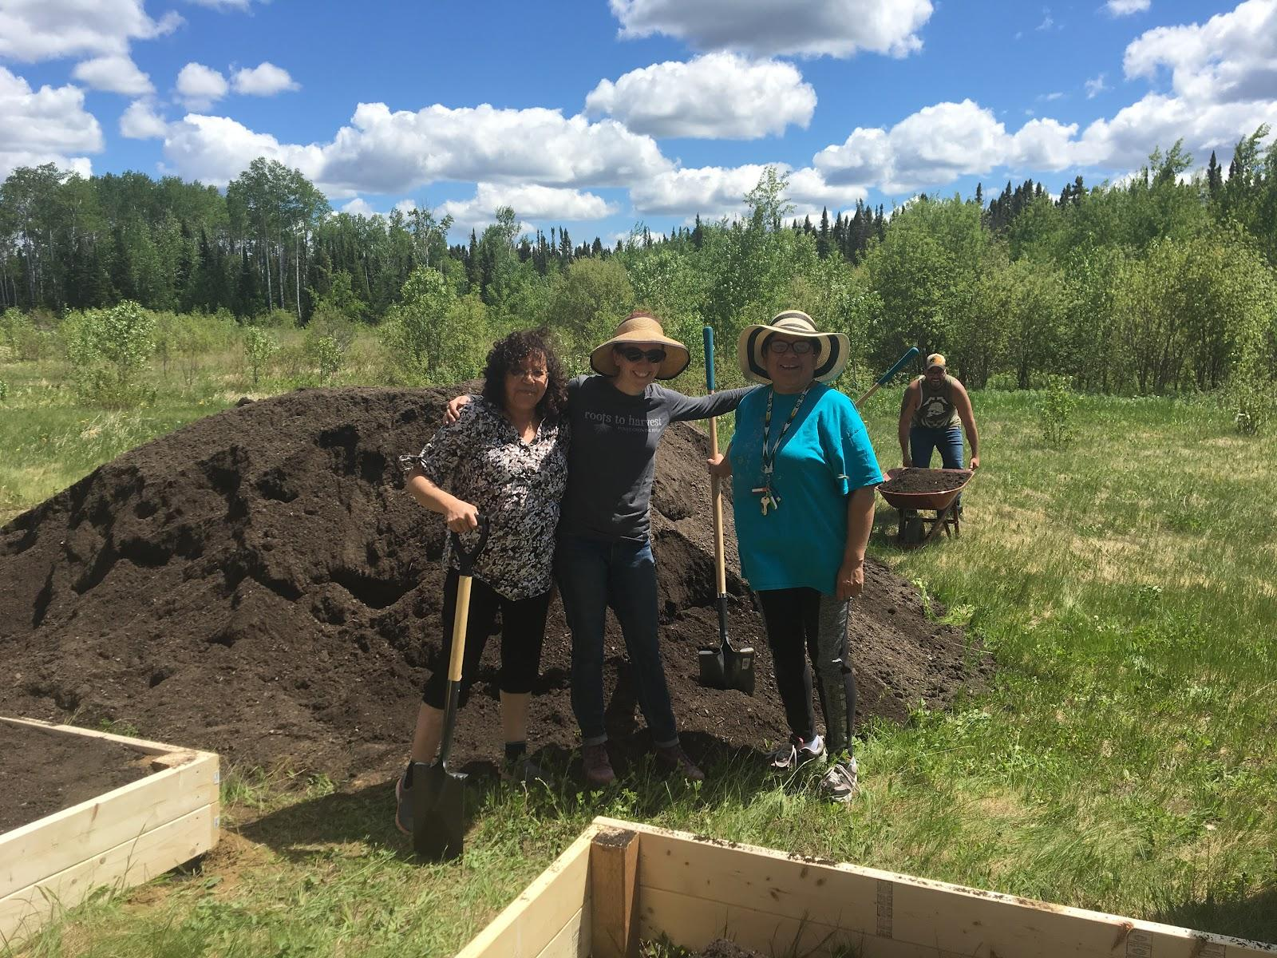
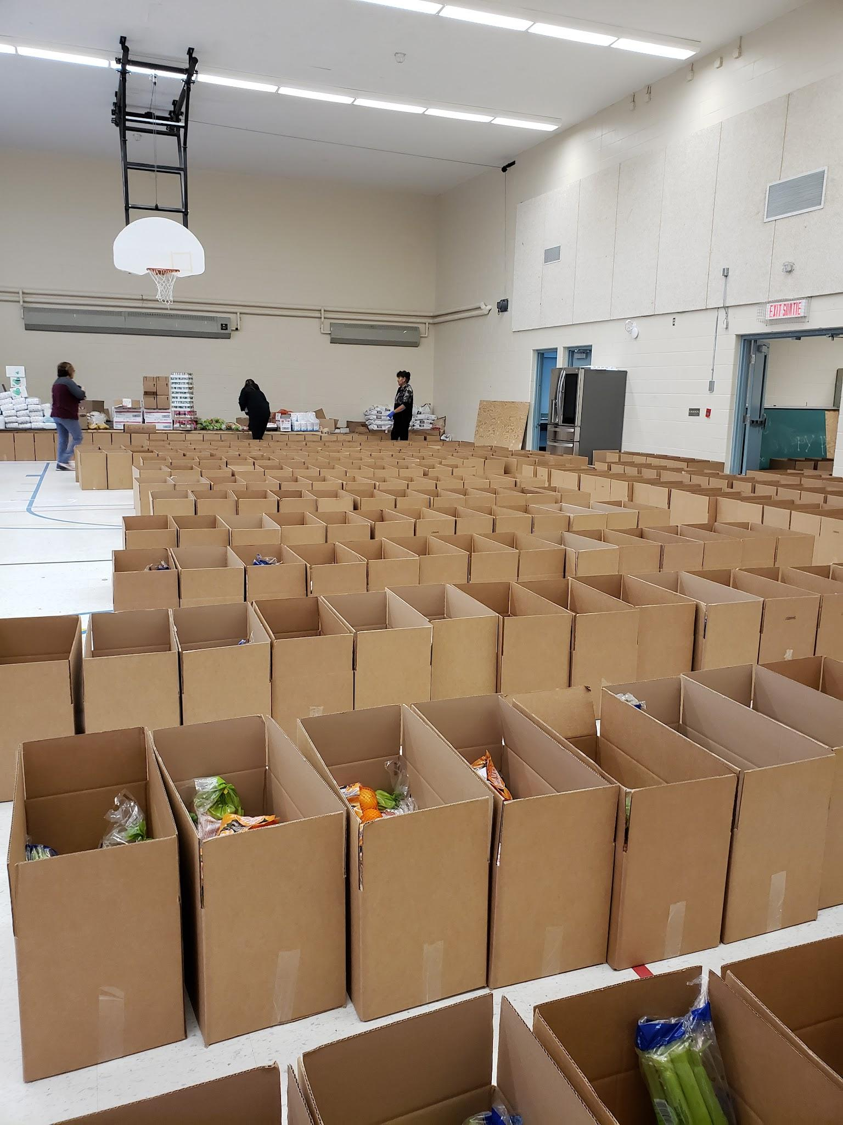
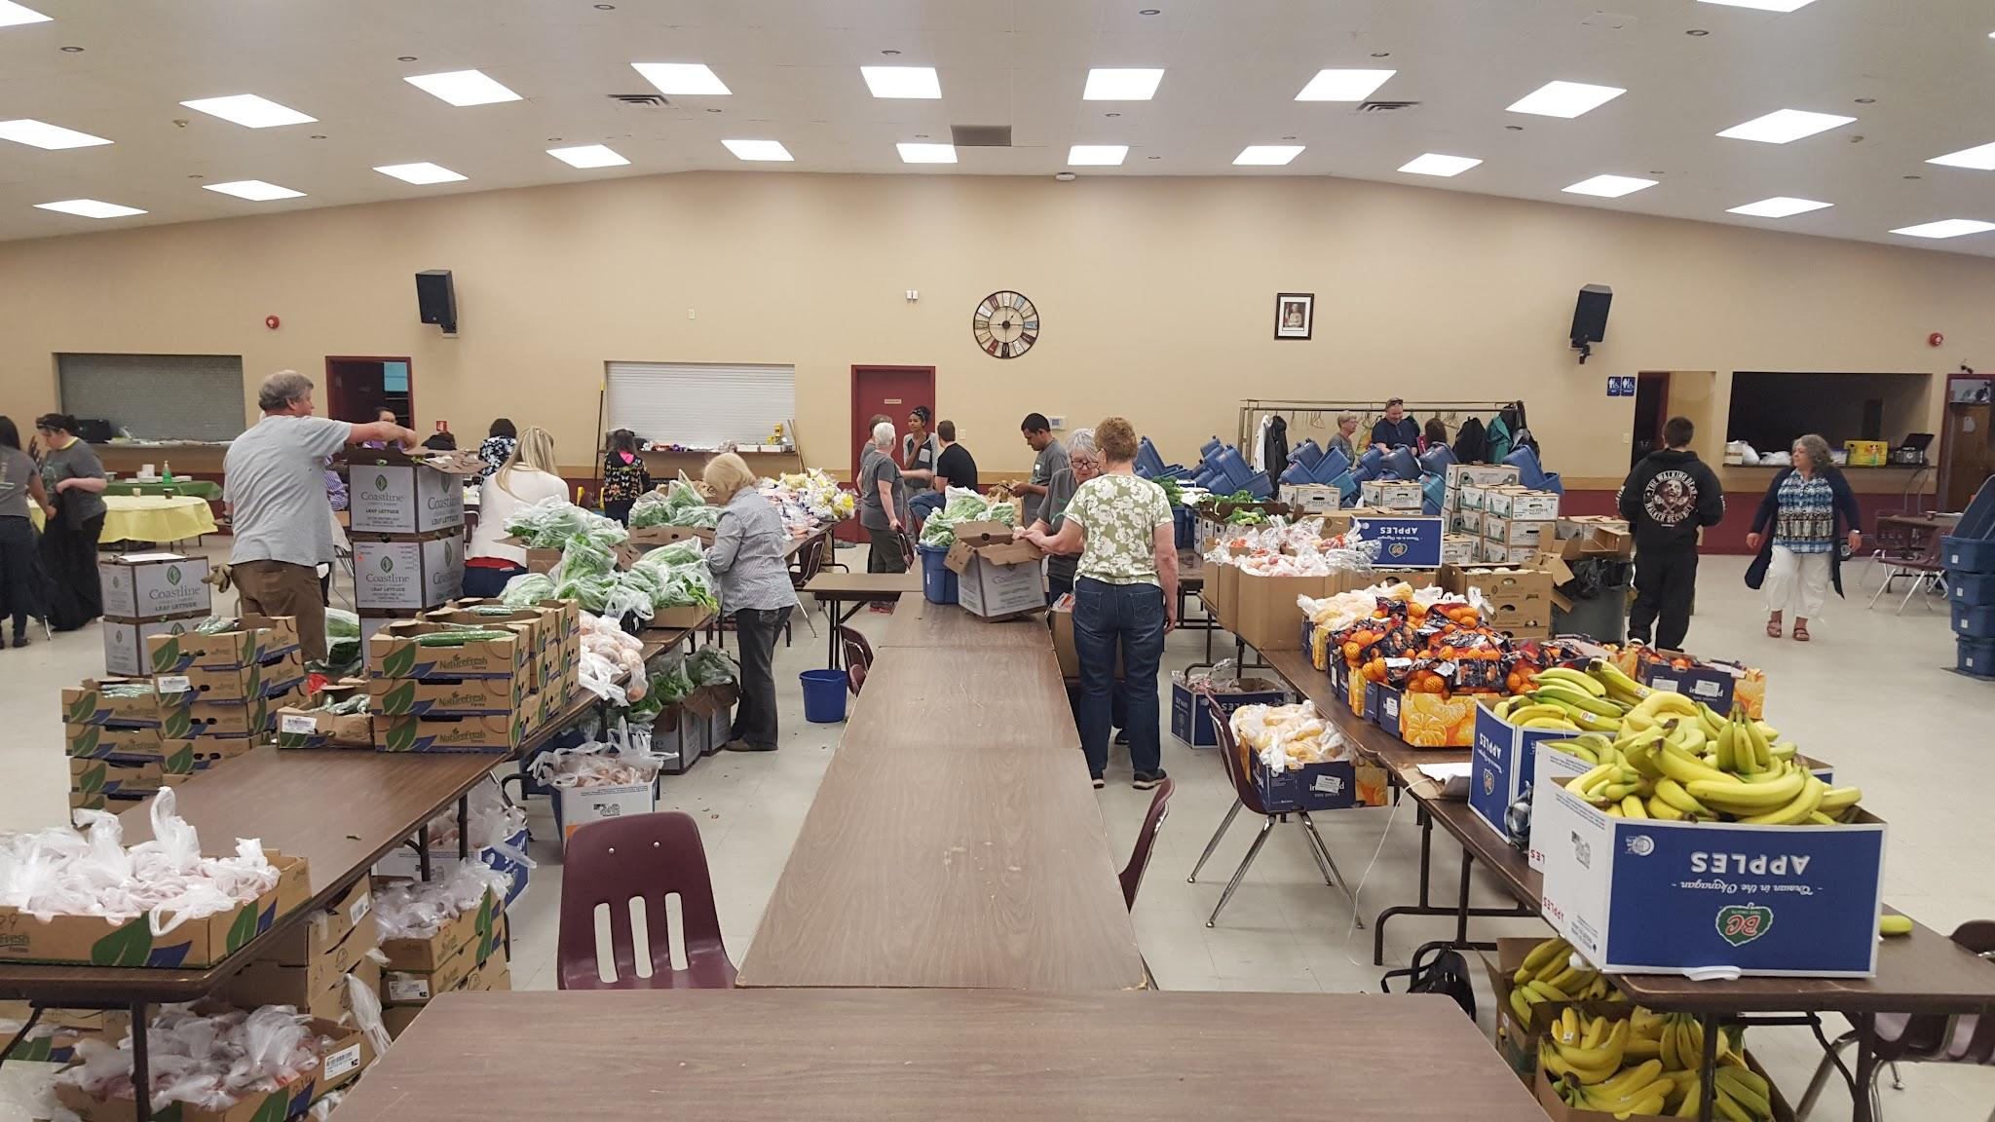
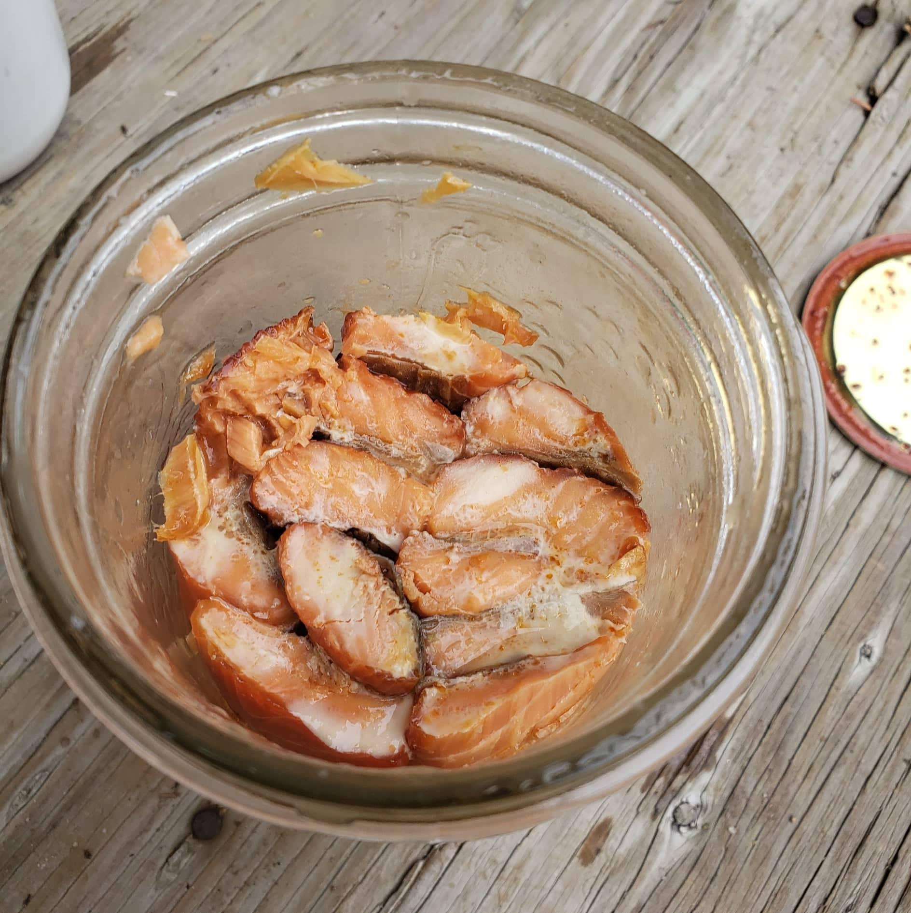
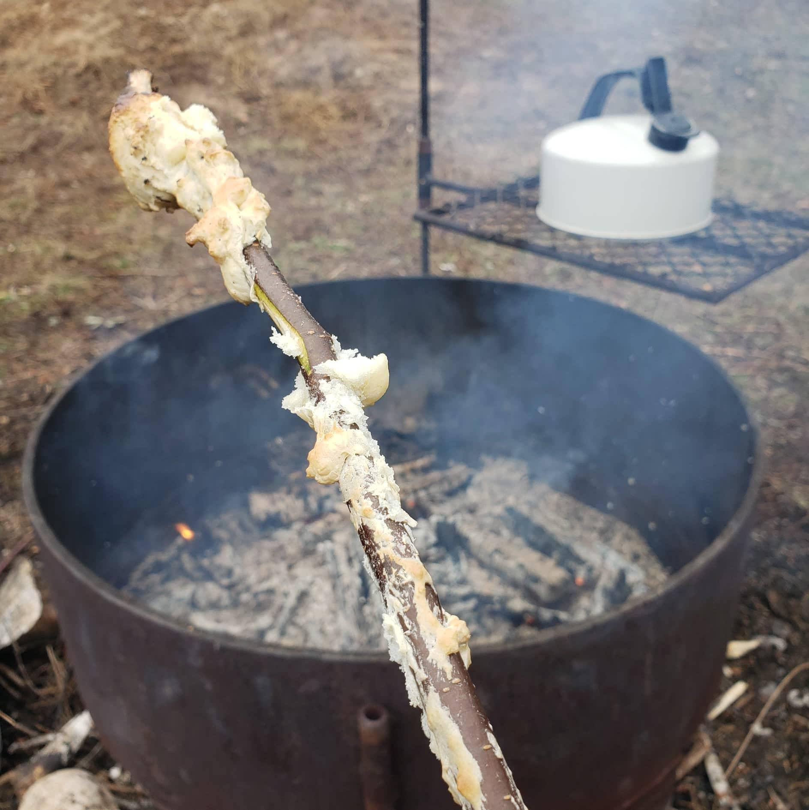
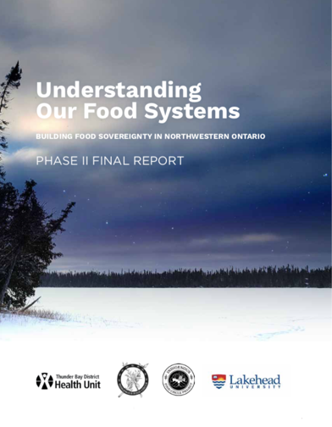
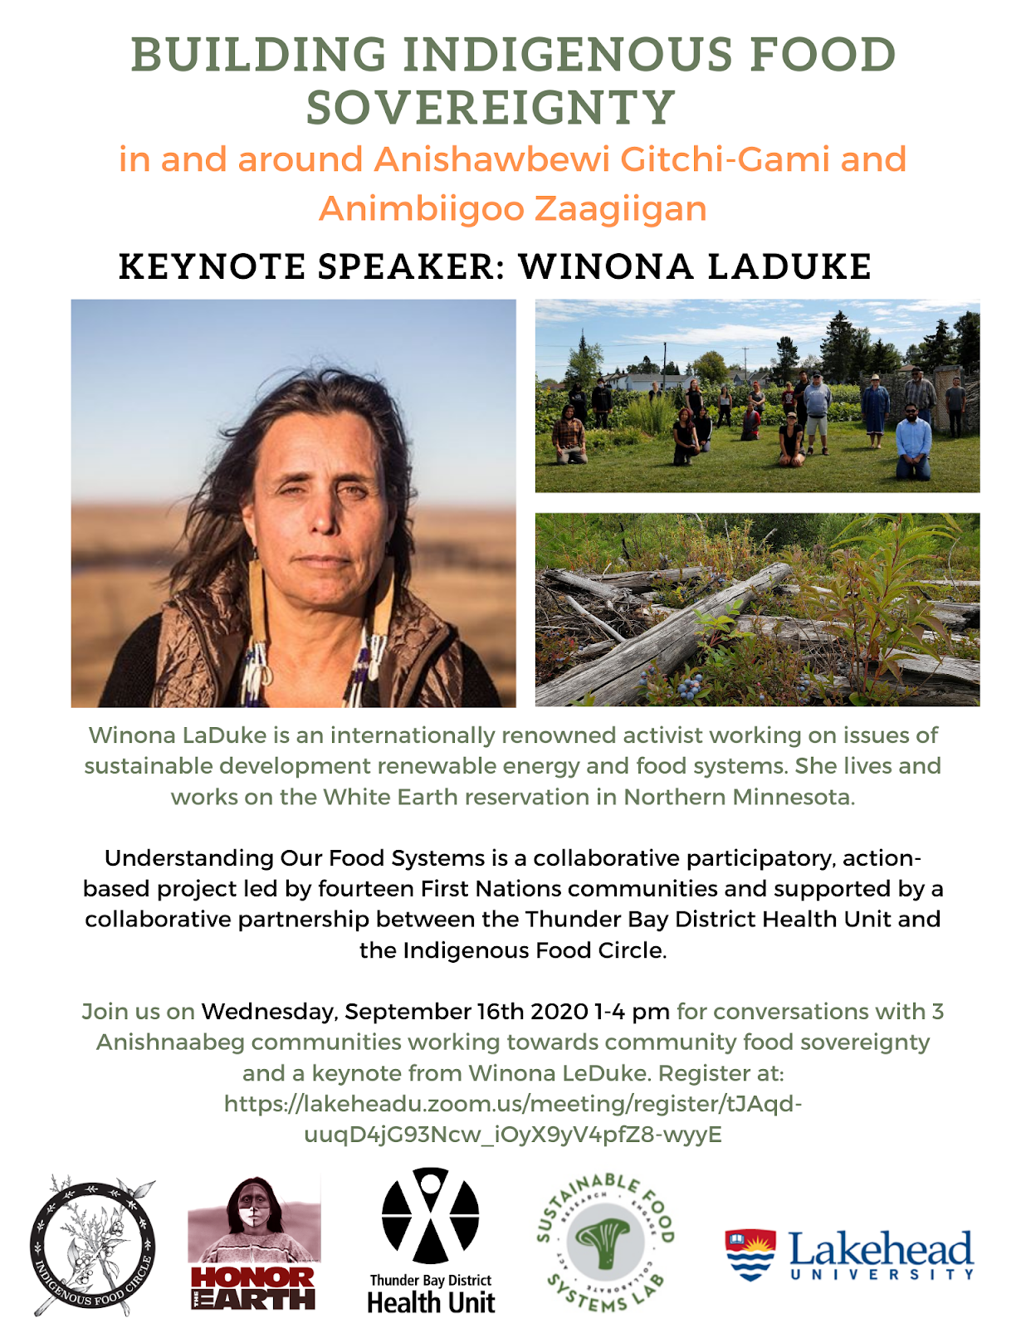
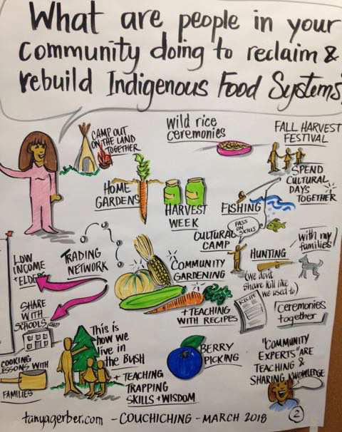
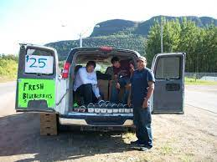
Our Collective Work

Slide 6
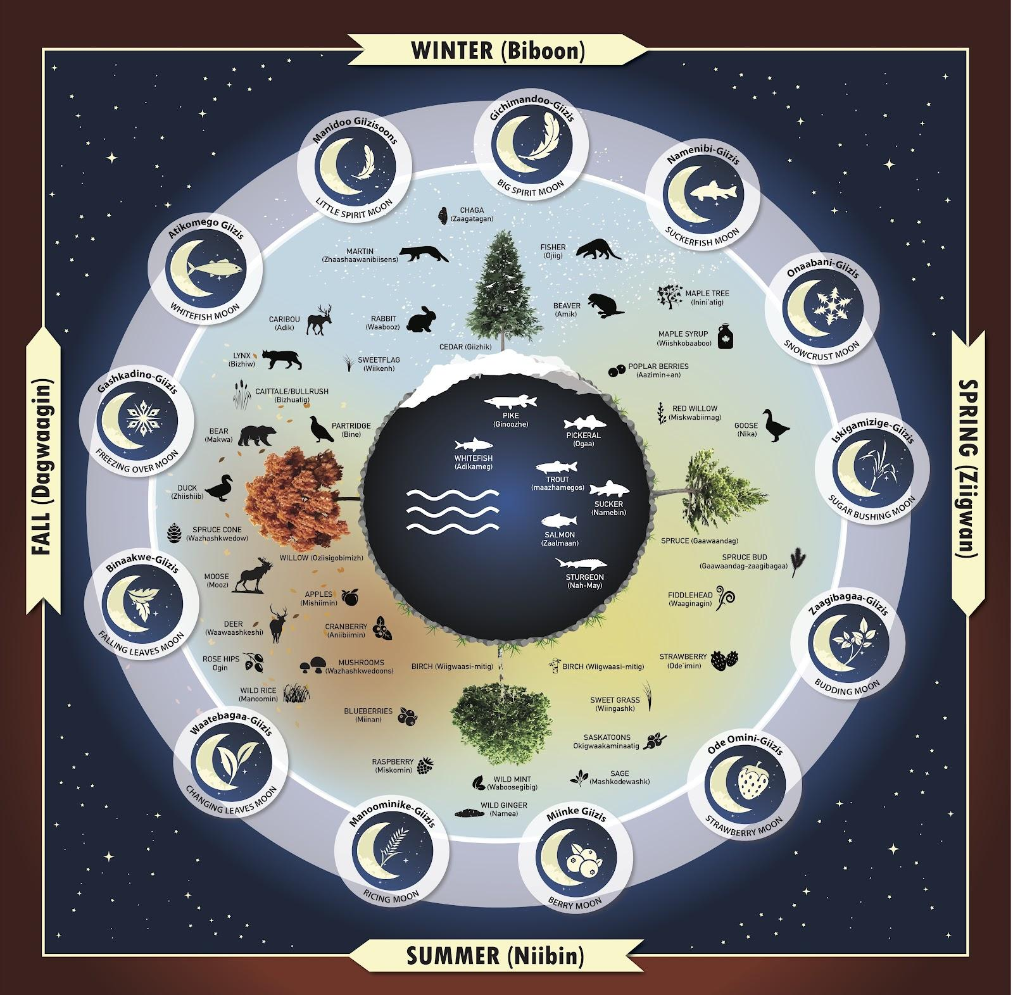
Traditional/Ancestral Harvesting in/around Lake Nipigon and Lake Superior
Poster, Board Game and Video
Historically the Anishinaabe, Anishinaabeg, Anishinabek of Lake Nipigon and Lake Superior regions used the sun, moons, stars and planets to guide community practices around time, harvesting, gathering, storing, preserving food and medicines and governing community in general. Most common in our homelands is the thirteen moon seasonal governance system.
13 Moons Video

Slide 7
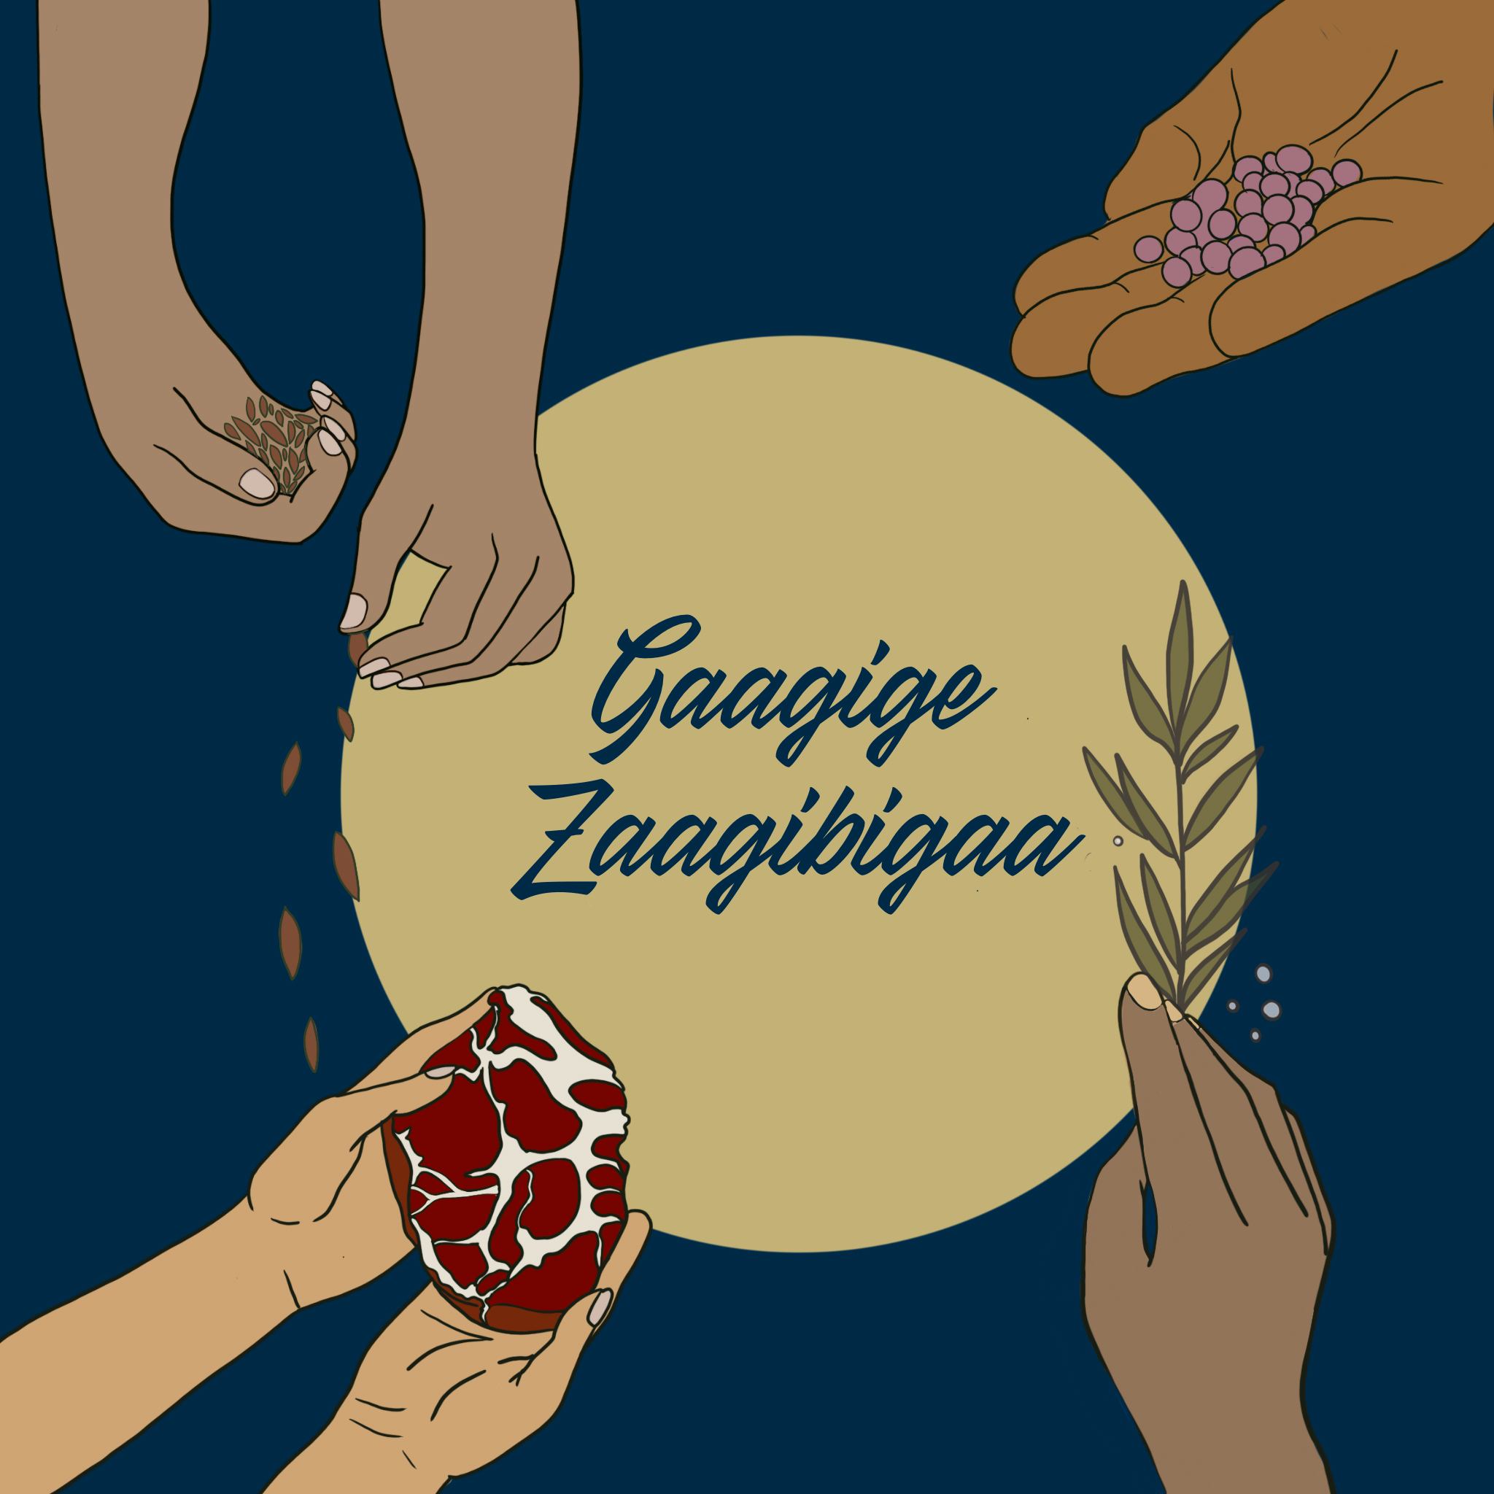
Gaagige Zaagibigaa (GZ) is an Indigenous, grassroots led organization working to support Indigenous Sovereignty across Northern Ontario through food system transformation work.
Notes:
This is done through lasting reciprocal relationships with community partners, funding interventions across the breadth of community life, and a suite of wrap-around supports that help solidify and reinforce community efforts.
Gaagige Zaagibigaa recognizes food sovereignty work and food system transformation efforts as vehicles for and accelerators of Indigenous sovereignty and resilience.
The tradition of sovereign, resilient families and communities interconnected in respectful relations has existed in our communities since time immemorial. The concept of creating funding that supports households and community food sovereignty initiatives emerged from the lived experiences of food actions over 10 plus years who found there were no accessible funds for such initiatives, GZ is hoped to be the intervention to this.

Slide 8
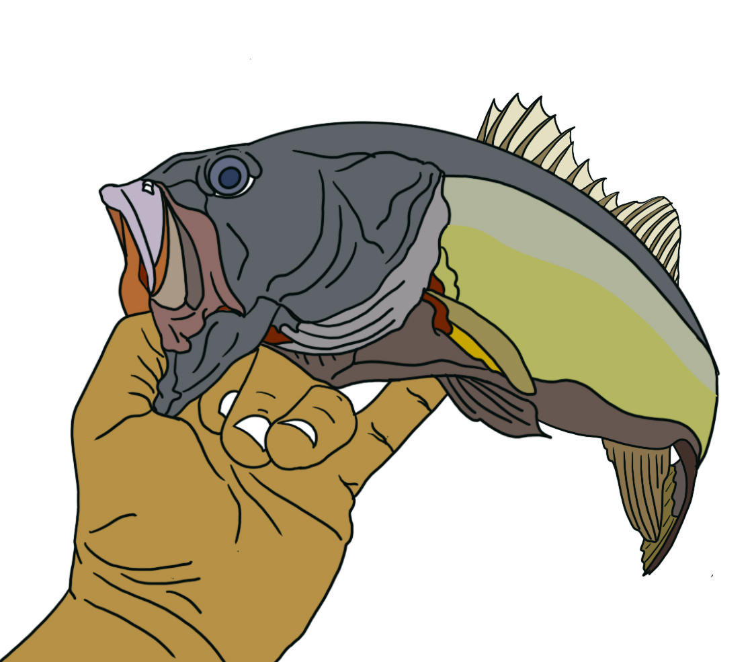
Decolonizing operations/work
Relationship Centered
Community Granting
Sovereign Household Support Program
Land Protection and Rehabilitation
Kinship Lines
Maamiigan “Coming to the right place”
GZ’s work

Slide 9
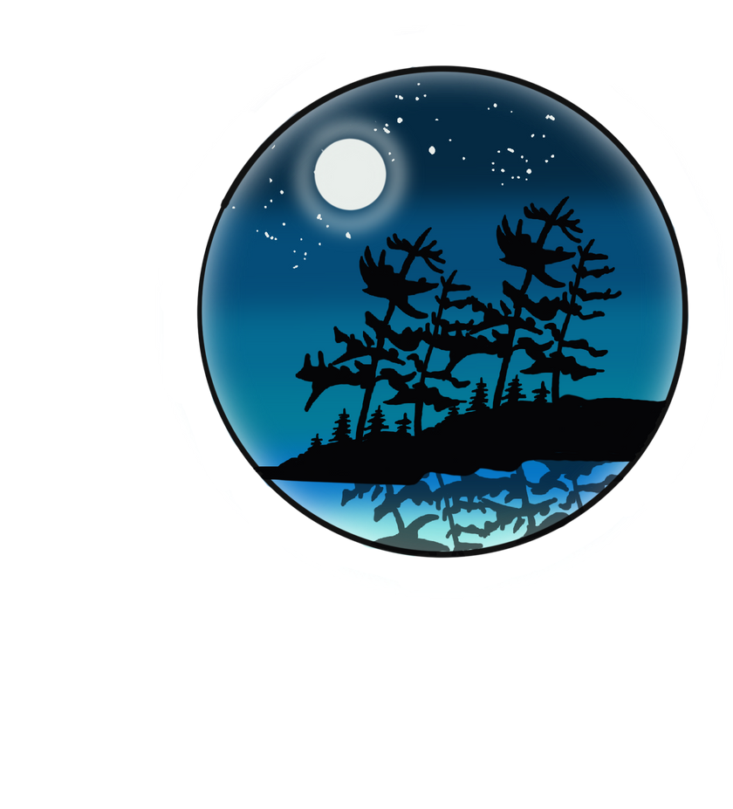
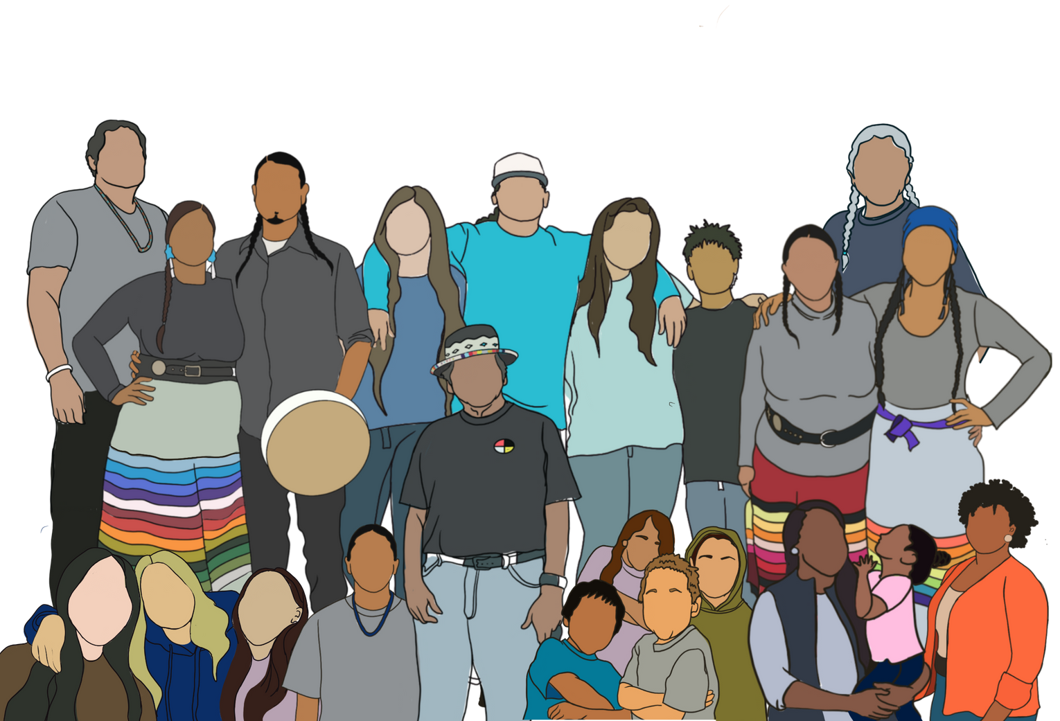
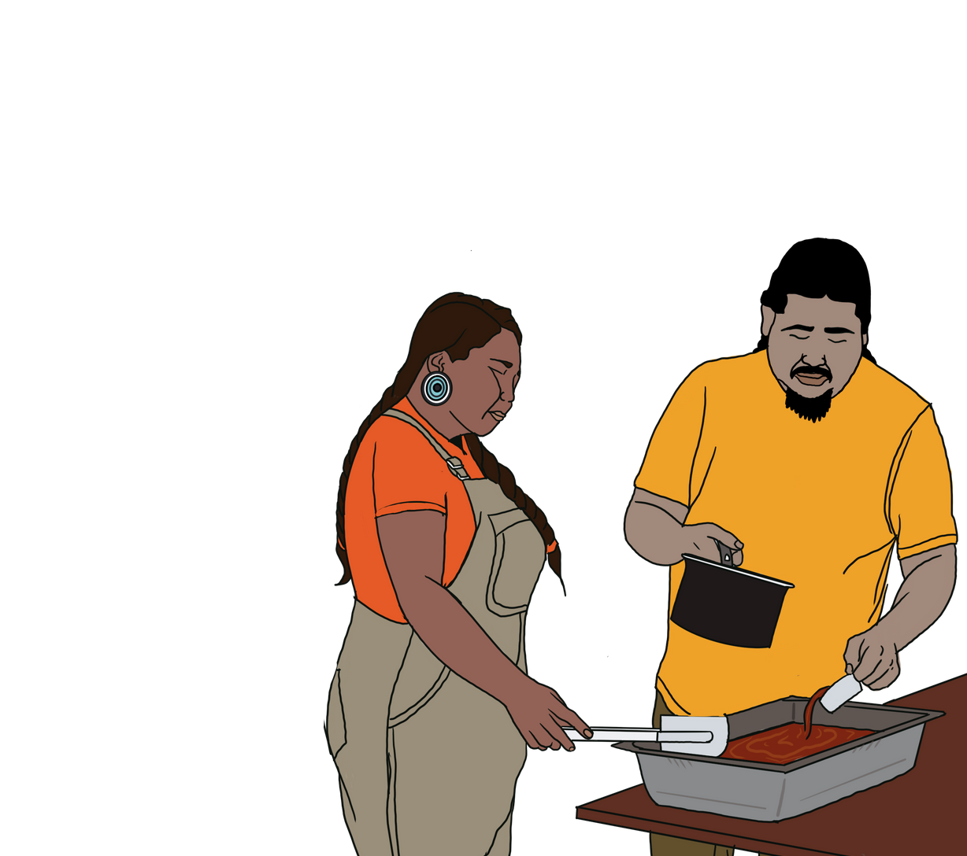
Community Granting
13 Community Granting Partners
Multi-Year Funding
Up to 50k with limited restrictions

Slide 10
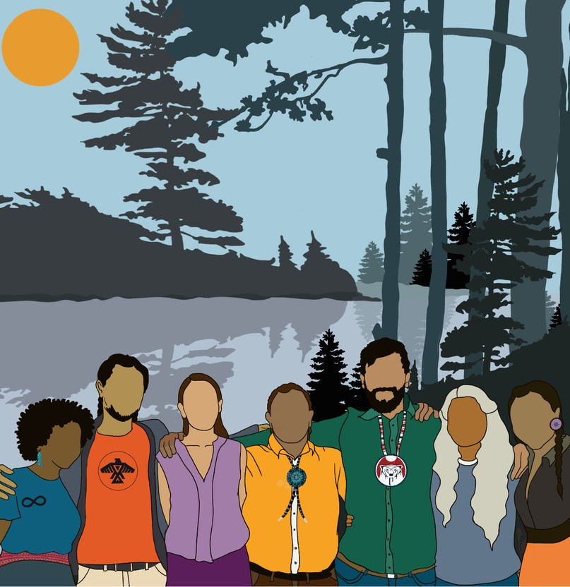
Kinship Lines ”We will Plan”
Kinship Lines (Community of Practices)
Planning Initiatives across a breadth of territories
Tools, Resources, Webinars, Kinship Line Networks
Direct Planning Initiative Support
Knowledge Reclamation and Exchange, Land Protection and Food System Revitalization

Slide 11
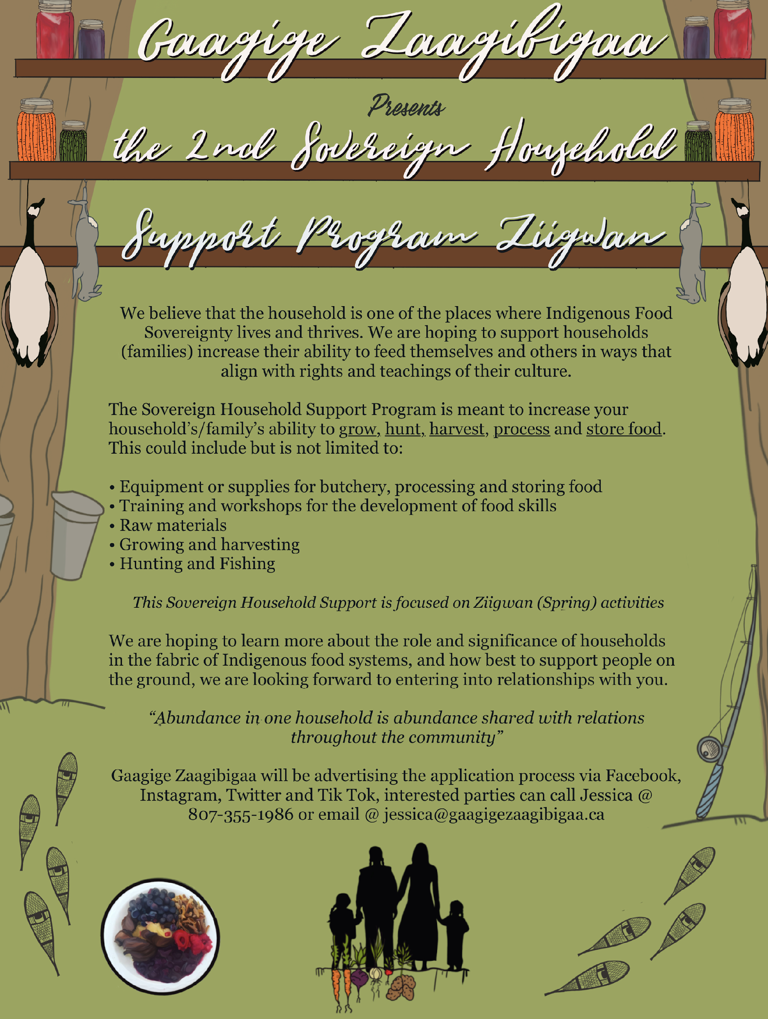
Sovereign Household Support Program
2 Granting Periods Year (Ziigwan and Dagwaagin)
Household and Family focused
Aim to support 250 Households each round (500 Households a year)
$1000.00 Rural and Urban & $2000.00 Remote
Application process (Google Forms, Call-Ins, Direct support with crafting)

Slide 12
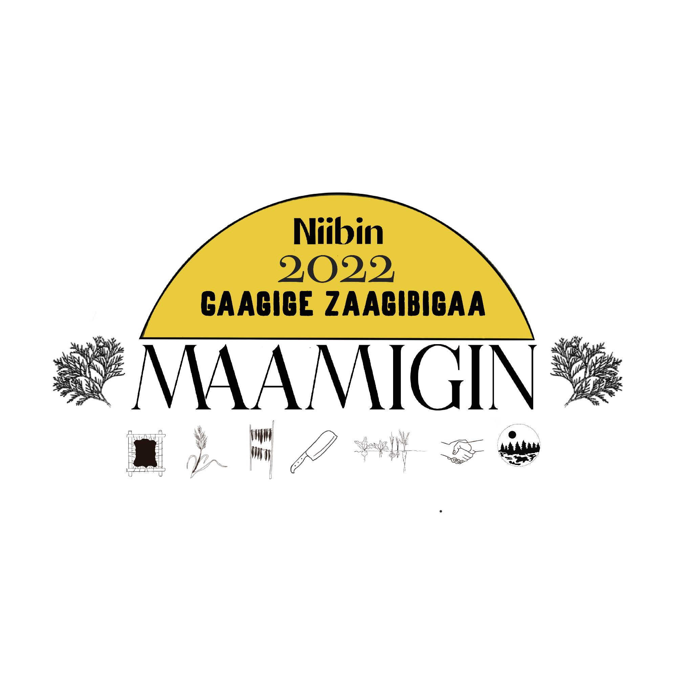

Slide 13
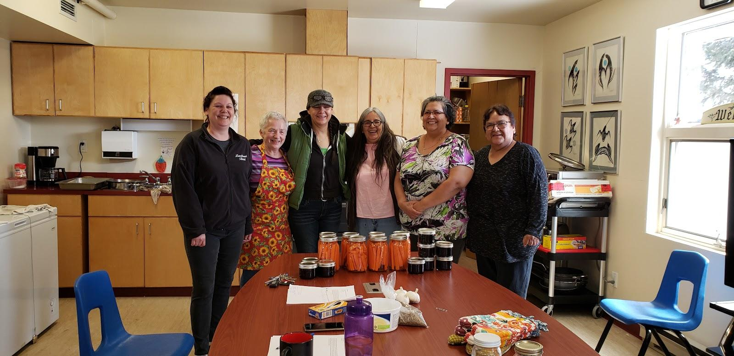
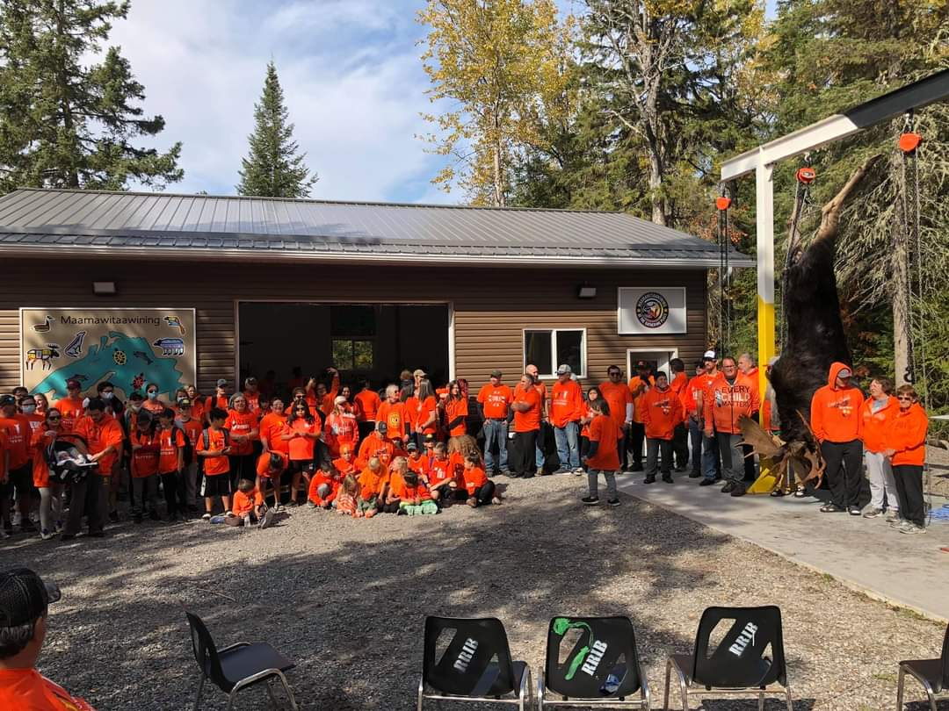
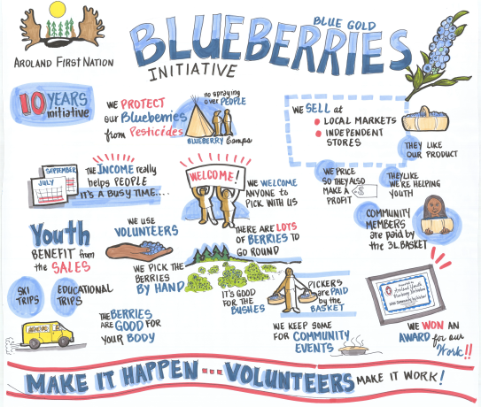
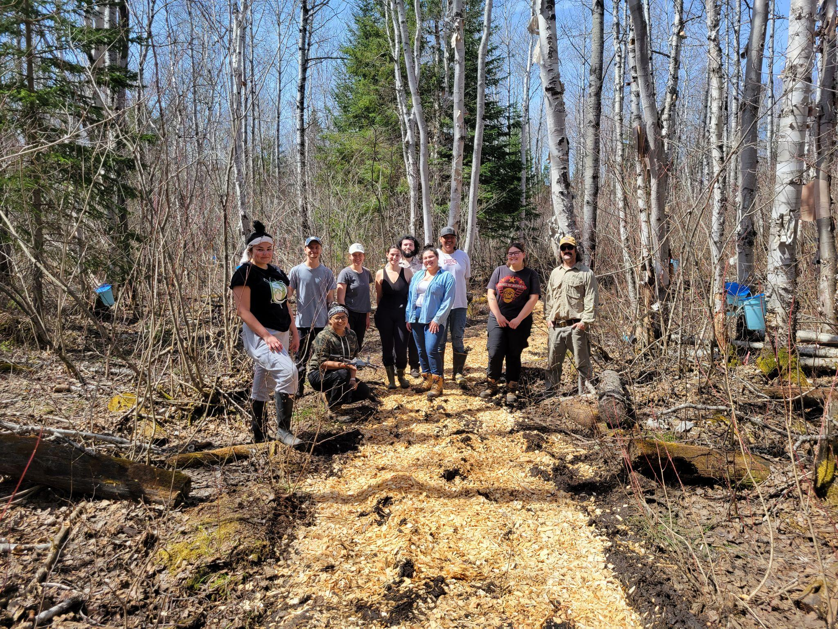
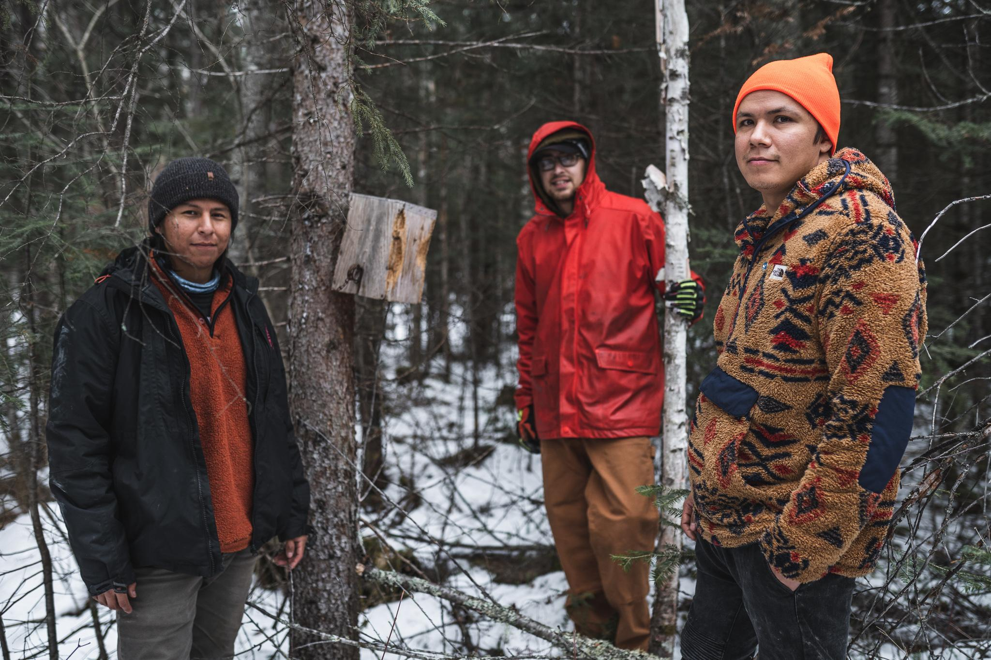
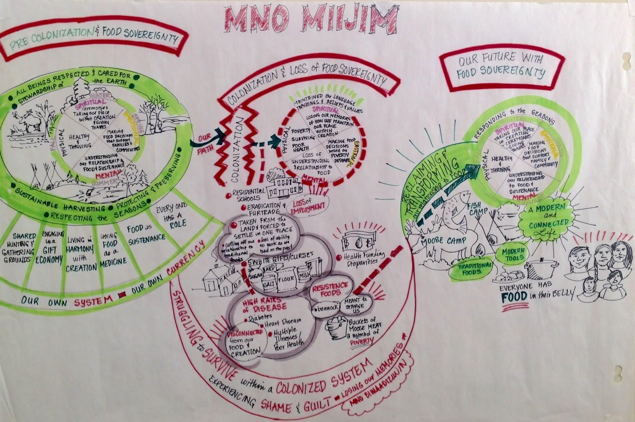
Placed Based Project Stories

Slide 14
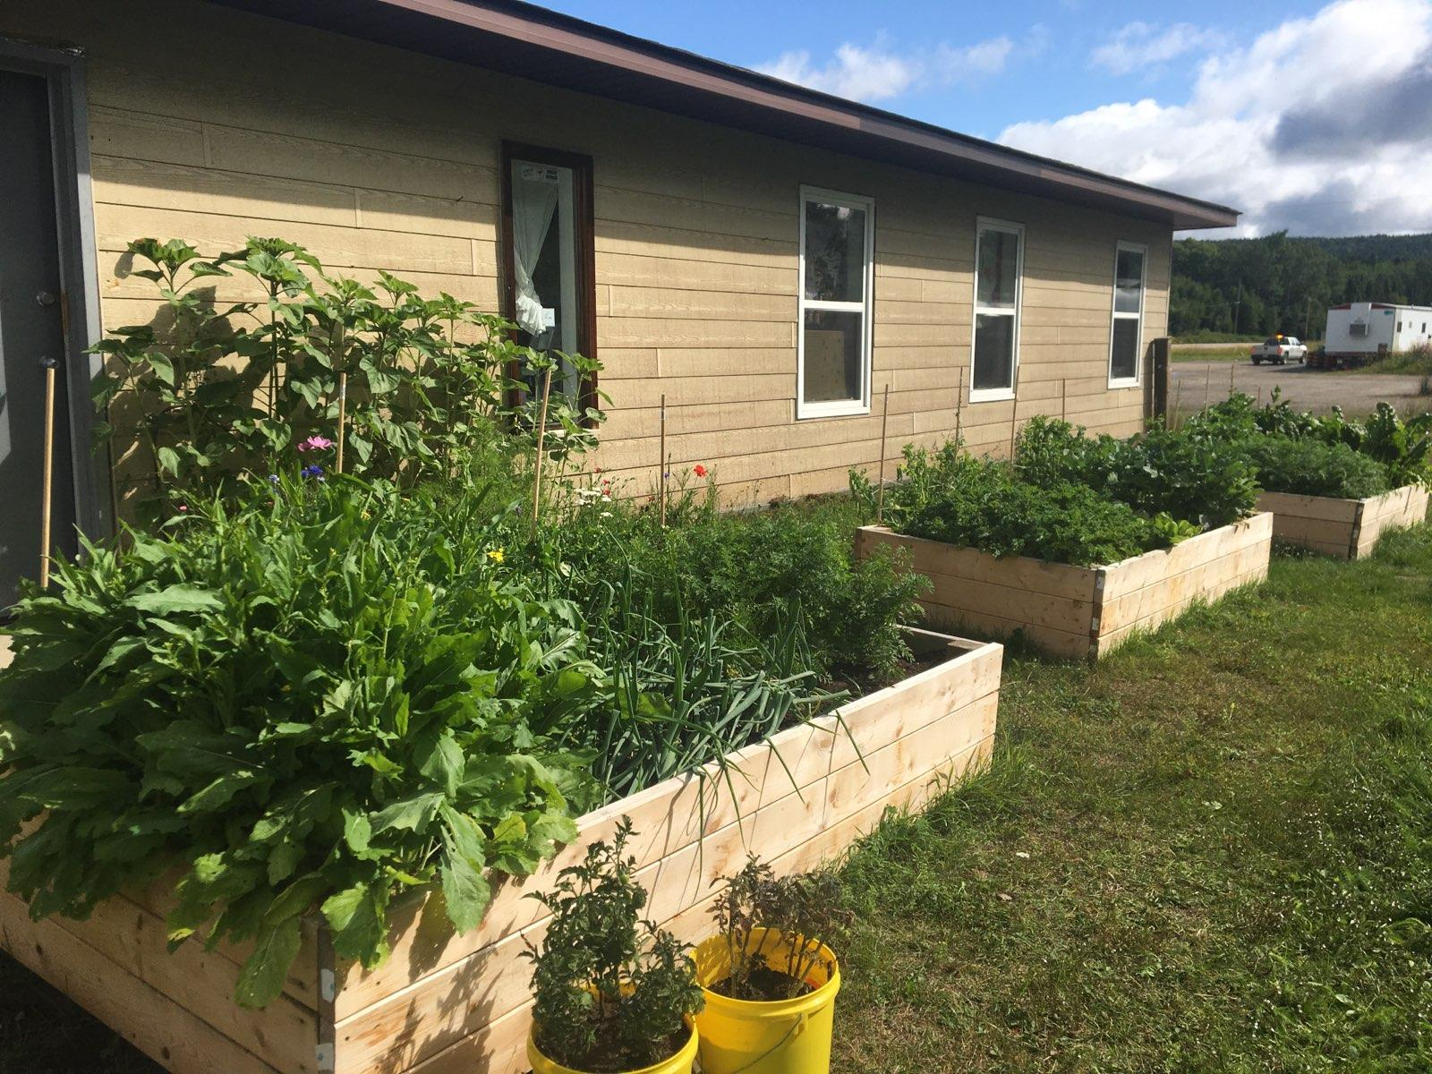
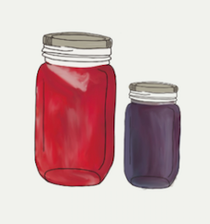
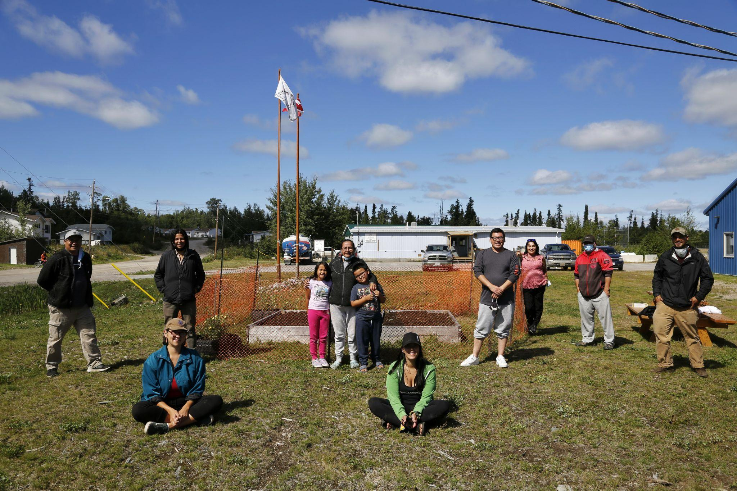
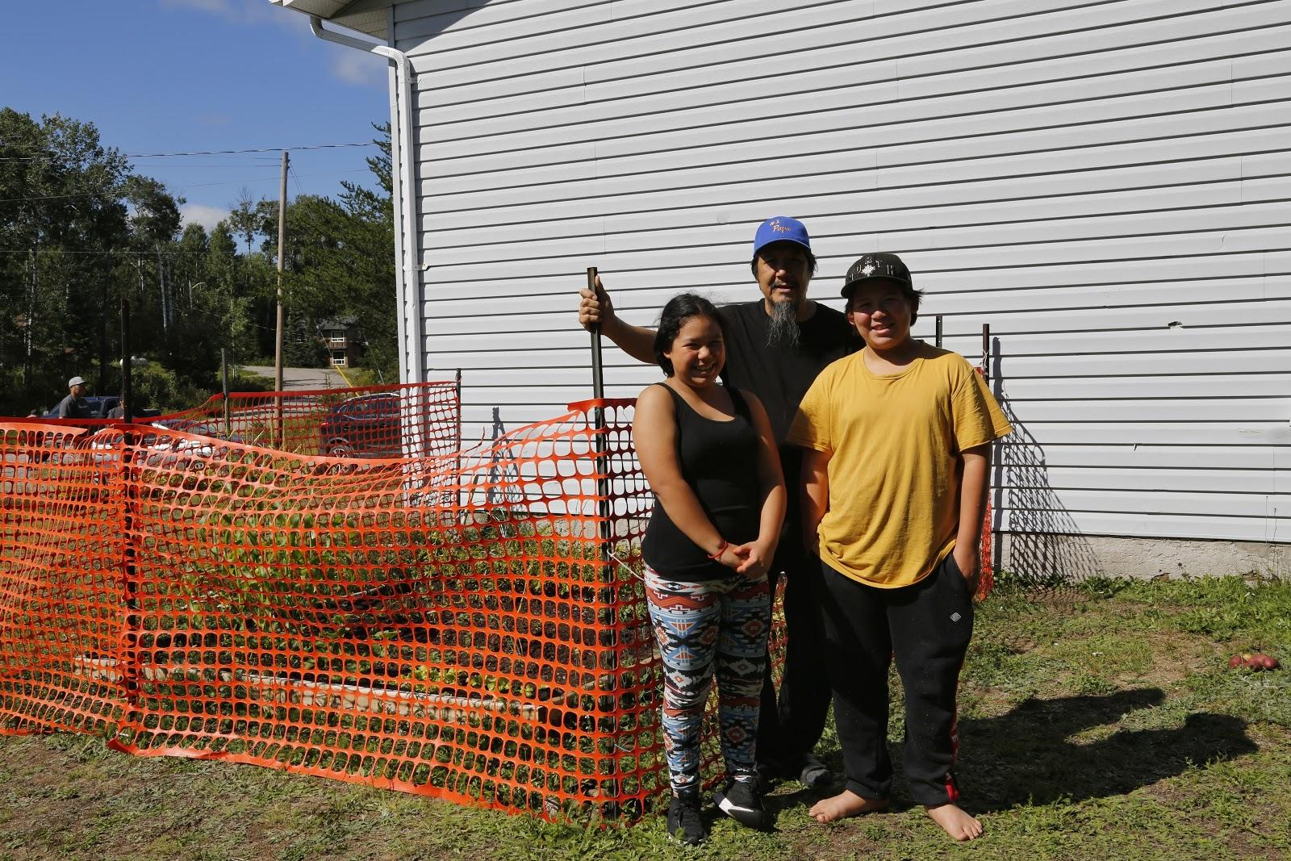
Whitesand First Nation
Community and Household Garden Project
UOFS Community Garden

Slide 15
Aroland First Nation Community Kitchen
Aroland Youth Blueberry Initiative
Aroland Youth Blueberry Initiative (AYBI) welcomes all community members (children to elders) to harvest and sell blueberries to support programs for youth. Foraging for blueberries is highly valued as a source of income, food security, tradition and as an alternative to timber extraction. Through blueberry picking, the AYBI incorporates values for the youth around identity and connection to the land. They are taught traditional knowledge that is passed down from generation to generation around how to harvest and care for the berries.

Slide 16
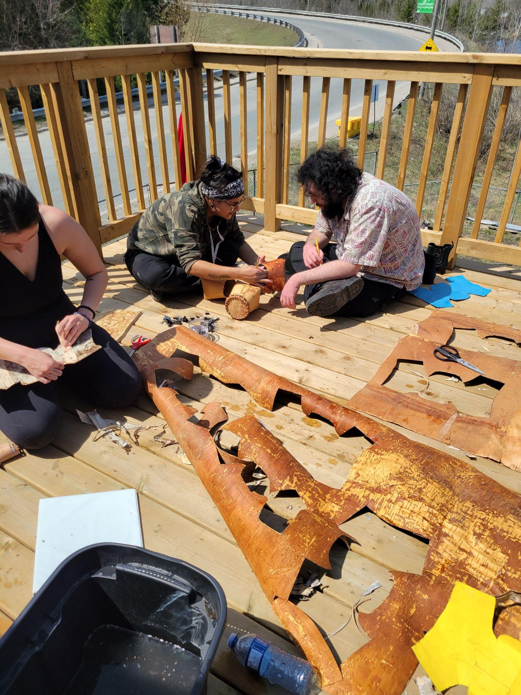
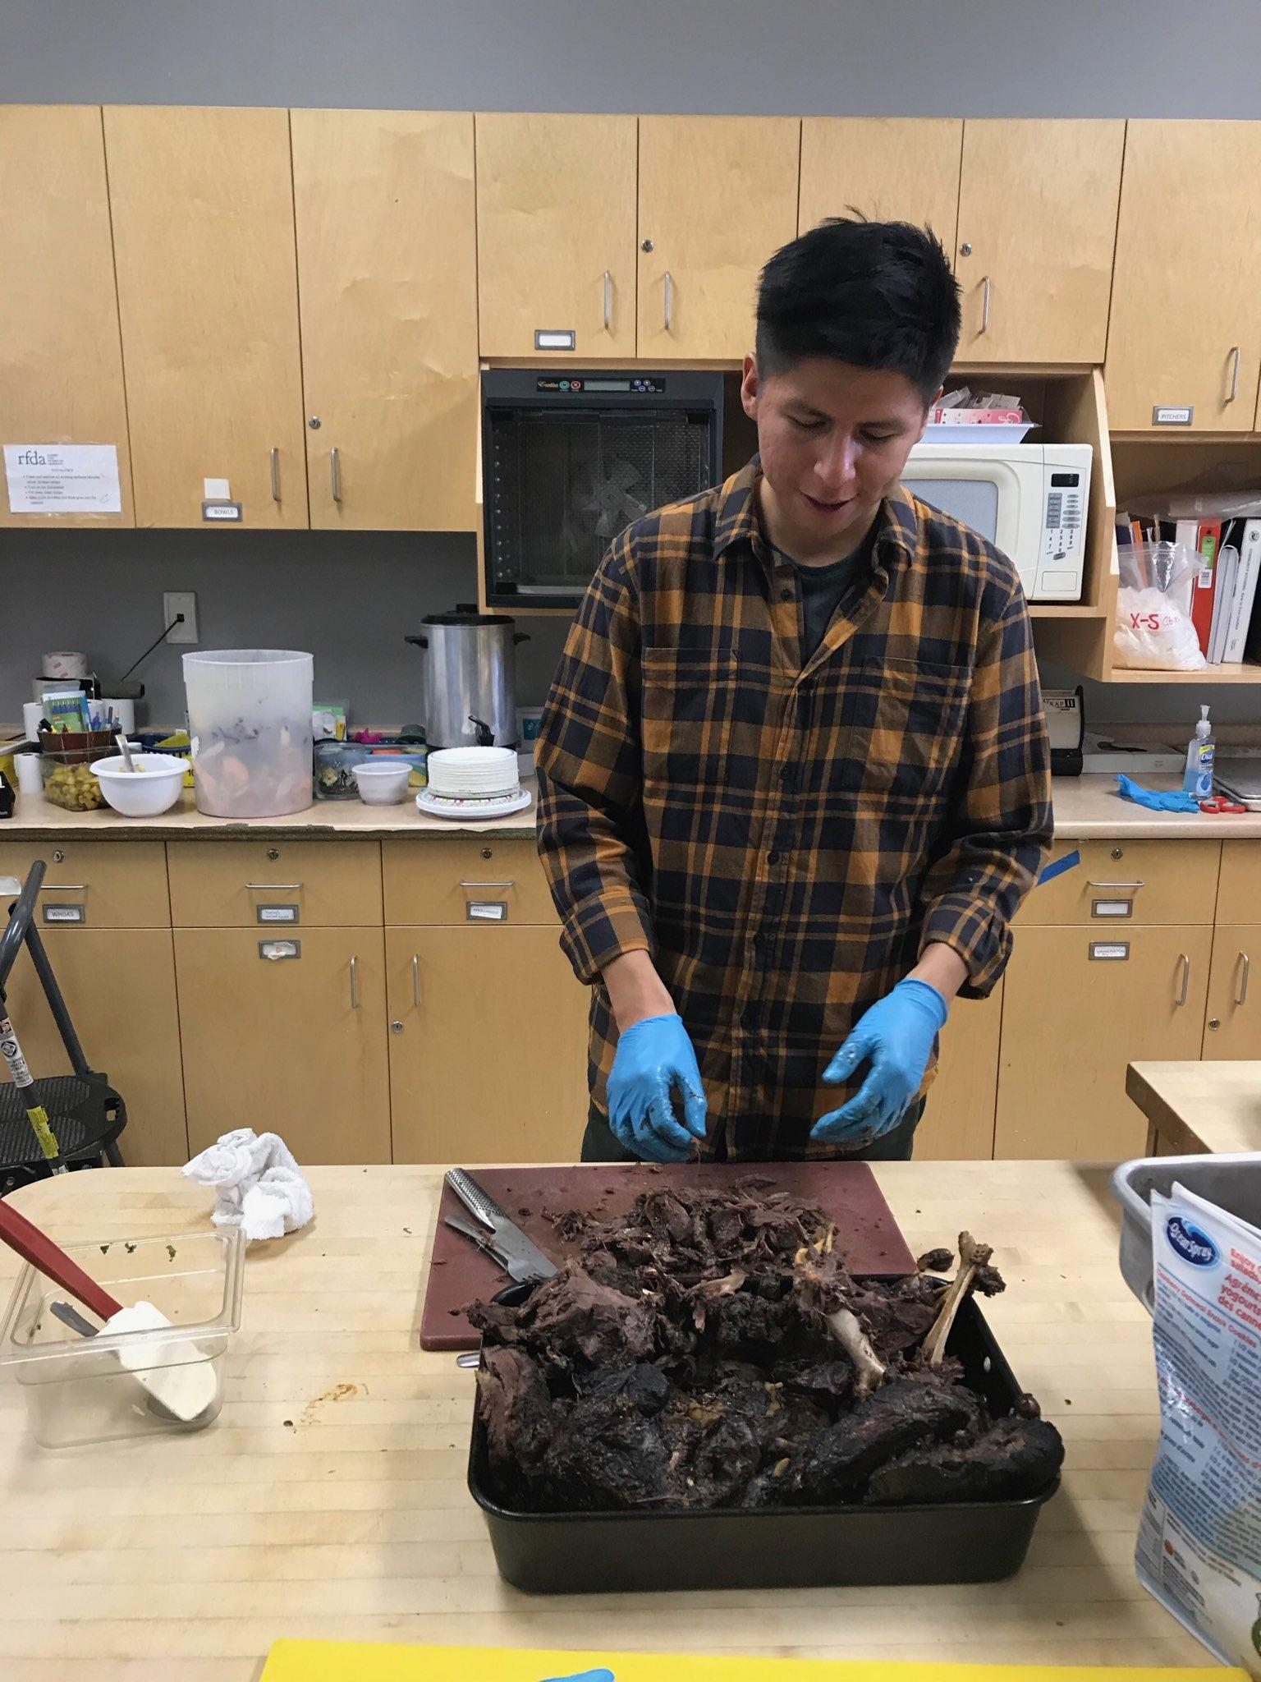
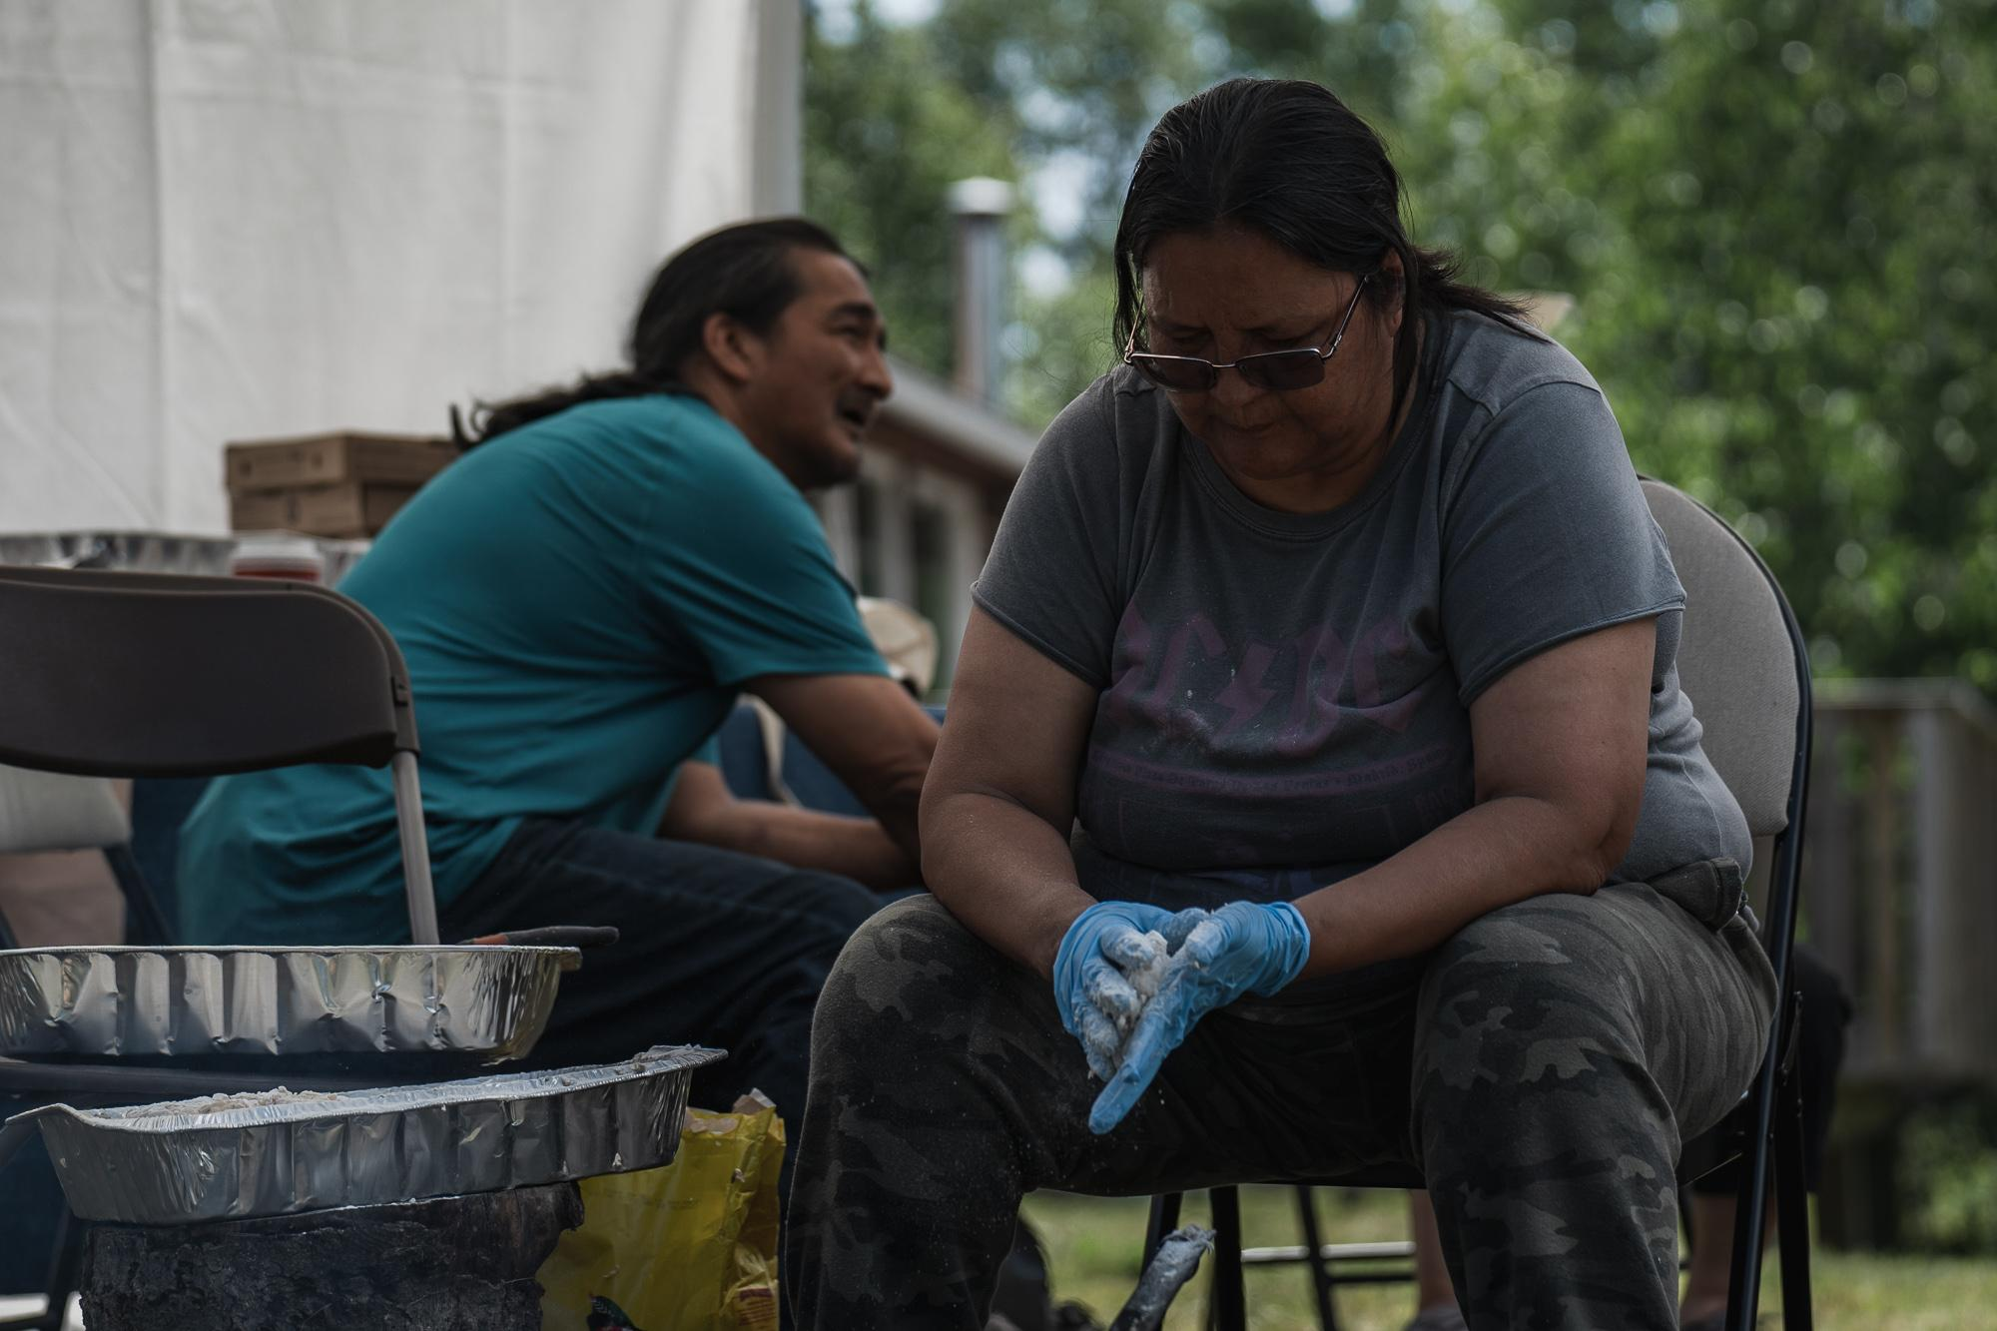
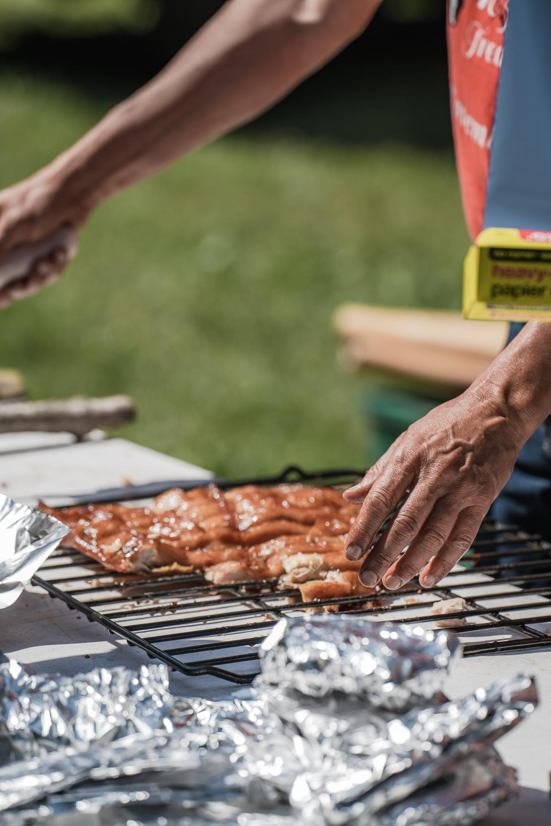
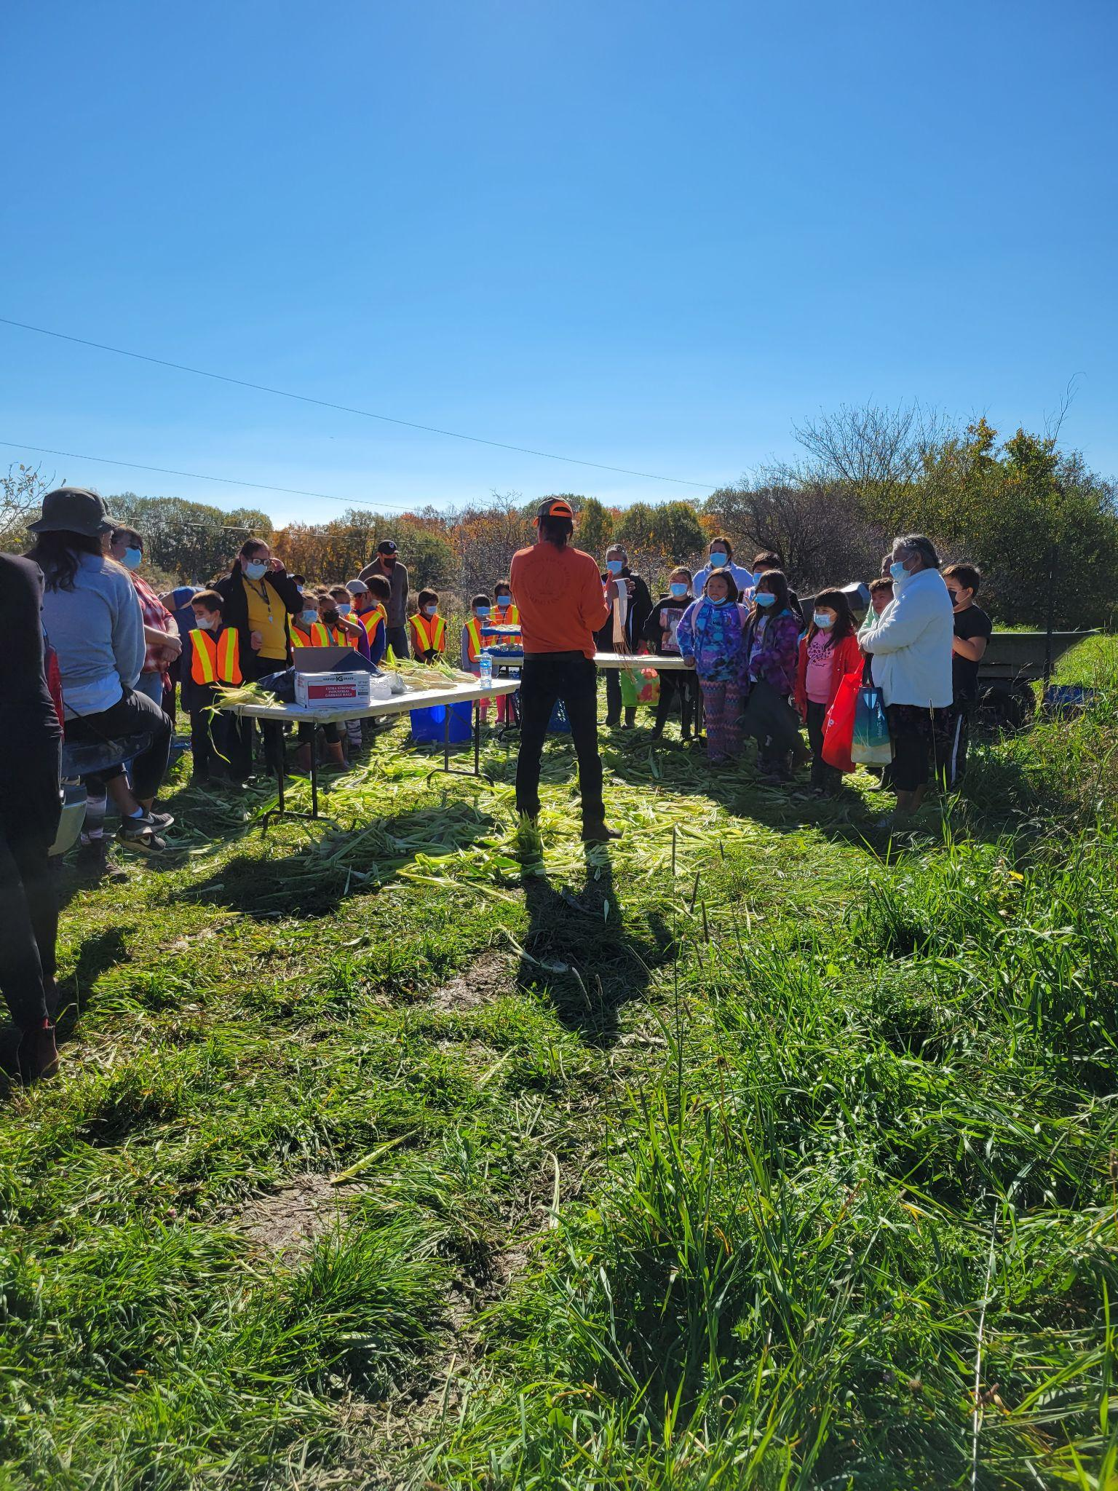
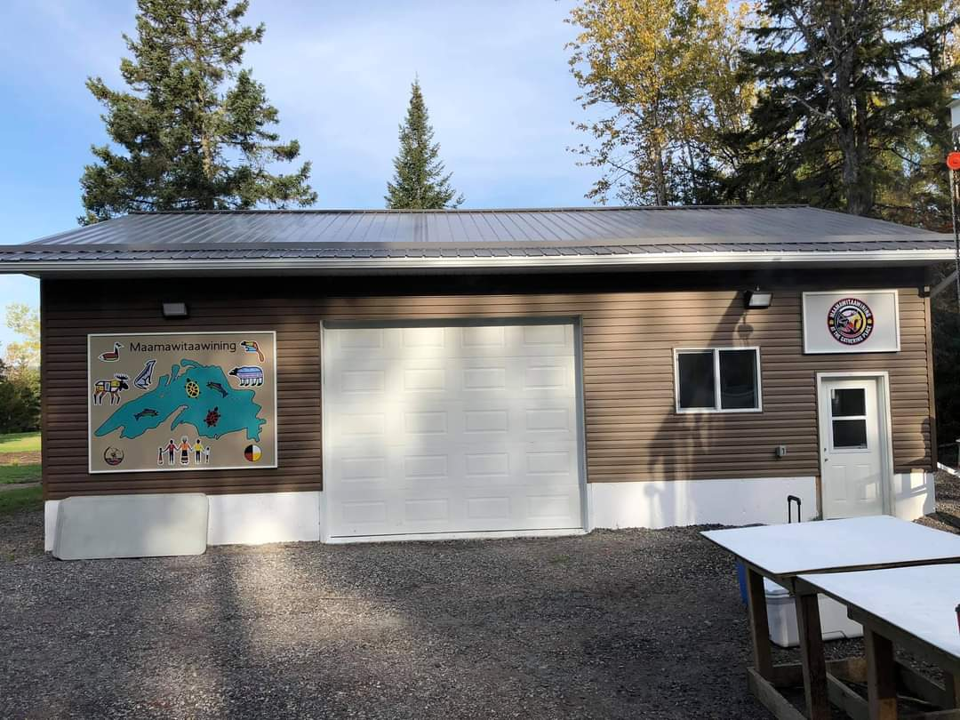
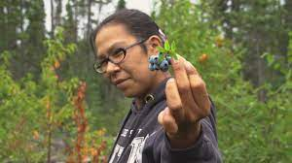
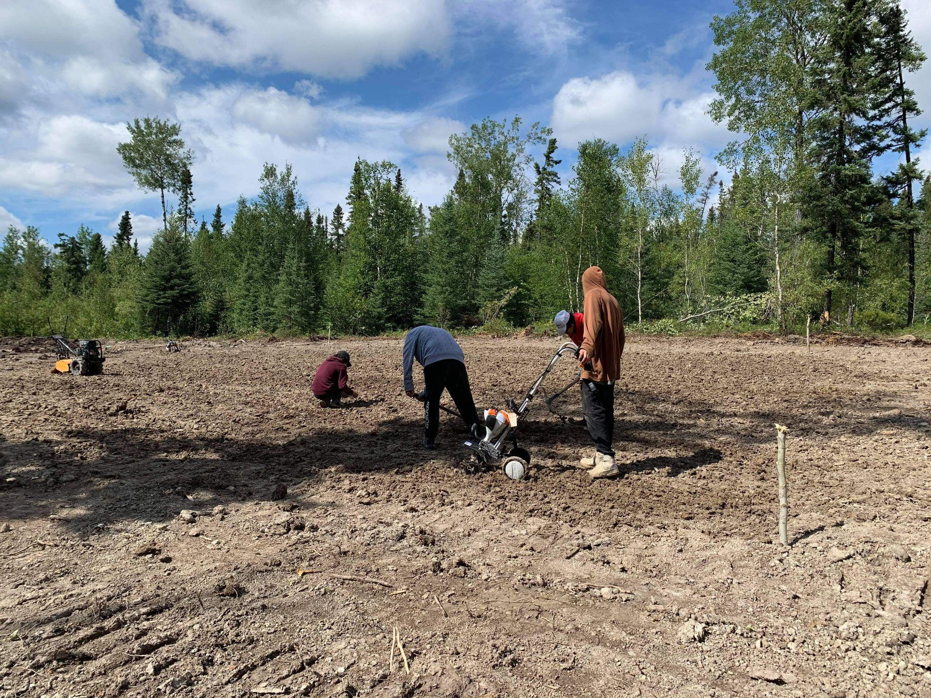
Placed Based Project Stories

Slide 17
Red Rock Indian Band - Maamawitaawining
Red Rock Indian Band began Maamawitaawinig in 2018 with the fabrication of a 4 prong moose hang, the erection of the hang made the community realize that they would benefit if they had the proper butchering processing equipment for community programming, members, cultural and modern teachings and future economic ventures. Slowly Maamawitaawining came to a reality and is a fully equipped butcher shop. RRIB is building a collaborative operational plan for Maamawitaawining to achieve all of these things.

Slide 18
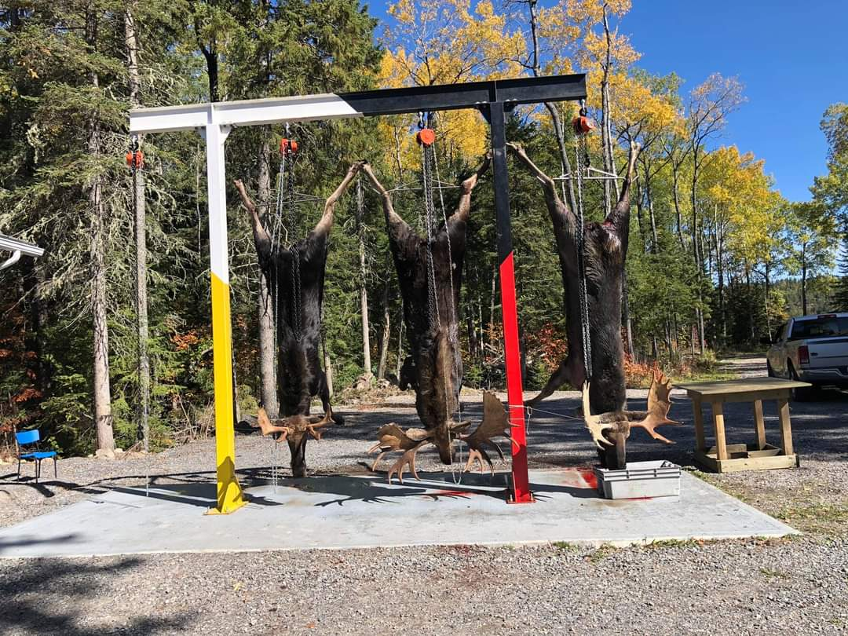
Red Rock Indian Band - Butcher Shop

Slide 19
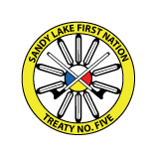
Sandy Lake First Nation Potato Garden and Gardener Support Program
Sandy Lake First Nation and its people have been a gardening community since before settler colonization. Over the last 15 years its Diabetes Prevention Program and Economic Development Corporation have been leading support in the revitalization and restoration of community and household gardening. In a community of 3200 people on reserve their are 96 households that have household gardens with much growing experience with these households. With Covid-19 Emergency Funding the community purchased a community tractor with all its accompanying equipment, this year GZ will support the development of their community potato garden that will run as a 3 year project (to start) and begin to distribute potatoes to community members and neighbouring communities to of set transportation costs.

Slide 20
Land First Sheshegwaning
Youth Initiative
The Land First Youth Initiative aims to bring cultural restoration and revitalization to Sheshegwaning First Nation members everyday. Their focus is on connecting and building relationships with the land and restoring ancestral practices around food, land and protection of non human relatives. The Initiative is partnering with other Island First Nations to bring out other youth to share and learn with. The Initiative started with a community garden/market and this year the group is focusing on a traditional foods garden (7 sisters) and an edible food forest.

Slide 21
Wahkohtowin Guardians Program
13 Moons Seasonal Teaching (Field Season)
Wahkohtowin Development GP Inc. has been exploring and building the Conservation Economy to increase the ecological and social benefits that accrue to local communities from forest resources. Focusing on the Chapleau Crown Game Preserve as the proof-of-concept area, a key and early priority was collecting and understanding information about the state of the CCGP resources, and closely related, using Guardians and people from local communities to collect the information.

Slide 22
Wrapping it all together GZ stylez

Slide 23
Questions & Miigwech

