Slide 1
revitalizing, Regenerating, and Resilience In Indigenous Agriculture
Glenda Abbott
January 17th 2023

Slide 2
Glenda Abbott Pelican Lake First Nation Nehiyaw-plains cree
Educator
Indigenous Program and Curriculum Development Specialist
Traditional medicines, indigenous gardening, heritage seeds and ethnobotany
Indigenous Healing Modalities Practitioner
Ancestral Birth Knowledge Keeper
Indigenous Birth Justice Network
Mother of 2 sons- 25 years old and 23 years old
Grandmother of a beautiful granddaughter

Slide 3
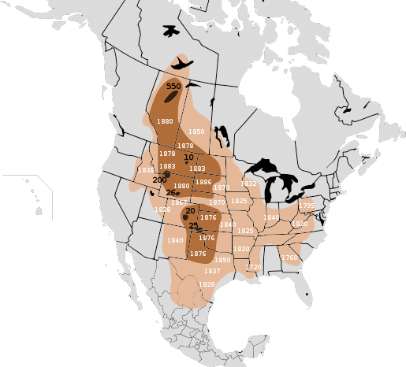
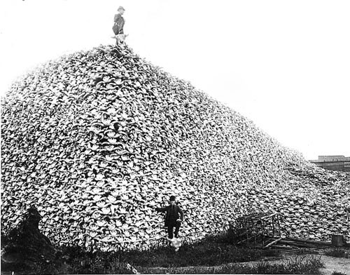
Introduction
History of agriculture
Understanding Indigenous agriculture
Impact of systems redefining land & wealth

Slide 4
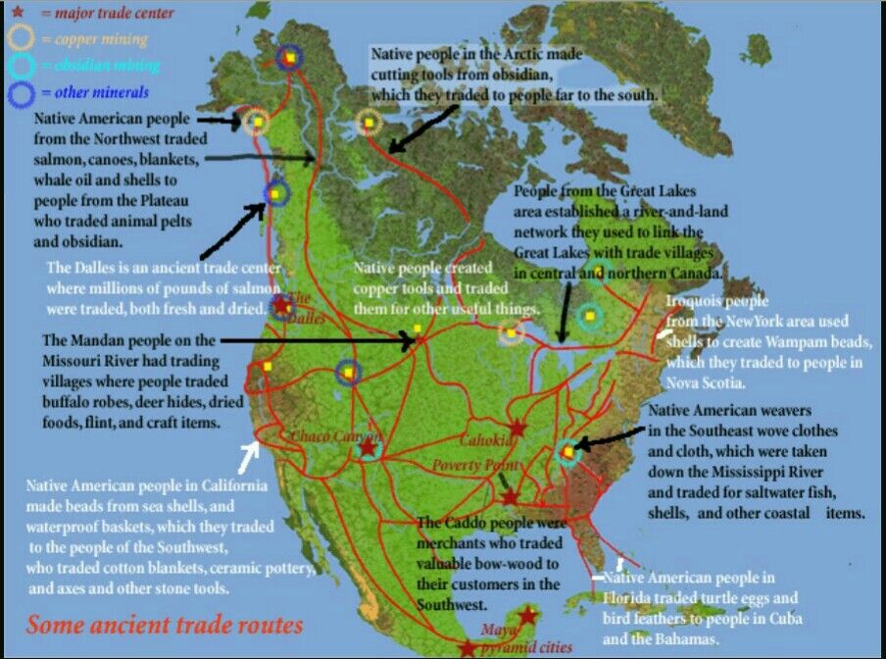
Indigenous Migrations and Origins
Opaskwayak cree Nation and river-1968 digging basements- 2500-year-old burial chamber of a women wrapped in ceremonial wear with cedar cloak, atlatl with stone head from Great Lakes, shells from Gulf of Mexico, ochre from South Dakota
Wilfred Buck
Notes:
The Natives of north/ central/ south America were never some " isolated tribes" as western civilization made it out to be, and much more has been kept than is reported.

Slide 5
Restorative research & Education in Ancestral knowledge and Science

Slide 6
Revitalizing Indigenous Agriculture: the history, importance of Indigenous migrations and Remembering all forms of Agriculture
Indigenous Foodways requires understanding the relationships that have been developed over hundreds of generations
Our Foodways renew & reciprocate ALL kinship relationships

Slide 7
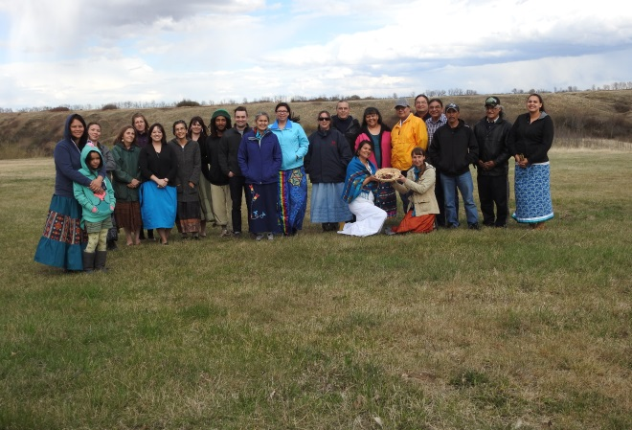
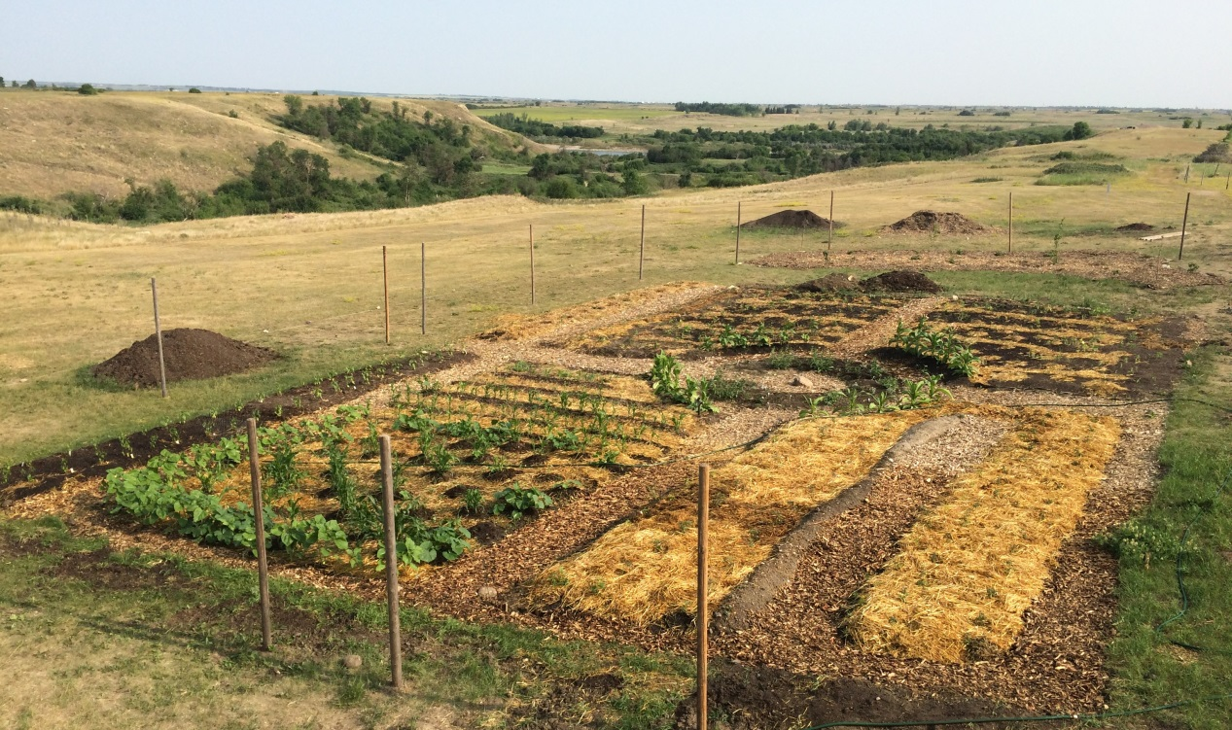
Revitalizing Indigenous Agriculture Project (RIAP)-
This was a 4-year pilot project that is working towards building community as well as the physical structures for teaching traditional medicines and foods found within Opimihaw valley, as well as the organic garden food, as traditional medicine.
Teaching Indigenous cultural and spiritual protocols when engaging with land ending with a traditional harvest and ceremonial feast.
decolonizing diet and promotion of indigenous culture.
RIAP participants 2015
Tobacco and 3 sisters
Participants learned seeds songs for working and harvesting in the garden. We also sang the songs for engaging with the sacred plants.

Slide 8
Regenerative Land based Practices - Seeds - Native Plants & gardens - Water - Animals
plants
insects
Winged, legged
swimmers
2 legged
bacteria
Spirituality and Protocol: How do we honour our relationships
human responsibility vs Rights

Slide 9
Natural Laws foundational in Ancestral Foodways
1. Law of Creation: Creation stories, Older Brother stories, Community and Kinship Stories- how we are related
2. Laws of the Land: land based experiential learning, land-based ecology with native plants and gardening, common traditional medicines, and traditional foods prep – Pastahowin-ochinewin
3. Laws of the People: Understanding and building roles in Sacred Circle teachings. Strengthening Kinship, and community gatherings -wahkotowin

Slide 10
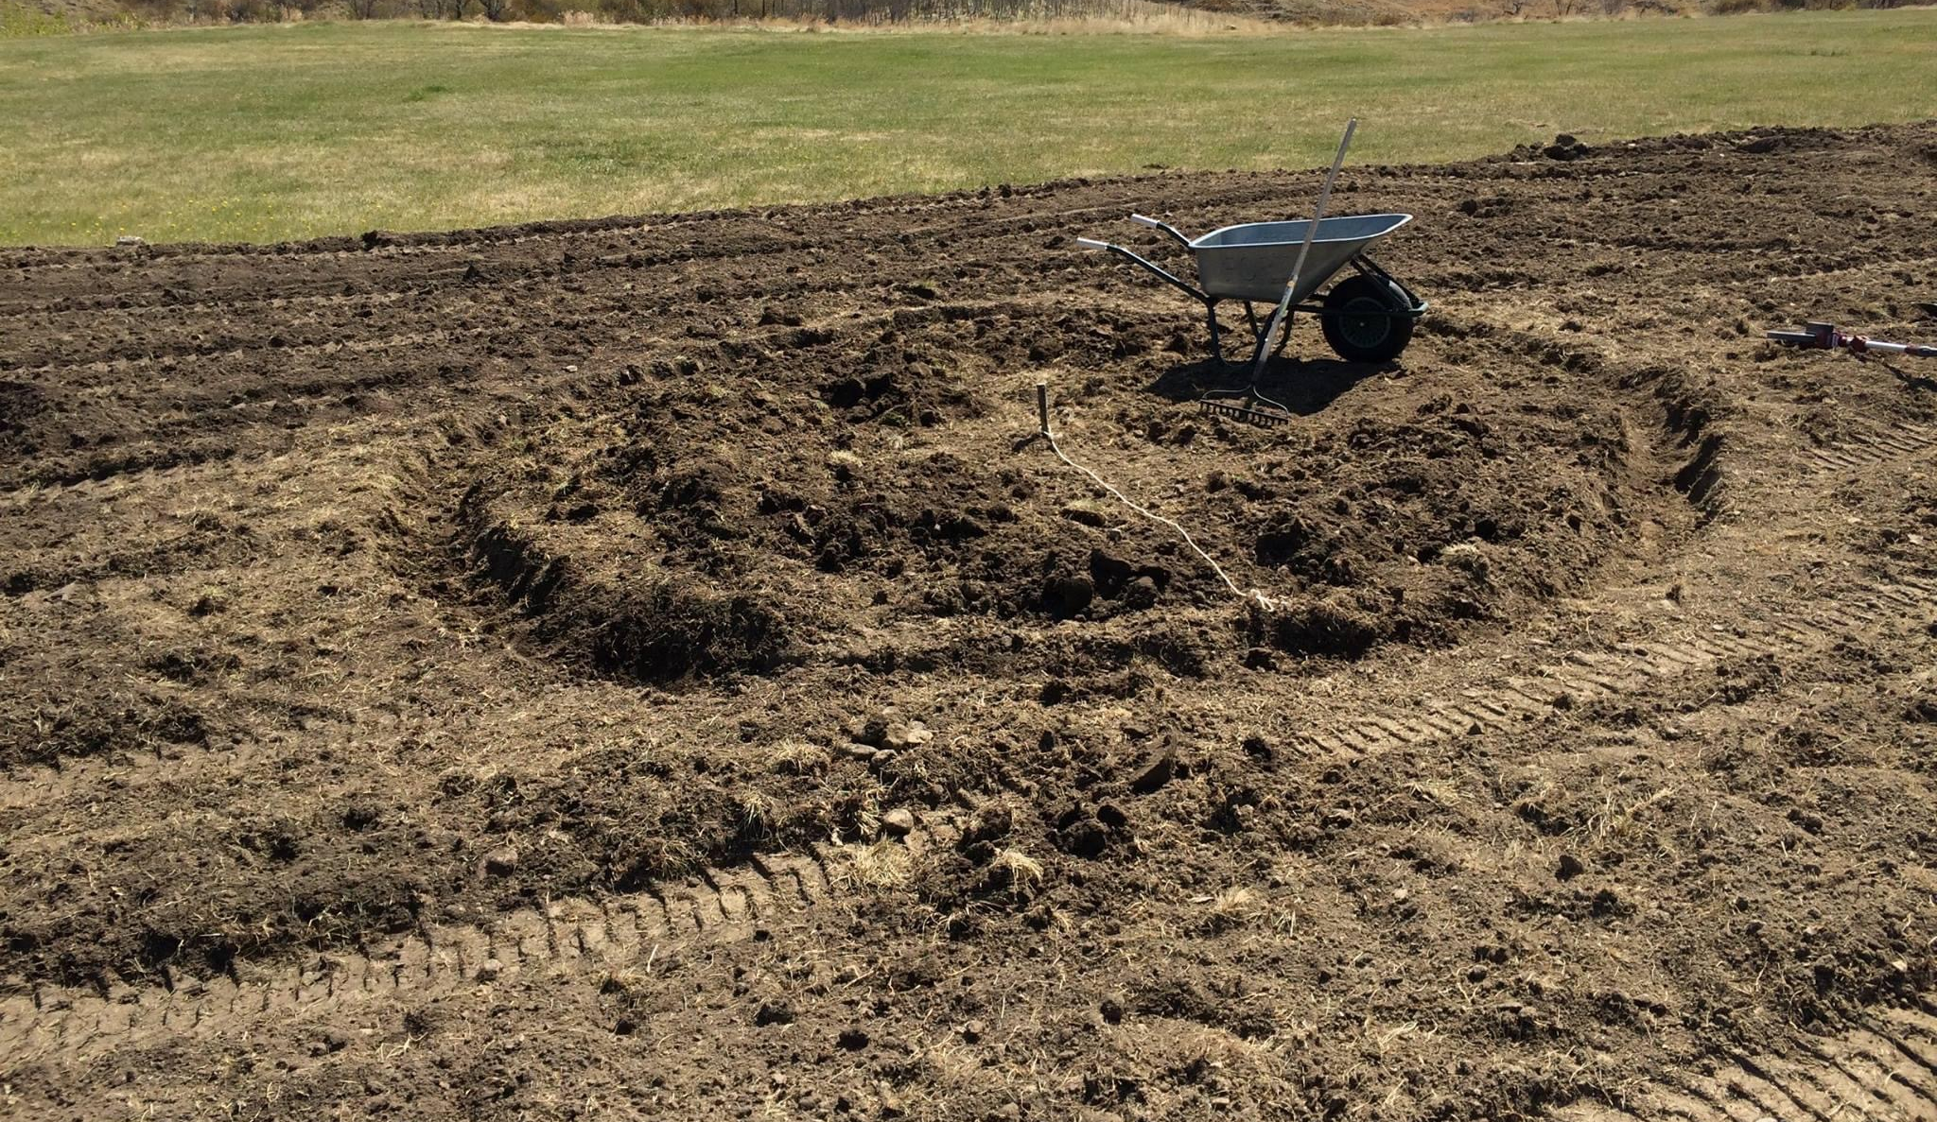
Understanding kinship through spirituality and Protocols
Notes:
Tobacco Song
- Seeds Songs
- Three Sisters soup
- 7 Sisters and winter - harvest for February Day camp
- Composting recycling and the Bison hunt
Water Teachings
Language posts
traditional methods of preparing foods

Slide 11
The First People
“We call the plants the First People. They were the first created in our oral tradition before the animals, before the fish, before the birds, and their duty was to hold the earth together and live their life as a teaching for those who would be created in the future.
The plants left many things to us as human beings. They left the ones who would be our food, they left the ones that would be our medicine, they left the ones that would be our building material, they left the ones that would be our basketry material, they left the ones that would be the scent and fragrance of the sacred in this universe, they left beauty and they dressed the earth. The earth was bare before the plant people were created.”
Bruce Miller (Skokomish), from Gifts of the First People

Slide 12
7 Sisters Garden: têpakohp nîtisânak kistikân

Slide 13
February- March Harvest
“So Sister Sunroot had said to those of the red nation “wherever you see me, know that THAT is where the soil will be good when I am done. For every time that you harvest from me, you move the soil, every time you move the soil you create an environment that you can then plant later.
Once my tubers start to become smaller and smaller, you know that the soil is becoming richer and richer. When the soil becomes too rich for me then you know the other sisters can be planted. I am the one that makes way for the other sisters to live a little better life.”
Sister Sunroot makes room for the corn, beans, squash, sunflower, tobacco and of course the seventh sister is US!
Women are the bearers and the carriers of the seed, so they were the ones to become the seventh sister.

Slide 14
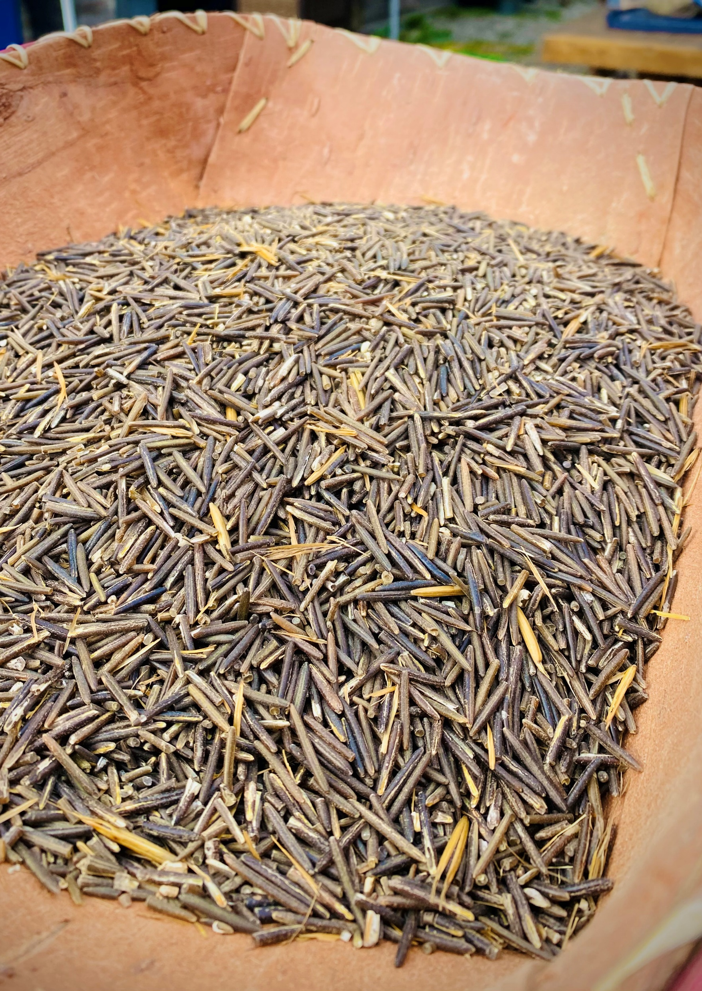
SACRED SEEDS
A sacred vessel that carries the seed into humankind and is regulated by grandmother moon
The continuation of the strands of DNA in manito minas- Sacred Seeds- a memory of lives strung back originating from first woman, seed after seed.
We related them to what is known in Creation story as the sacred seeds of life

Slide 15
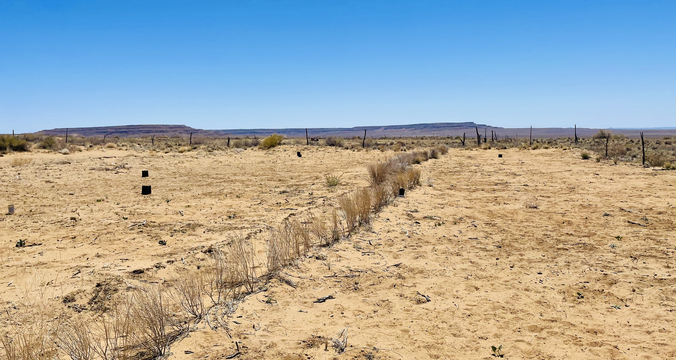
Hopi Friends
Seed protocols and lands specific to families
Multigenerational
Interruption of traditional methods impact continuity of teachings

Slide 16
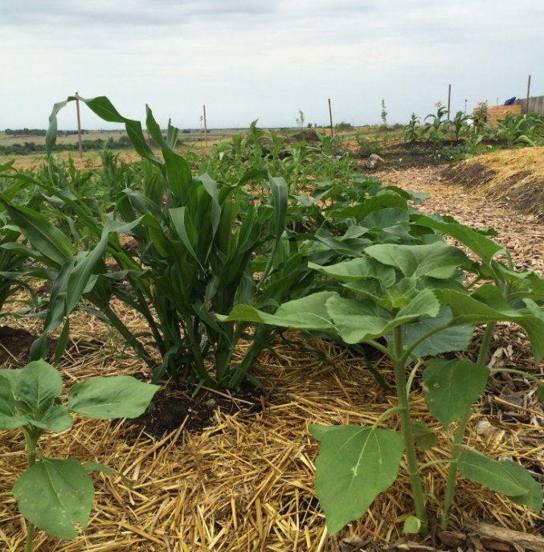
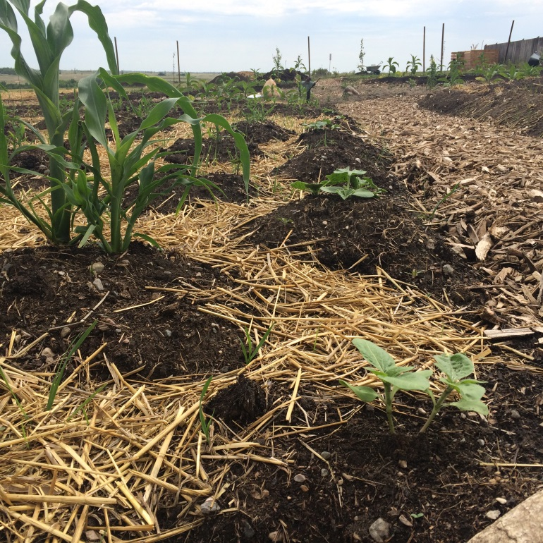
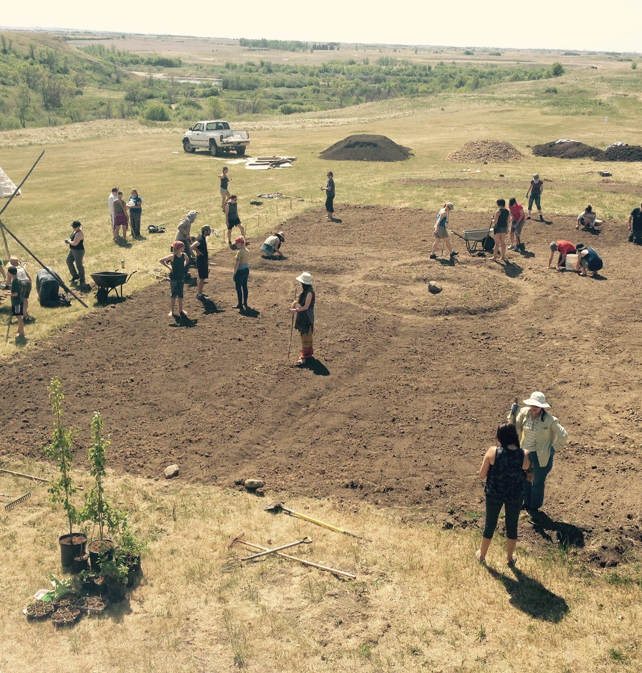
Seed Songs & Kinship as important as water
Notes:
What to consider when growing for seeds:
Are there ways to work out trades for seeds and vegetables between neighbors in community?
Are there a couple neighbors who will grow the same varieties as you so you can swap seeds for genetically stronger seeds?
What seeds am I saving and what families do I need to avoid while planting?
Note: When starting with a few seeds, it will take approximately 3-4 seed generations to build up enough seed to be able to eat and save for growing next season

Slide 17
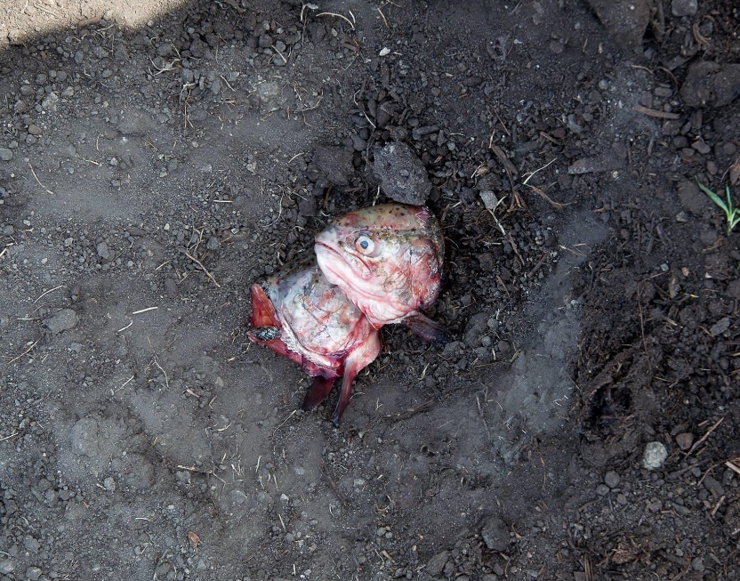
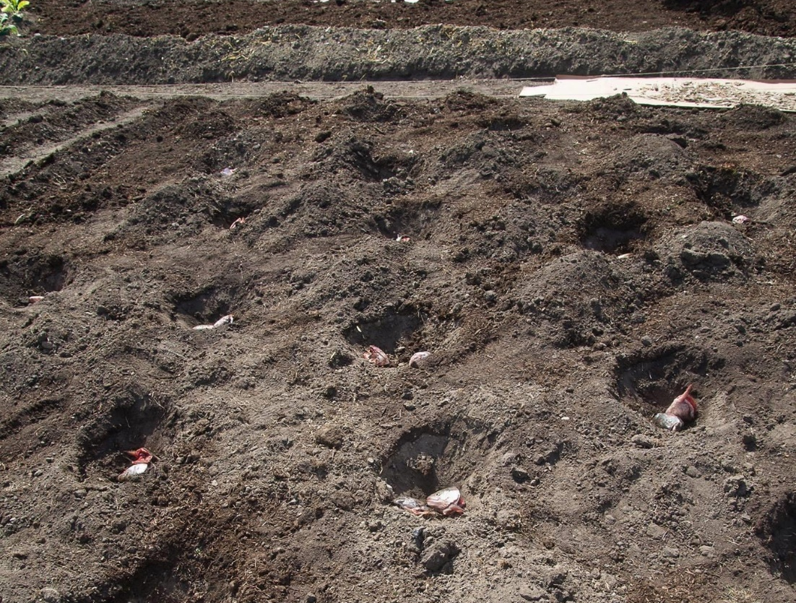
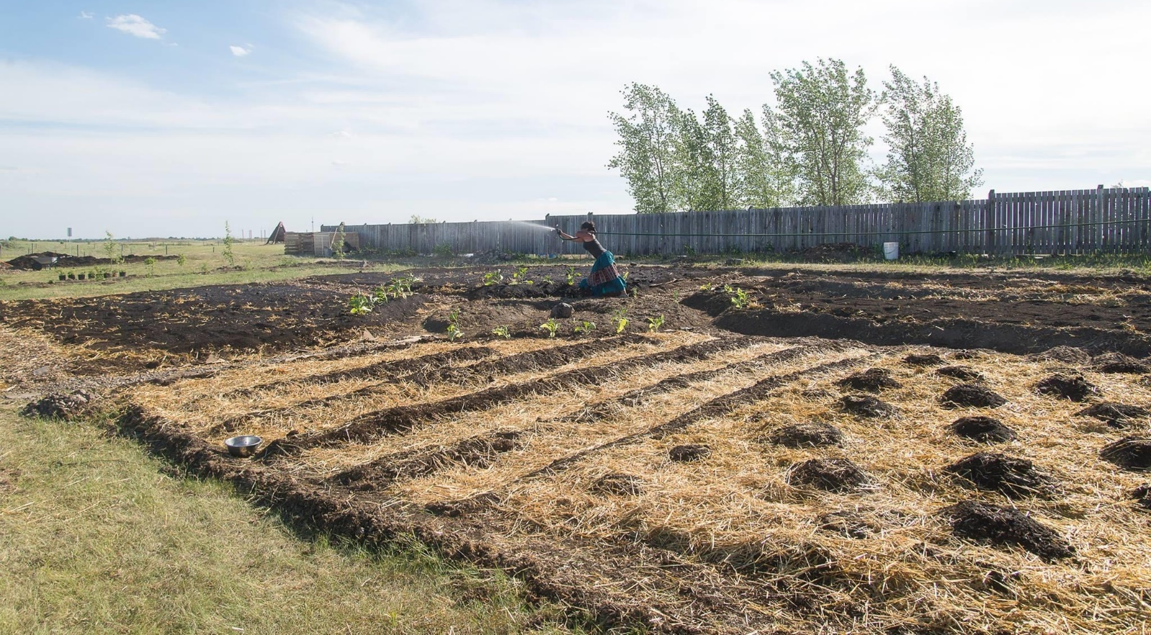
Seasonal alignment and spiritual reciprocity
Laws
land
ceremony
creation
time

Slide 18
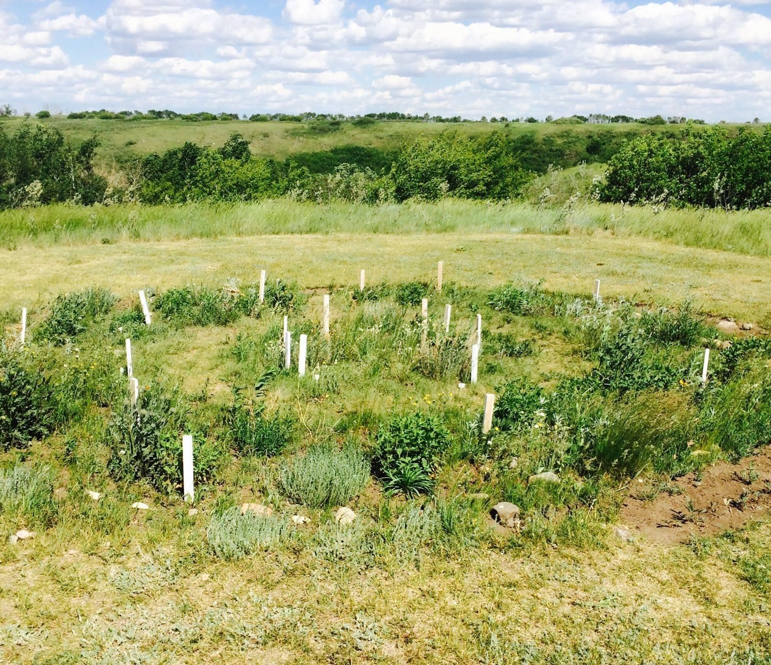
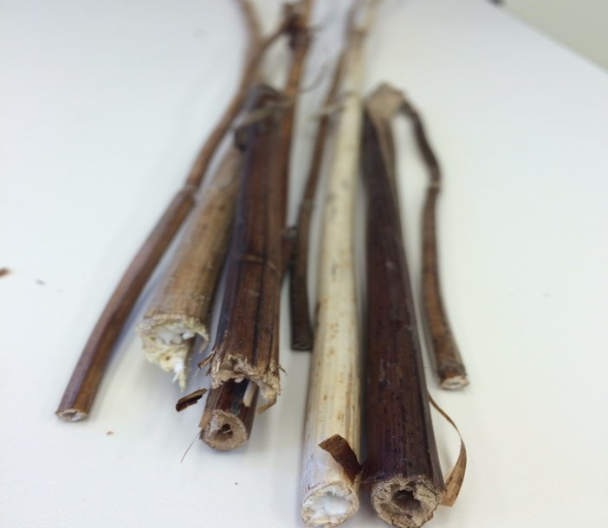
Native Bees
The honeybee can travel about five kilometers looking for food, while a bumble bee travels about one kilometer, but many other species only travel 200 metres from the nest.
Dr. Cory Sheffeld
Notes:
250 species of Indigenous Bees in Sask
350 in Alberta
800 in Canada
Most are solitary bees
Most do not sting
No species have honey
Range in size from 2mm to large bumble bees
Specific bees will pollinate specific flowers

Slide 19
Example of Plant Relationships
Bark: Feminine issues with menstruation
Roots-child diarrhea, chest colds
Eat raw to prevent cold and fever
Petals for heart
Vitamin C
Leaf: Feminine birth and aftercare, slow
Roots and Stems for child diarrhea, stomachache, boiled for fevers,
Fruit is good for heart
Rose Hips
Raspberry
Giant Hyssop: powdered leaves for cooling fever, leaves for chest pains related to coughing and weak heart, magnesium, calcium

Slide 20
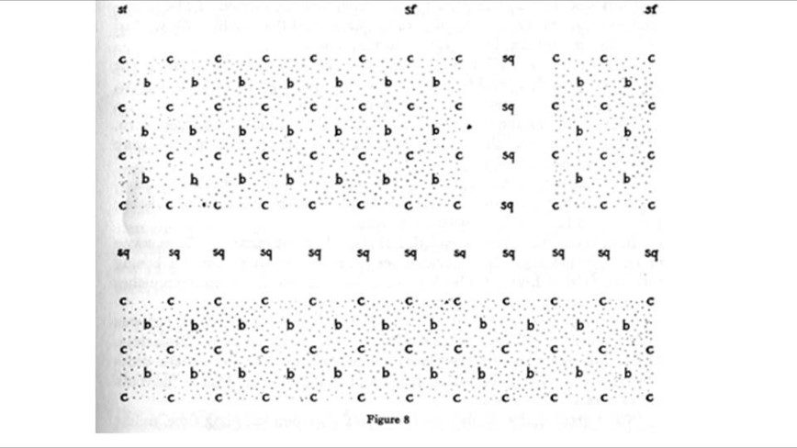
Buffalo Birds Garden- planting for success looks different for each of us
Notes:
Woman hoeing her garden with traditional bison shoulder blade hoe, Buffalo Bird Woman's Garden

Slide 21
Wise words
Plant in good soil
Keep the weeds out with timely work
Plant at the best time for each crop
Care for your crops as part of your family
Harvest the seed at the peak of maturity
Carefully select, dry, clean, and store
Keep extra seed
Maintain or breed new varieties

Slide 22
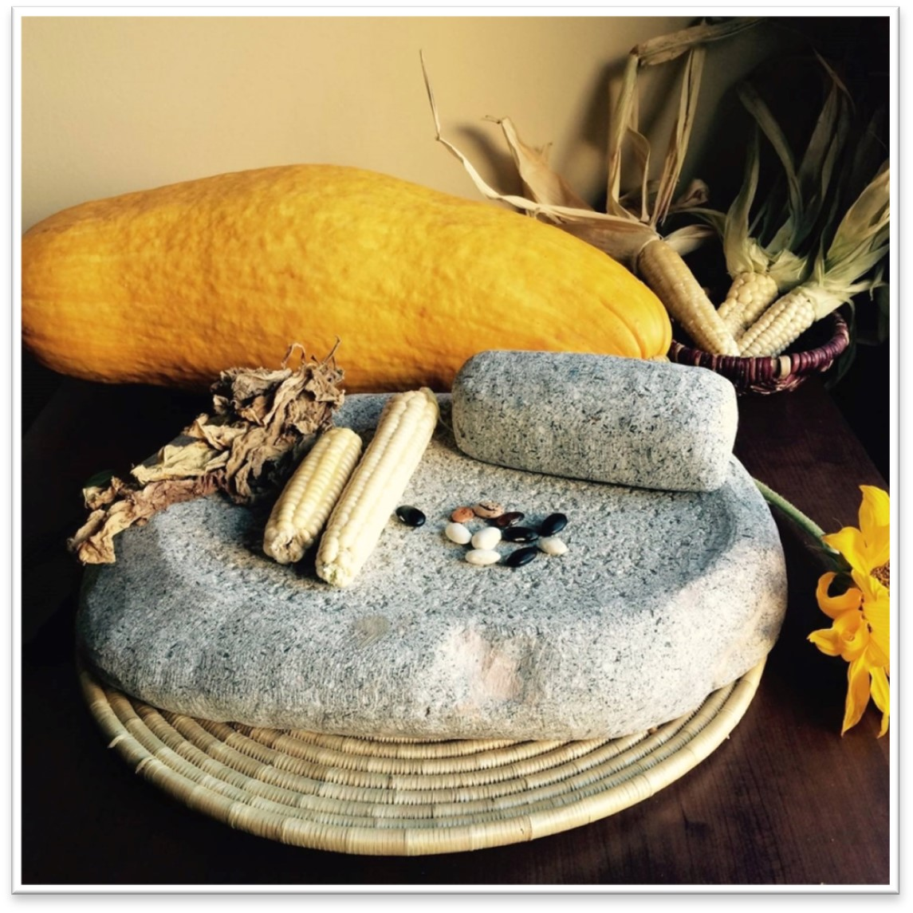
Concerns and Barriers: 1)land use policies 2) funding models 3) Climate Change 4) Corporations and seed sovereignty 5) Intellectual Property & Protocols

Slide 23
Priorities
Rebuild trade relationships through nation-to-nation agreements between indigenous kinship ties- “Scale Out”
Education on sustainable economy and land-based practices, community driven initiatives, Indig. coops, & collectives
Build social economy community projects and utilize relevant foodways curriculum for families
Decolonizing Funding Models and Long-term Visioning for 7 generations
Community Driven initiatives & funding that prioritize Indigenous Rites and responsibilities vs. Rights

Slide 24
We will never be sovereign until we can feed our people `Winona LaDuke 2008 White Earth Café` We will never be sovereign UNTIL we STOP operating within systems designed to destroy us and move to re-rooting ourselves into Indigenous systems that promote true abundance.
Scarcity vs. Abundance

Slide 25
Questions? Thank you!
Glenda Abbott | indigenousbirth@gmail.com | 306-930-5531

