Slide 1
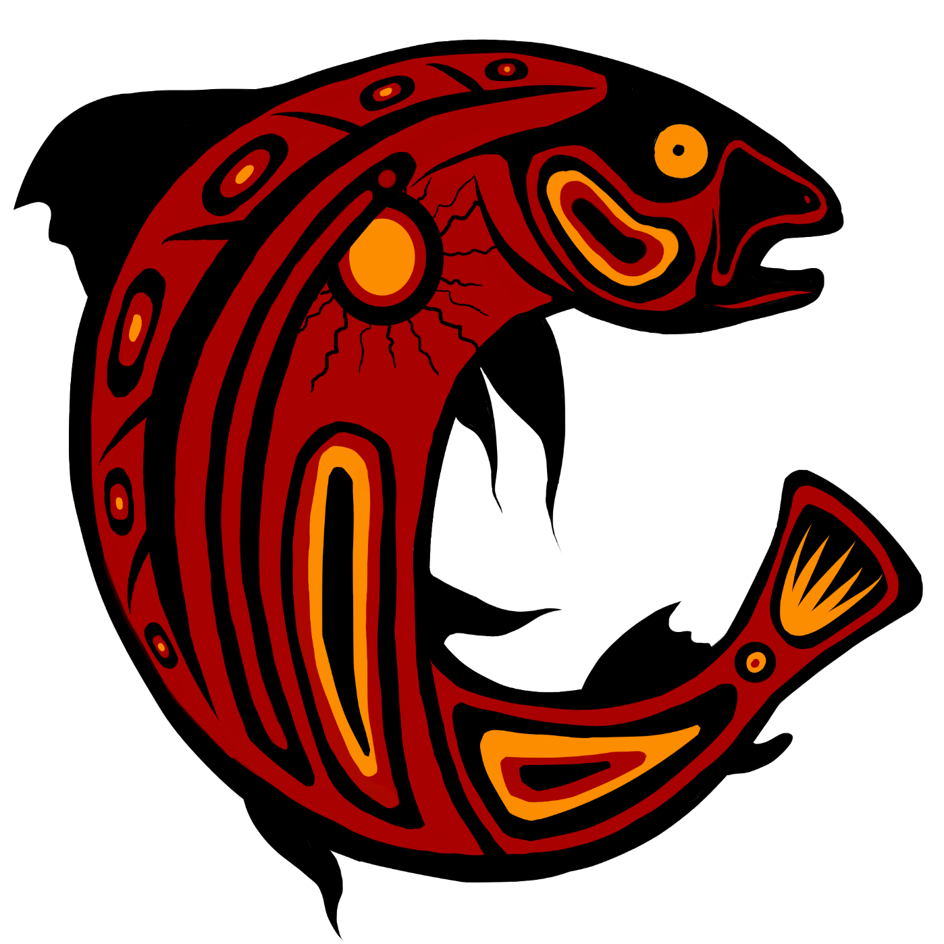
Buzwah Fisheries
Notes:
Today I’m going talking about Buzwah Fisheries, our place in the aquaculture industry, and our responsibilities that come with that.

Slide 2
beginning
Located in Wikwemikong first nation in the Manitowaning bay
Benjamin Kanasawe began business in 1997 with his son, peter kanasawe
With support from chief and council
Help from Waubetek
Started with 4 net pens
all labour done by hand

Slide 3
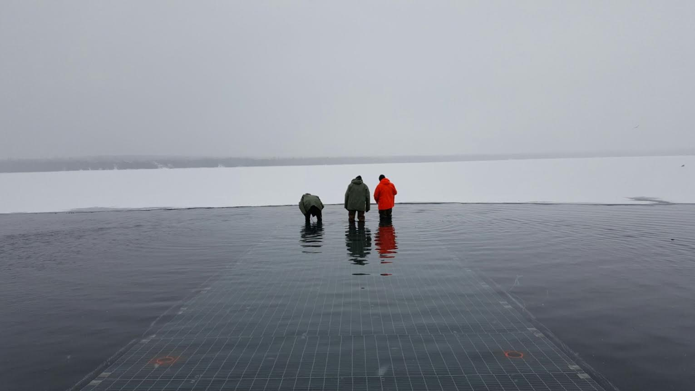
present
Indigenous owned and operated
Business has grown to 32 net pens
Submersible for ice out
Some labour is automated
Employs 10 people from the reserve
Bap certified

Slide 4
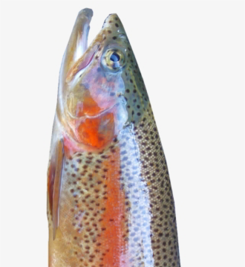
Fish
Rainbow trout only species
Fingerlings at 35g – 45g
32,000 - 35,000 per net pen
Leaves site around 2.5 – 3 lbs
1.1 million fish on site

Slide 5
Feed
fish eat once a day in the morning
Sizes range from 3mm – 7.5mm
Skretting, bluewater (sharpe)
Easily excitable – bad/good
By hand – observable behaviour
Automation – a necessity for efficiency

Slide 6
Site is fully submersible
Allows ice to leave Manitowaning bay without disrupting the fish
Site can be underwater in only a few hours

Slide 7
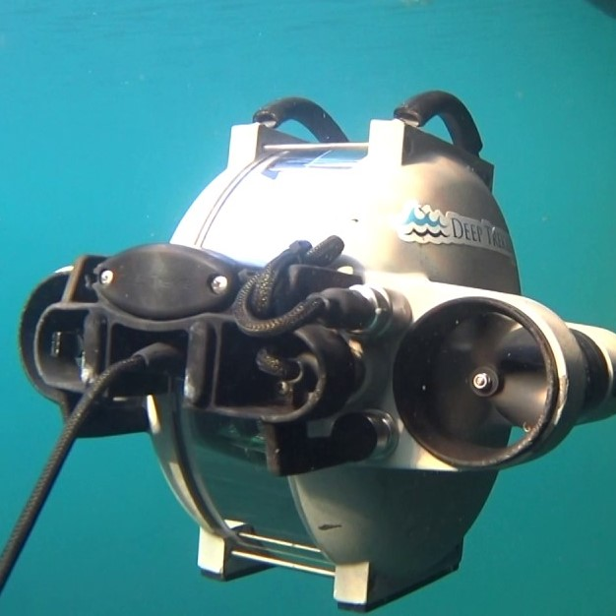
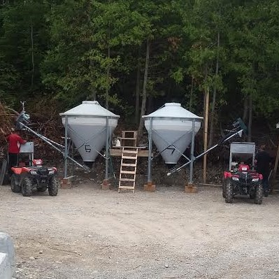
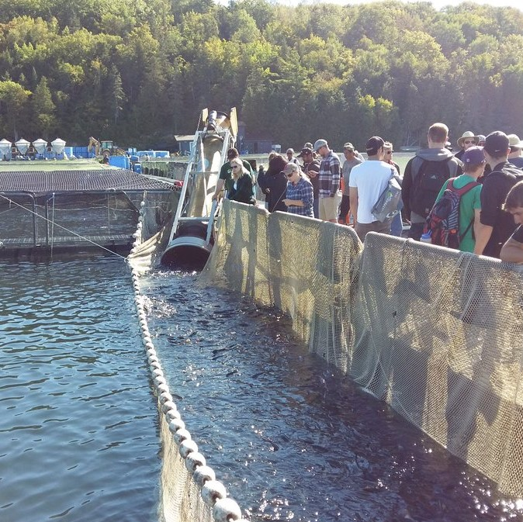
Automated equipment used at Buzwah fisheries
ROV (Remote operated vehicle)
Automatic feeders
Fish pumps/auger for harvest

Slide 8
What is “bap”?

Slide 9
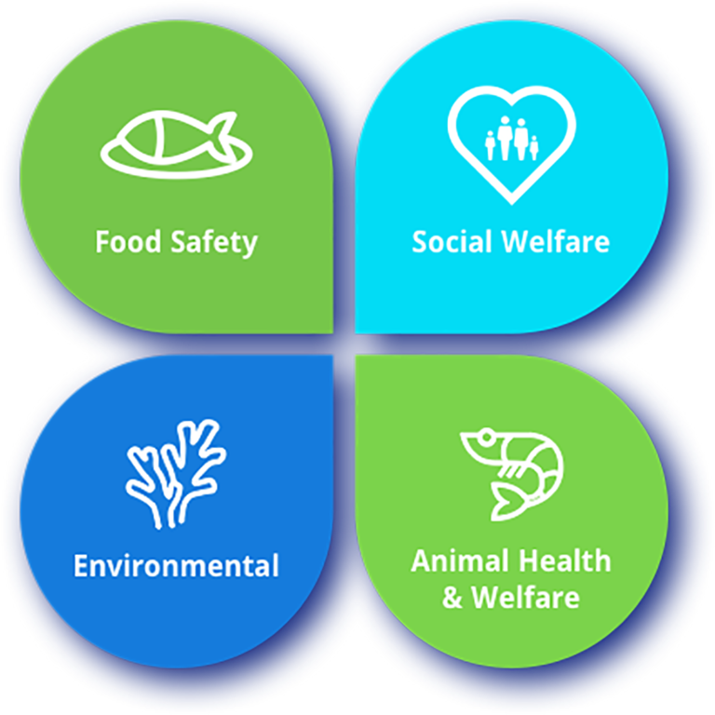
Best aquaculture practices
Globally recognized third party certification program
Safety of the environment
Social integrity
Health of both the animal and the consumer
Annual audit
4 pillars of responsible aquaculture

Slide 10
Social welfare
Ensures every worker knows their rights
Each worker has whmis training
First aid trained staff
Access to safety equipment
Fair workplace

Slide 11
Food safety
Important for all staff to closely monitor stock for disease
If disease is suspected it will only be treated with federally approved antibiotics

Slide 12
environment
Closely monitors the water quality during open water season
Temperature and dissolved oxygen are tested daily before feeding
Safety measures are in place in case of fire, oil spill, and Avoids any substances that would cause environmental damage.

Slide 13
Animal health and welfare
Ensures the safety of the animals both inside and outside the net pens
Extra measures in place to ensure fingerlings enter the net pens safely during transport
Animals are fed to satiation, never over or under fed, and never without food for more than a few days (during ice out)
Closely watch for complications and diseases, treat if necessary.

