Slide 1

Vertical Farming
Anishinabek Youth Ag Forum
January 18, 2023
Fadi Al-Daoud, PhD
Greenhouse Vegetable Specialist
Ontario Ministry of Agriculture, Food and Rural Affairs (OMAFRA)
E-mail: fadi.al-daoud@ontario.ca
Phone: (519) 551-6703
Blog: ONGreenhouseVegetables.ca
LinkedIn: https://www.linkedin.com/in/fadi-al-daoud/

Slide 2
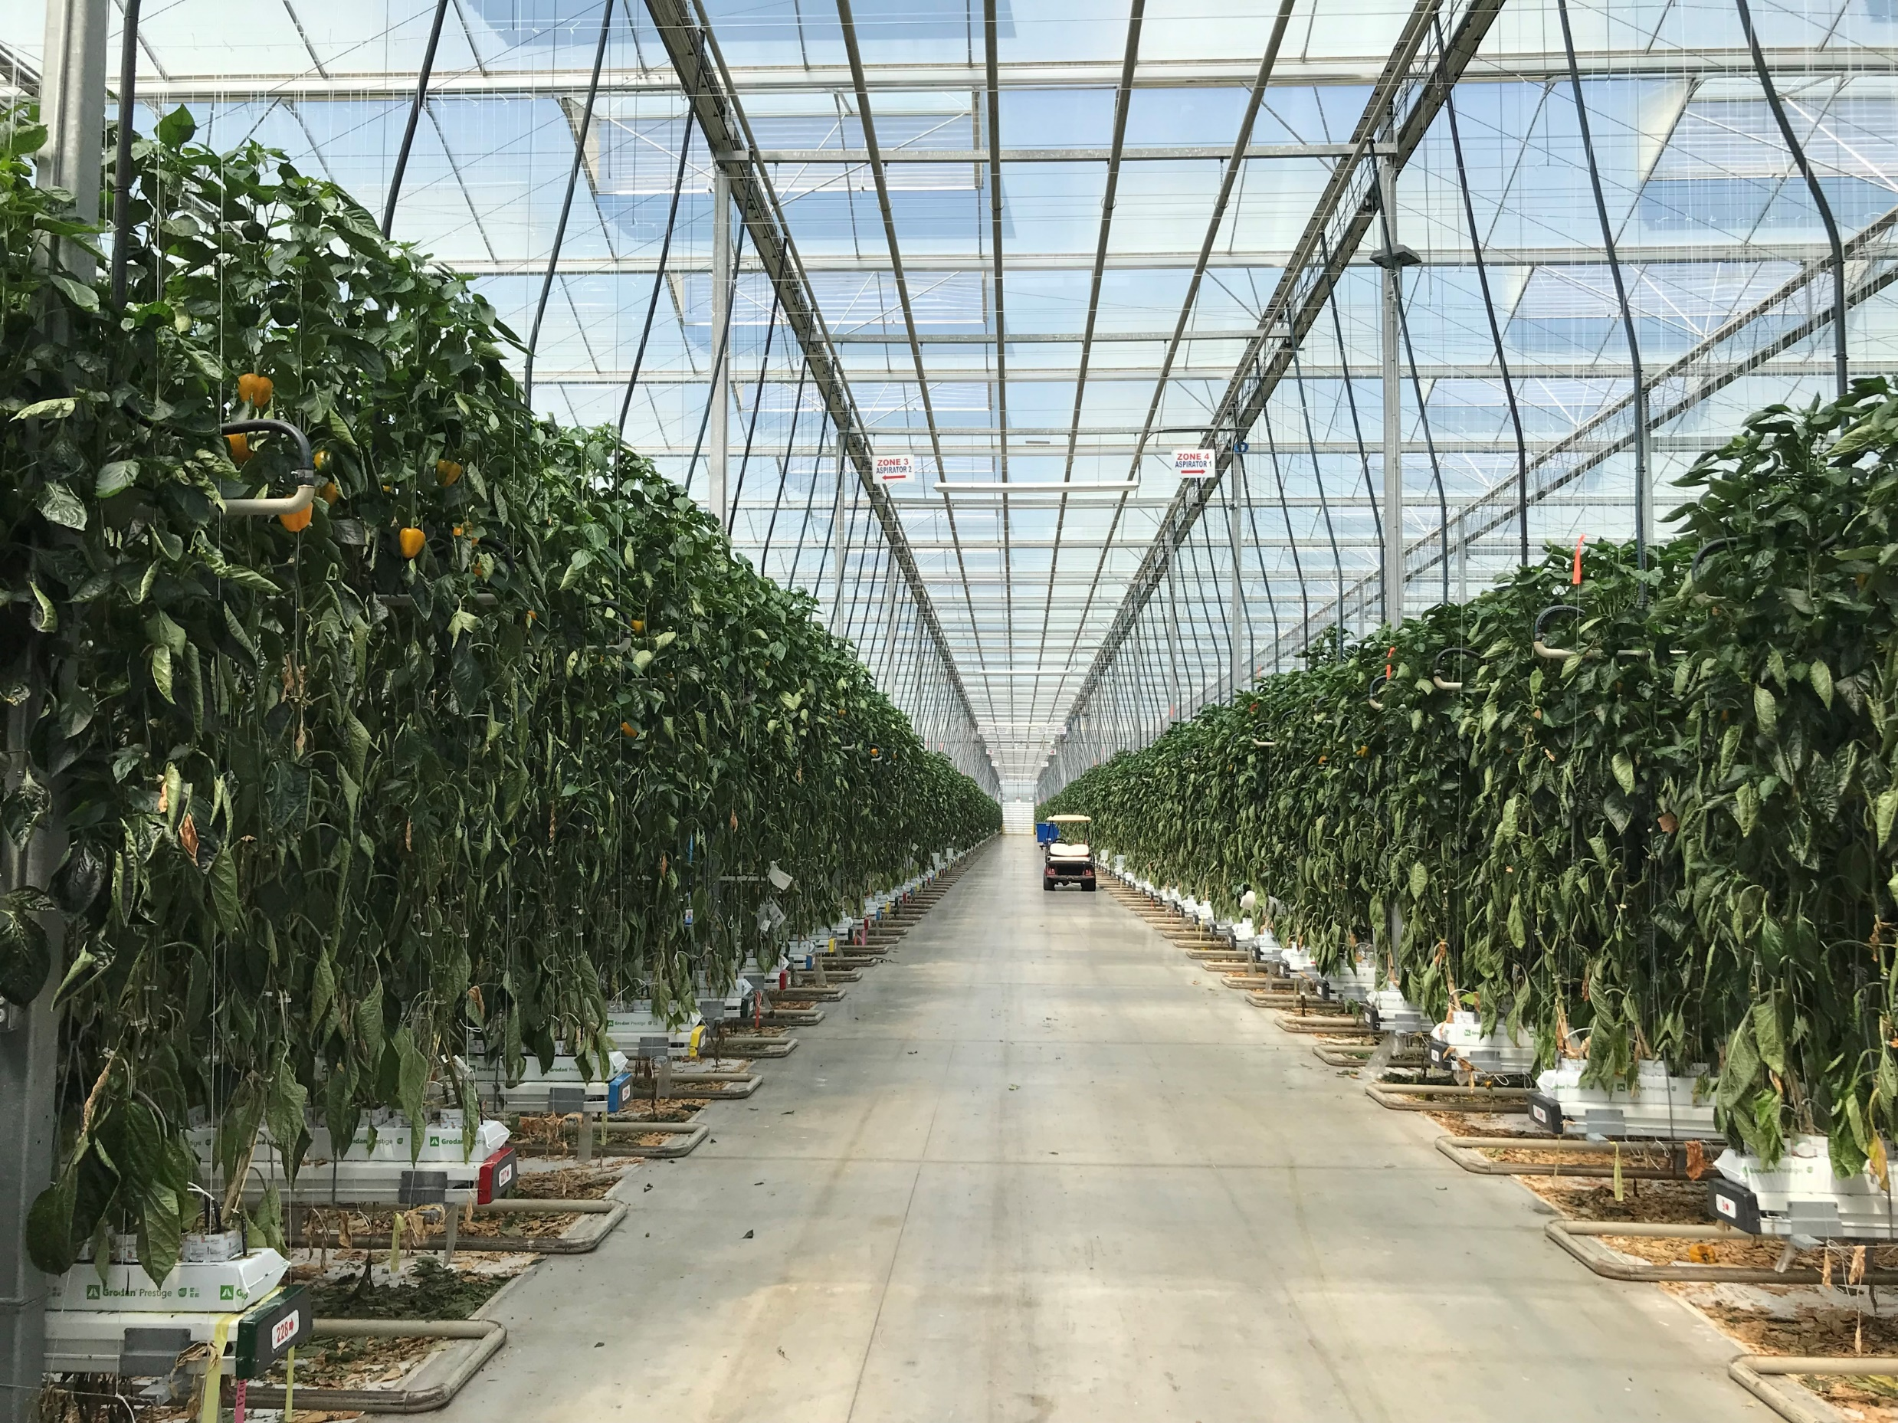
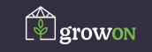


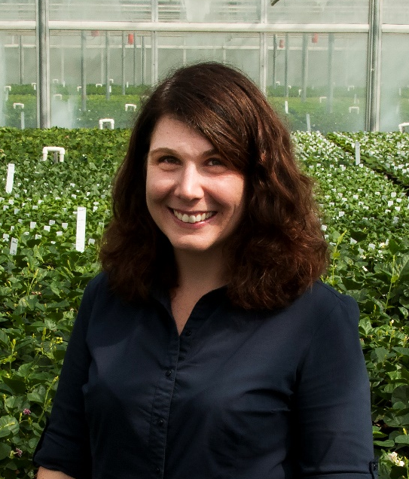
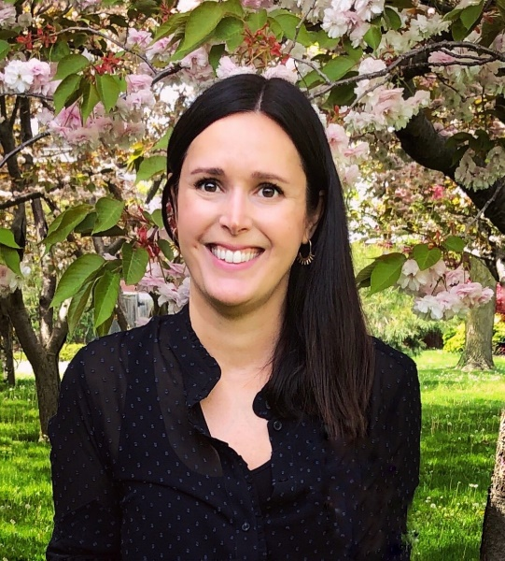
OMAFRA’s Greenhouse Team
ONGreenhouseVegetables.ca
Dr. Fadi Al-Daoud – Production
Greenhouse Vegetable Specialist
Cara McCreary – IPM
Greenhouse Vegetable IPM Specialist
Dr. Chevonne Dayboll – Production
Greenhouse Floriculture Specialist
Dr. Sarah Jandricic – IPM
Greenhouse Floriculture IPM Specialist
ONFloriculture.com

Slide 3
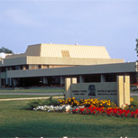
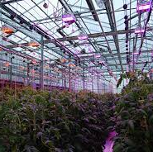
Where We Are and What We Do
Based out of Agriculture and Agri-Food Canada’s (AAFC) Harrow Research and Development Centre (Harrow, ON)
Portfolio includes food production in controlled environment agriculture (CEA) in Ontario
  Greenhouses (GH)
  Vertical farms (VF)
Work with producers, researchers and industry to advance CEA in Ontario
  Research
  Training and education (knowledge transfer and translation, KTT)

Slide 4
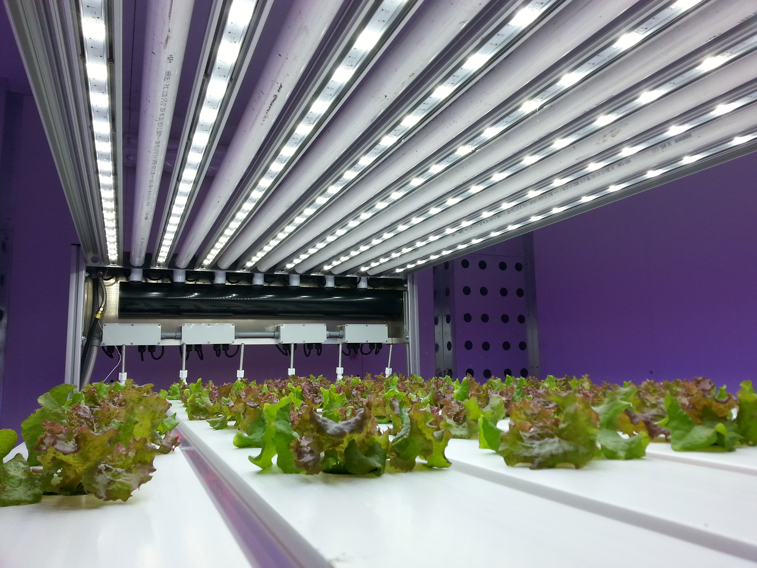
Presentation Objective and Outline
Objectives:
Provide an overview of vertical farms (VF) in Ontario
Outline:
Vertical farming and sector overview
Production system
Research
University of Guelph

Slide 5
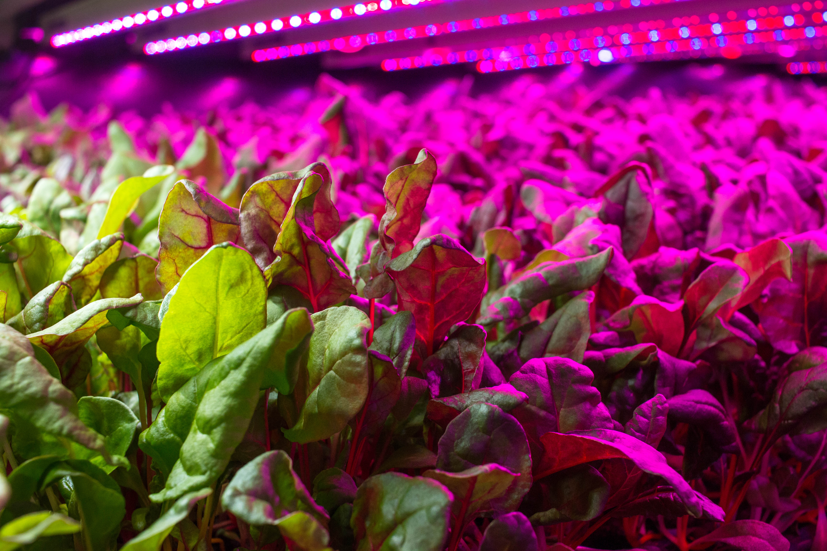
What is vertical farming?
A form of controlled environment agriculture (CEA)
Growing food indoors
Light, temperature, water, fertilizer, humidity, air, etc. are all controlled
Lighting technologies like light-emitting diodes (LEDs) are making VF sustainable and profitable
Good Leaf

Slide 6
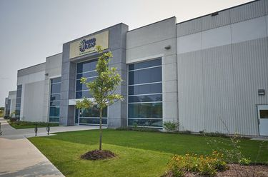
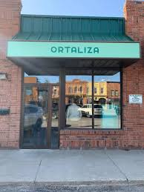
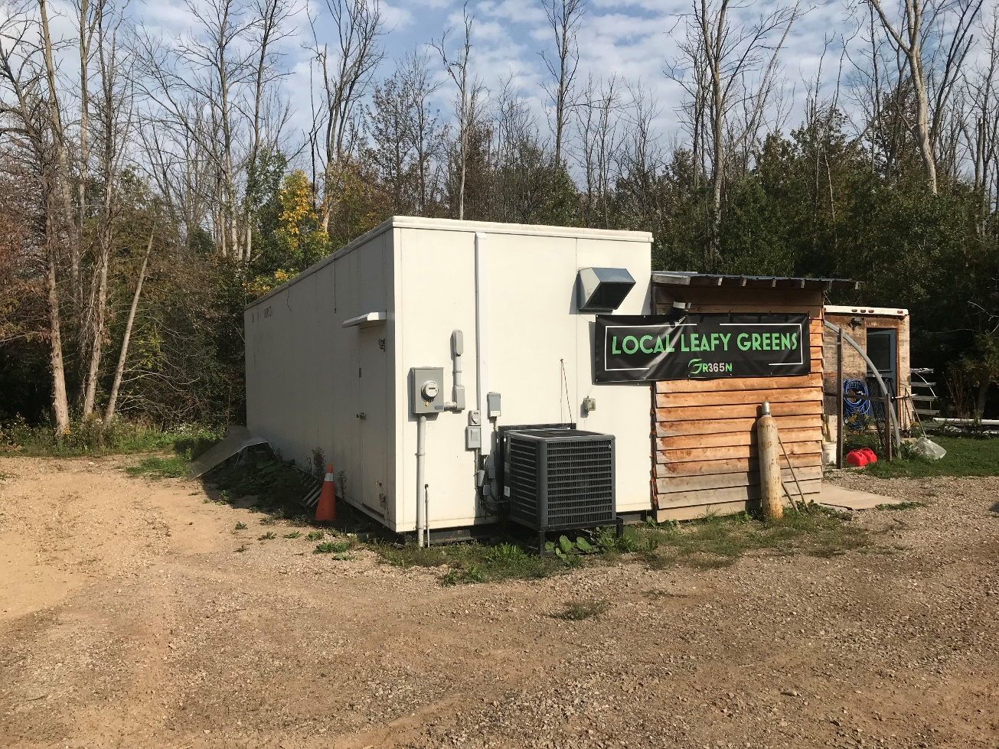
Structure
Buildings: warehouses, store front, re-purposed buildings (barns)
Containers: retrofitted shipping containers
Good Leaf
Ortaliza
GR365N

Slide 7
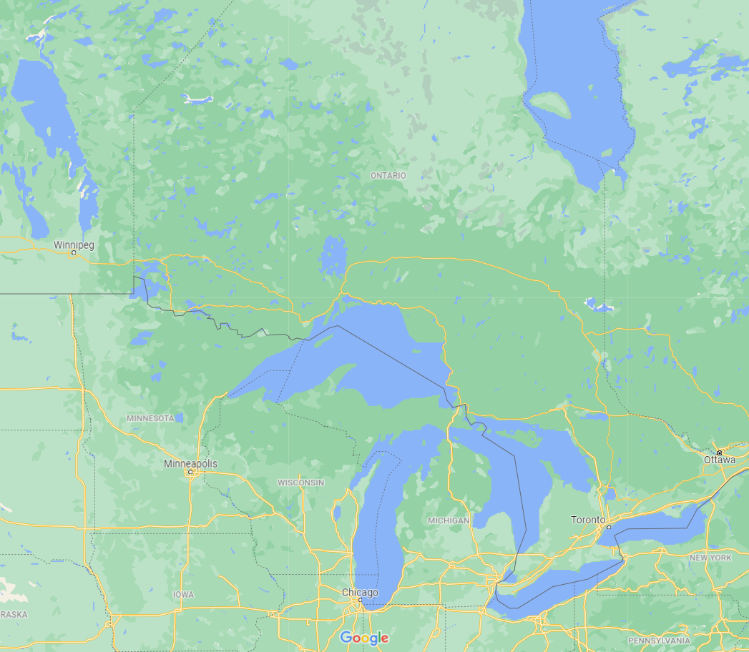

Location
Province-wide
Cluster in eastern Ontario
Agricultural, industrial, and commercial zones
Produced and consumed locally
Local workforce
Dryden
Timmins

Slide 8
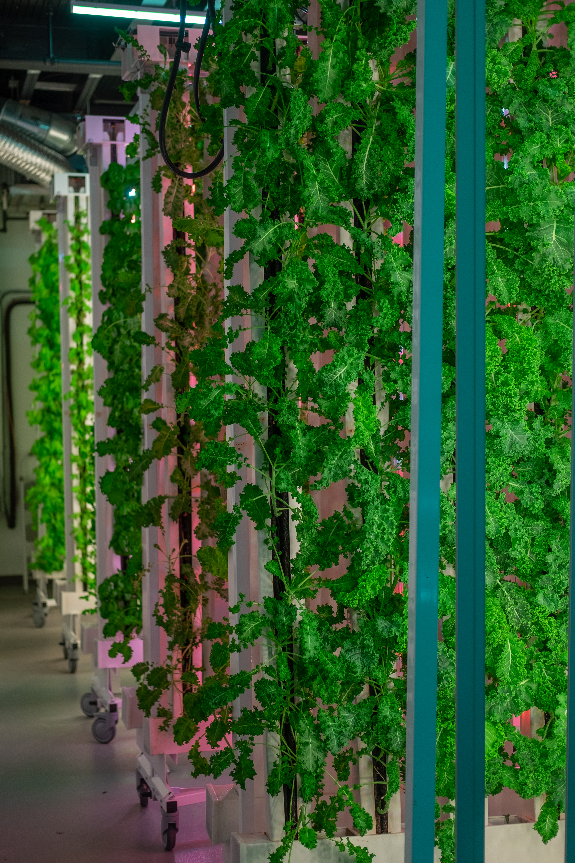
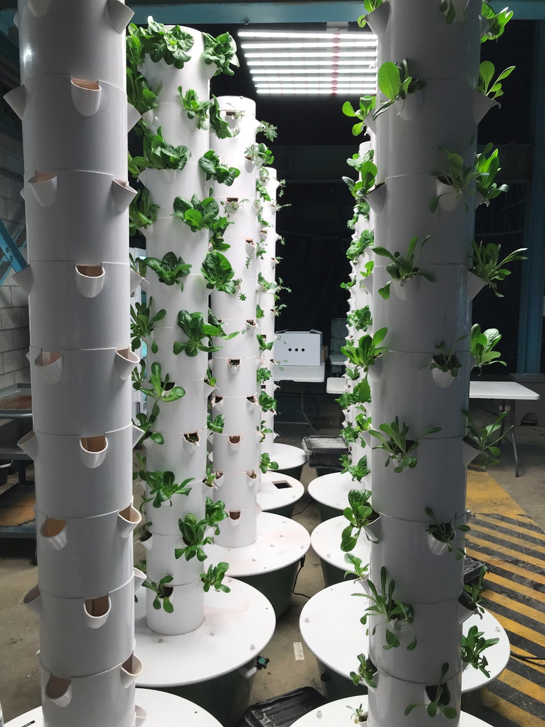
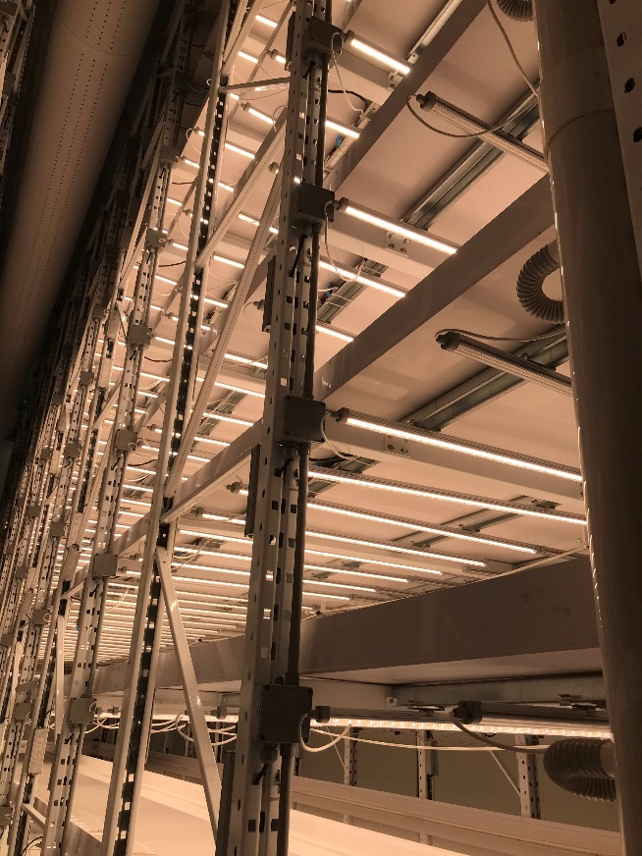
Production System
Zip Grow
Horizontal surfaces: stacked vertically on shelves to maximize production.
Vertical surfaces: in what is commonly referred to as “grow walls” or “grow towers”. These towers stretch from floor to ceiling with plants growing on the side of them.
Undulating path: where one row of lights is present at the top of the growing environment and plants are rotated up and down to alternate their exposure to light and shade.
Farmia
Vertical North

Slide 9
Production System
Growing Media | Nutrient Solution | Environment Control
Soil: organic production Soil-less: rockwool, coconut coir, peat | Hydroponics: drip irrigation, nutrient film technique Aeroponics Recirculation and sterilization/filtration (UV systems most common) | Light Heat Humidity Air movement CO₂ enrichment (not common)

Slide 10
Environment Control Systems
Sensors
Central computer systems
Autonomous growing
Hort Americas

Slide 11
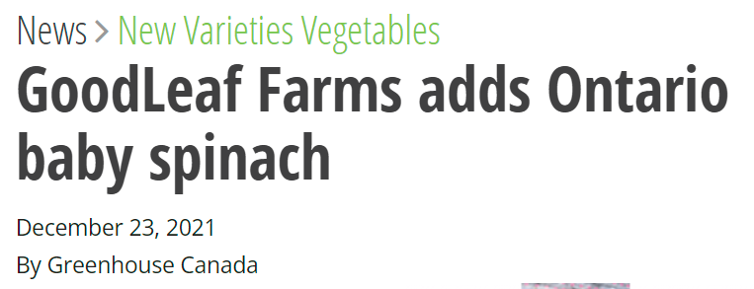
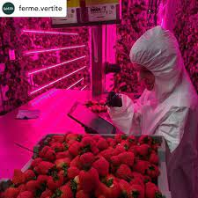
Crops
Short production cycles (1-2 months to harvest)
Most common:
leafy greens (lettuce, arugula, kale, bok choy, mustard greens, swiss chard)
herbs (oregano, mint, basil, cilantro, fennel, parsley, rosemary)
microgreens
spinach
Coming soon:
fruiting crops (strawberries, mini-vegetables)
Good Leaf

Slide 12
Recycled Nutrient Solution Schematic
dirty
leachate
tank
fresh water intake
pump
fertilizer injector
Disinfection
Element removal unit
clean leachate tank
pump
leachate collection
greenhouse leachate sump pit

Slide 13
Recirculated water DNA Scan Results from a pepper greenhouse using UV (Jan 2022, winter crop)
Fusarium
Pythium

Slide 14
Recirculated water DNA scan results from a warehouse vertical farm (grow wall) using UV (2022)
Fusarium
Pythium

Slide 15
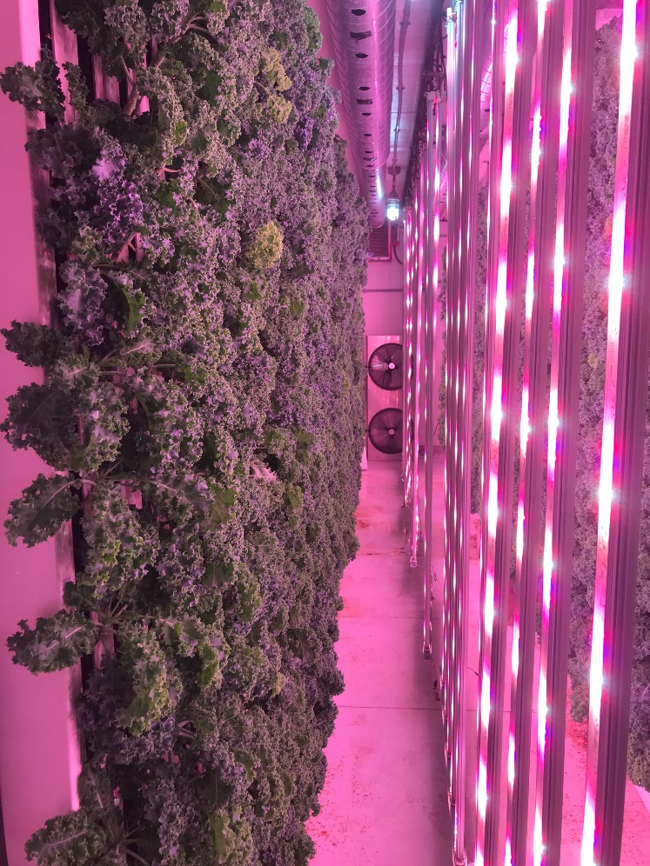
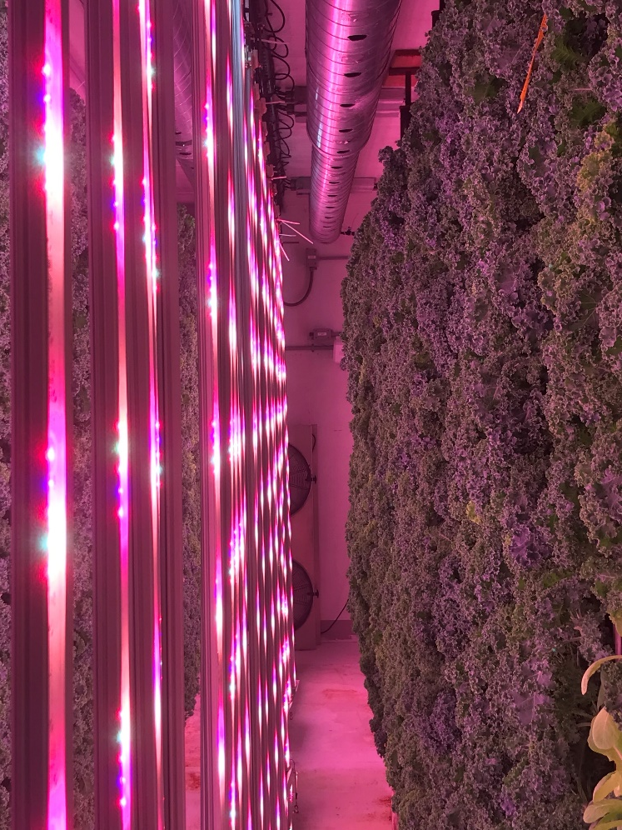
Light Quantity and Distribution in a Vertical Farm
Left Side
Right Side

Slide 16
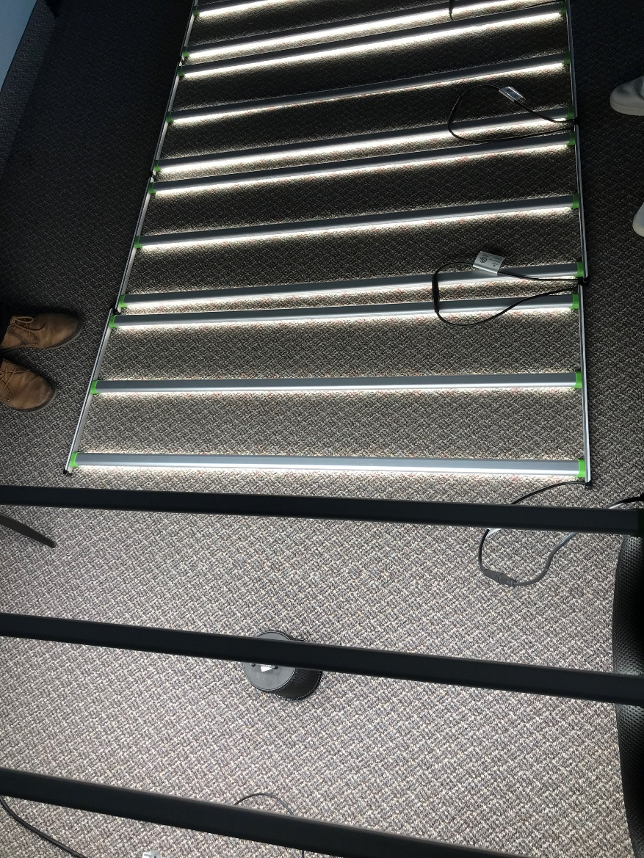
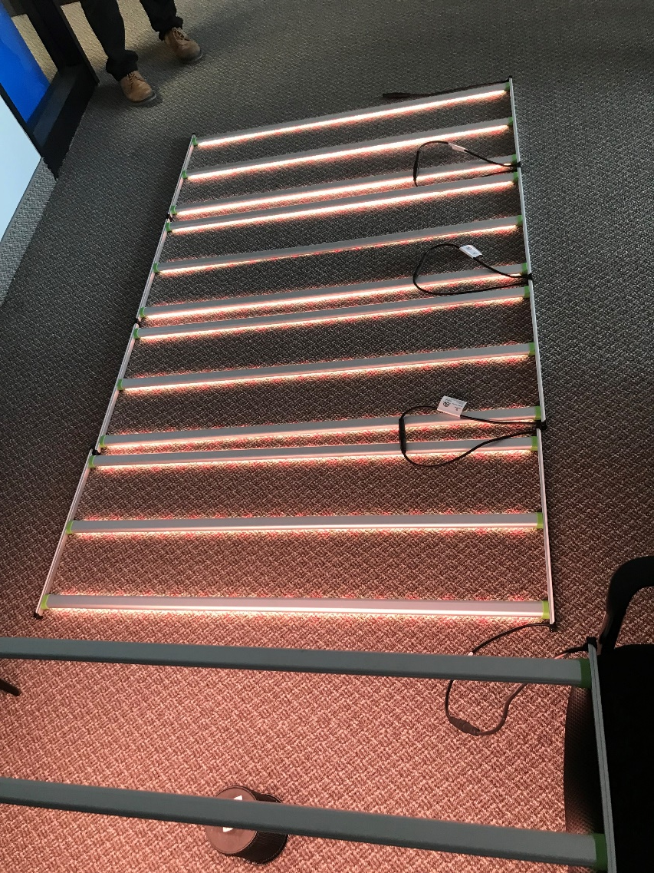
Light Quality Changes with Intensity of Some Dimmable Lights

Slide 17
Summary: Benefits and Challenges of VF
Benefits | Challenges
More controlled growing environment and potential environmental sustainability | Limited crop selection
Brownfield sites and non-prime agricultural areas may be used | Electricity and natural gas prices
Smaller land footprint, reduce land use pressure | Technical expertise to install and manage and grower inexperience
Food is produced and consumed locally | Legacy as ‘niche’
Local workforce and skilled labour | Municipal plan policies and zoning of industrial uses may be inconsistent between municipalities

Slide 18


Resources
OMAFRA’s Greenhouse Crops in Ontario website (http://omafra.gov.on.ca/english/crops/hort/greenhouse.html)
ONGreenhouseVegetables blog (https://ongreenhousevegetables.ca/)
  GrowON Webinar Series
Canadian Greenhouse Conference (https://www.canadiangreenhouseconference.com/)
Greenhouse Canada (https://www.greenhousecanada.com/)

Slide 19
Vertical Farming in Northern Ontario
Fadi Al-Daoud, PhD
Greenhouse Vegetable Specialist
Ontario Ministry of Agriculture, Food and Rural Affairs (OMAFRA)
E-mail: fadi.al-daoud@ontario.ca
Phone: (519) 551-6703
Blog: ONGreenhouseVegetables.ca
LinkedIn: https://www.linkedin.com/in/fadi-al-daoud/

