Slide 1
WIIKWEMKOONG GITIGAAN
Gardening in Wiikwemkoong
By: Christianna Jones and Jocelyn Bebamikawe

Slide 2
THE WEB OF LIFE
“Humankind has not woven the web of life. We are but one thread within it. Whatever we do to the web, we do to ourselves. All things are bound together. All things connect.”
CHIEF SEATTLE

Slide 3
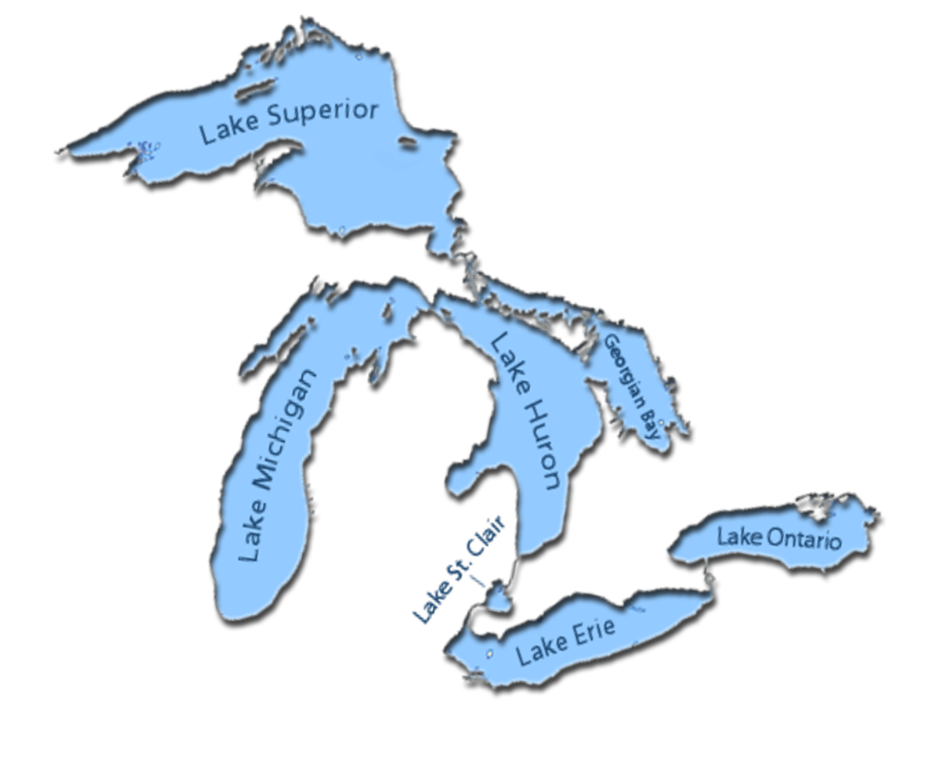
AGRICULTURE IN WIIKWEMKOONG
Agriculture and food production in Wiikwemkoong has been going on since time immemorial.
Early in the 1900's Wiikwemkoong shipped large quantities of maple sugar and syrup to markets in southern Ontario.
There are many homesteads throughout the community that were once productive working farms that provided meat and produce for community members.
Wiikwemkoong Gitigaan | Gardening in Wiikwemkoong

Slide 4
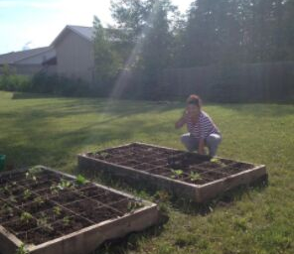
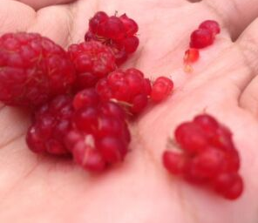
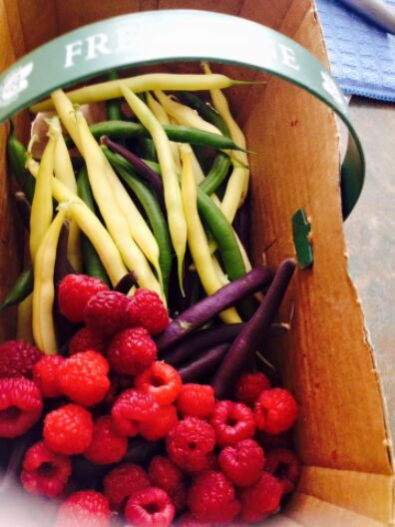
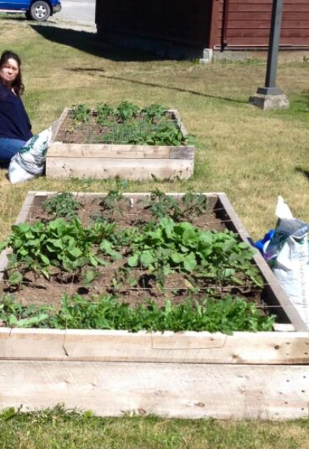
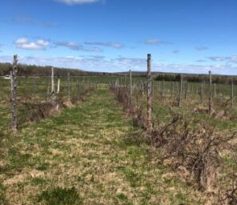
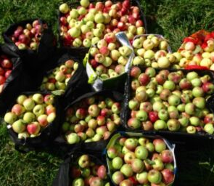
WHY WE STARTED GARDENING
PASSION FOR GARDENING
Find the thing that makes the fire within you burn; for us that's gardening and food sovereignty.
EDUCATING OTHERS
Gaining skills and confidence
Embrace a healthier, more active lifestyle
Building community and connections
SELF-SUFFICIENCY
Gain independence and the ability to adapt
Reduce food costs
Wiikwemkoong Gitigaan | Gardening in Wiikwemkoong

Slide 5
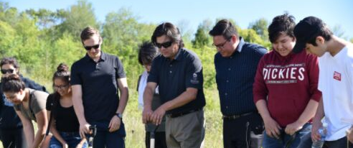
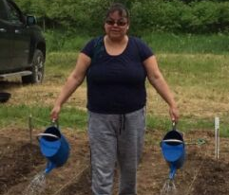
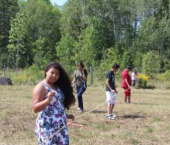
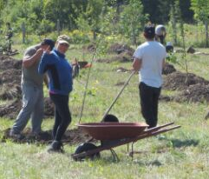
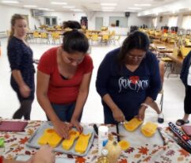
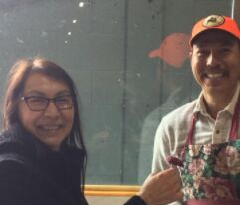
We created partnerships with:
FRIENDS & FAMILY
COLLEAGUES
COMMUNITY ORGANIZATIONS
Wiikwemkoong Gitigaan | Gardening in Wiikwemkoong

Slide 6
WHAT WE'VE DONE
2014-2017
2014
2015
2016
2017
Community Gardening Workshops started
Ontario works re-establishes raised bed gardening project
Tilling community members plots
Hosted Gardening workshops
Partnered with OW, WDC, Health Centre and Family Centre
WDC Completed Agriculture Study
Continued partnerships between organizations for raised beds and gardening workshops.
Applied to Rural Economic Development Fund for a value added apple study
Applied SNAPP for apple presses
Applied to Ontario Trillium Foundation for Foodshare Coordinator
Applied to Trees Canada for Haskap Berries
Won AVIVA Fund $50,000 to build a greenhouse at the high school
Partnership with Focus Forward for Indigenous Youth

Slide 7
WHAT WE'VE DONE
2018-BEYOND
2018
2019
2020 AND BEYOND
Community Gardening Workshops
Foodshare Community Gardens begin
Applied to Trees Canada for fruit trees
Started Greenhouse Construction
Indigenous Agricultural Gathering
Continue work on the greenhouse construction to be completed by August 2019.
Started Wiikwemkoong Gitigaan Club
Continue with garden plots and community workshops
Starting Bee Club
Revitalizing grapes, asparagus and fruit trees
Start development of a fulling functioning Market Garden
Community Farm & Food Co-op
Fruit tree revitalization project
Train community members as fruit tree arborists.
Continue bee keeping training

Slide 8
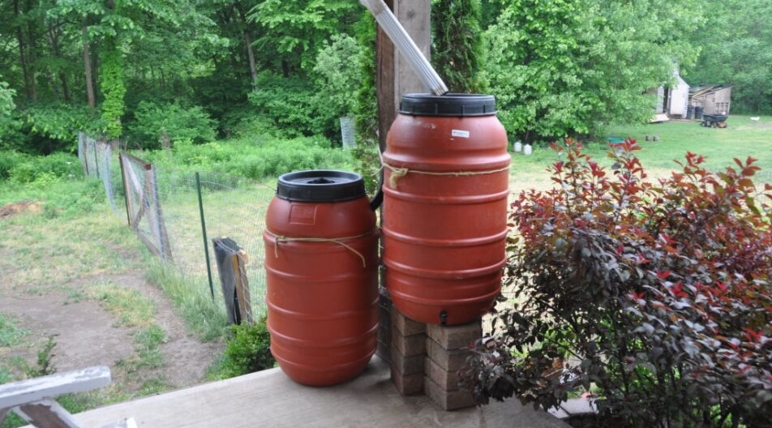
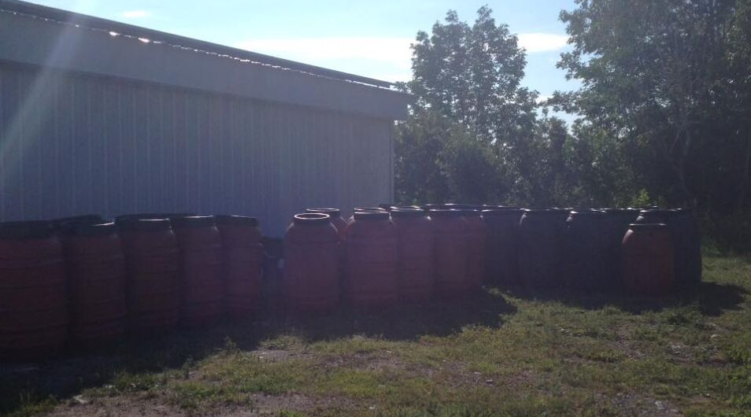
FUNDRAISING:
RAIN-BARRELS

Slide 9
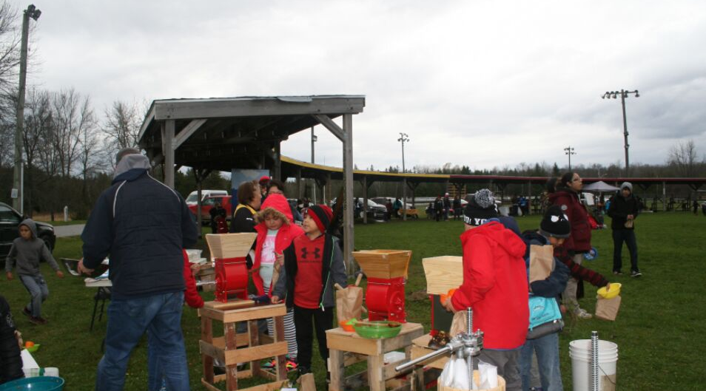
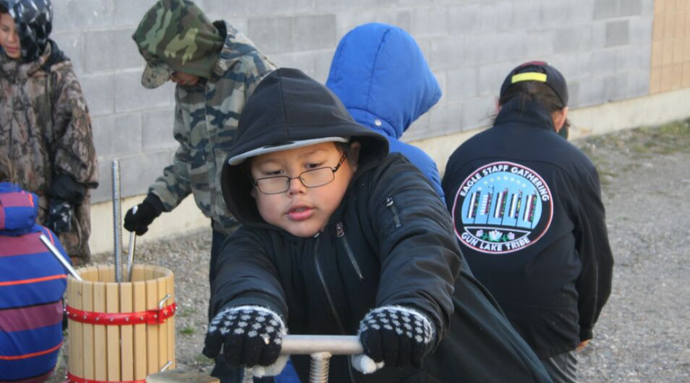
APPLE PRESSES

Slide 10
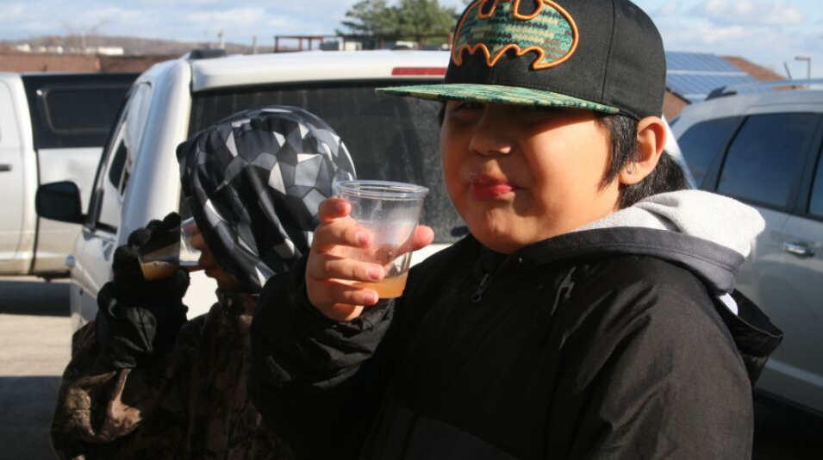
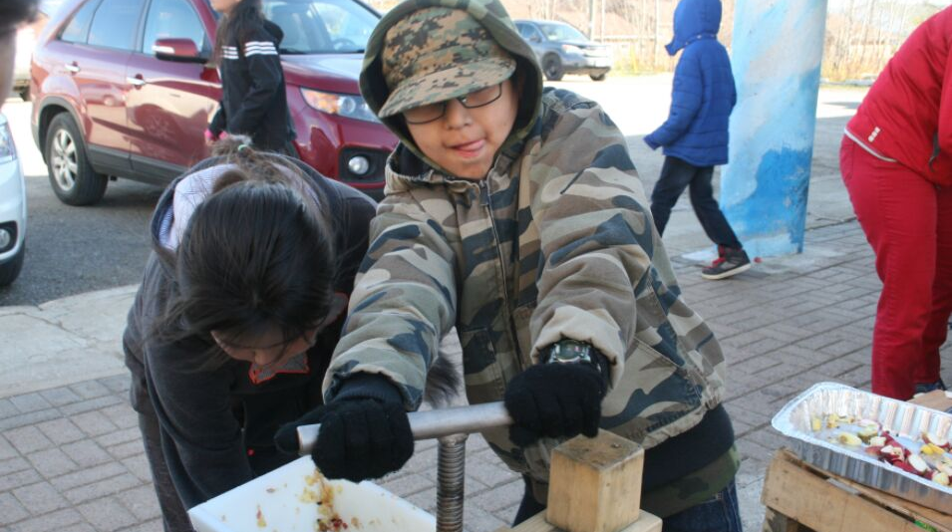

Slide 11
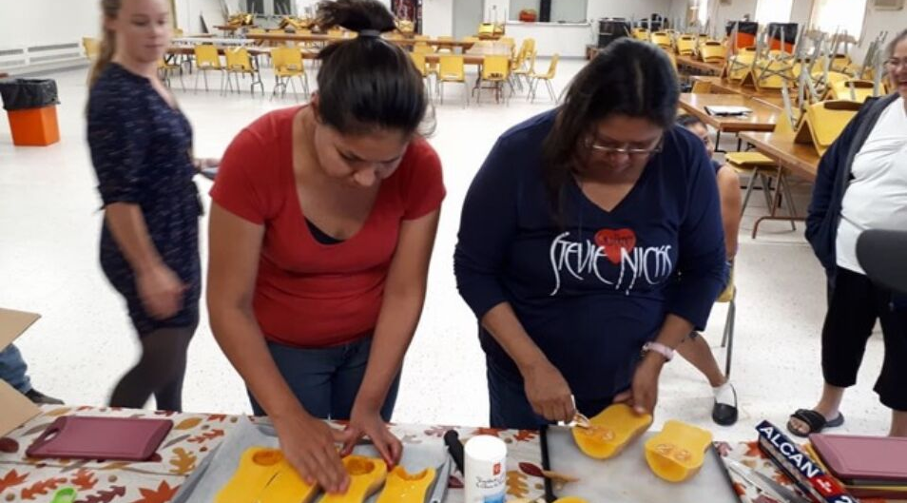
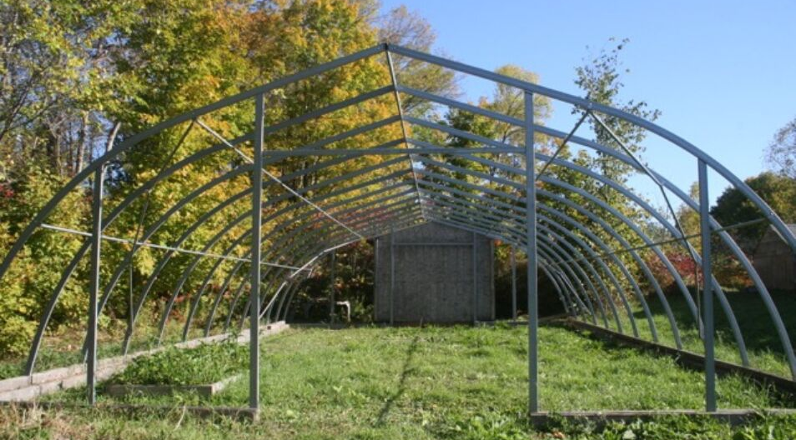
FOODSHARE
PROGRAM

Slide 12
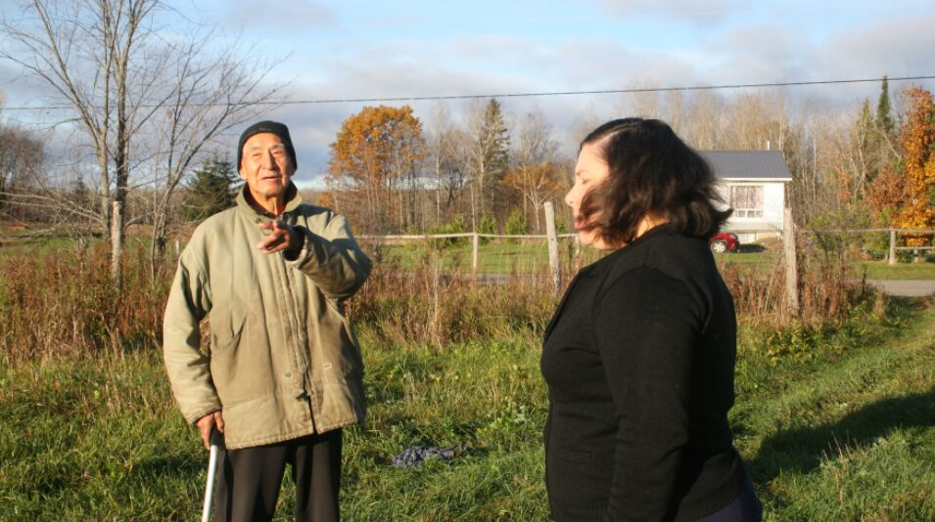
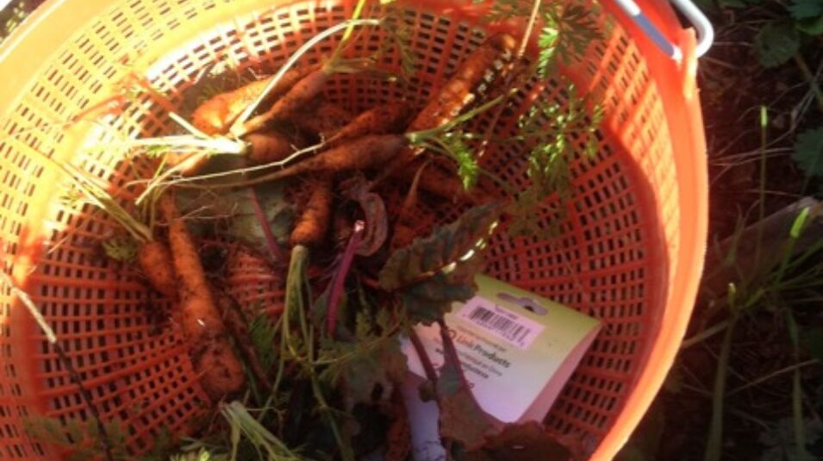

Slide 13
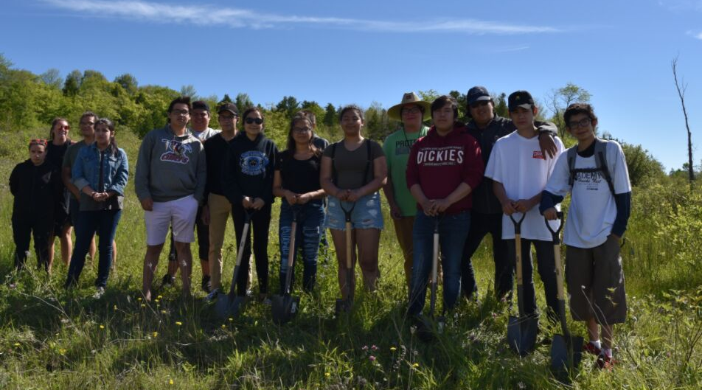
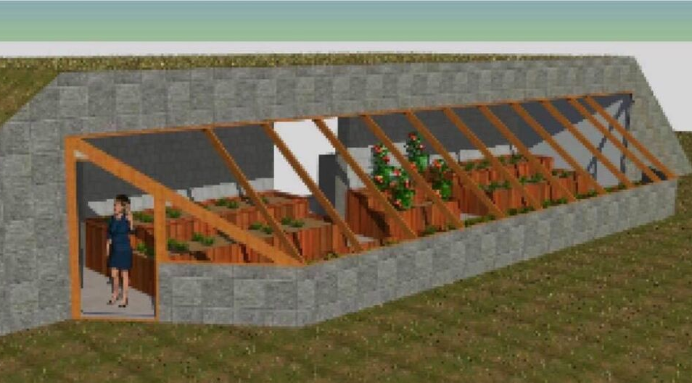
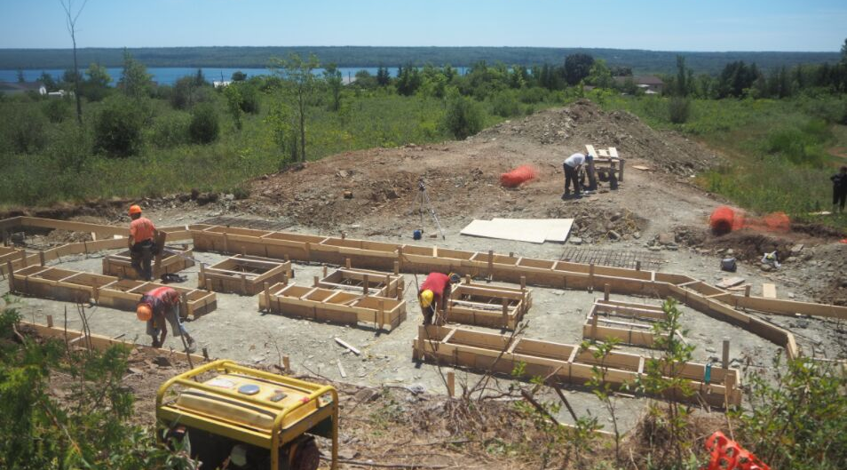
GREENHOUSE

Slide 14
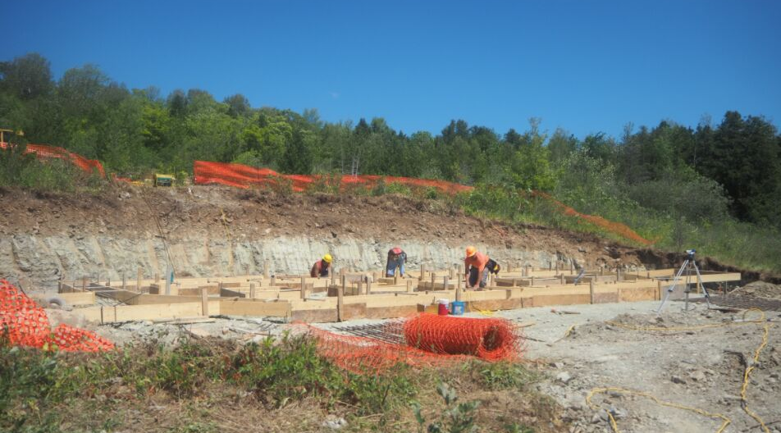
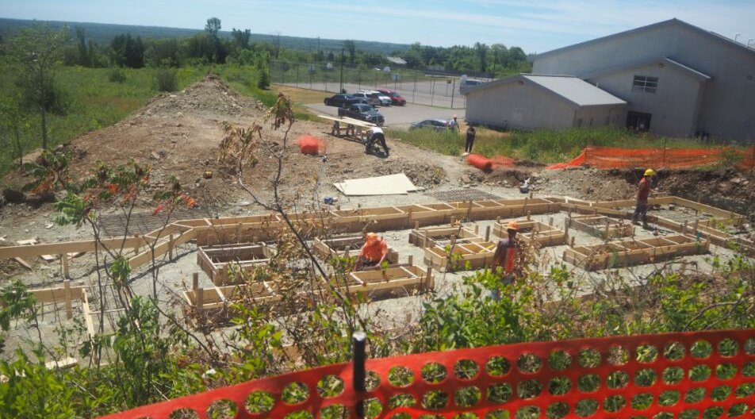
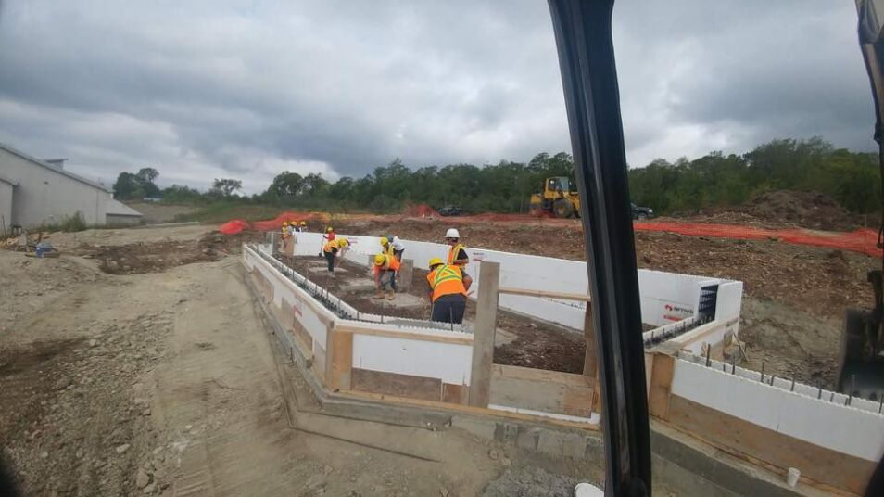

Slide 15
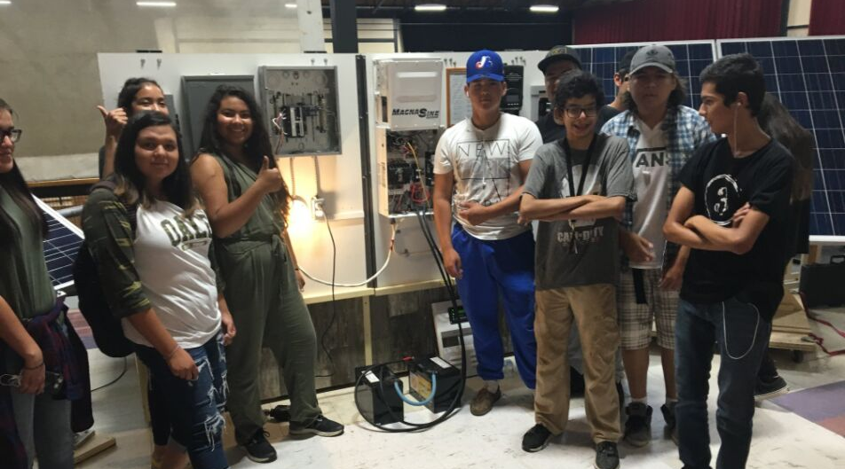
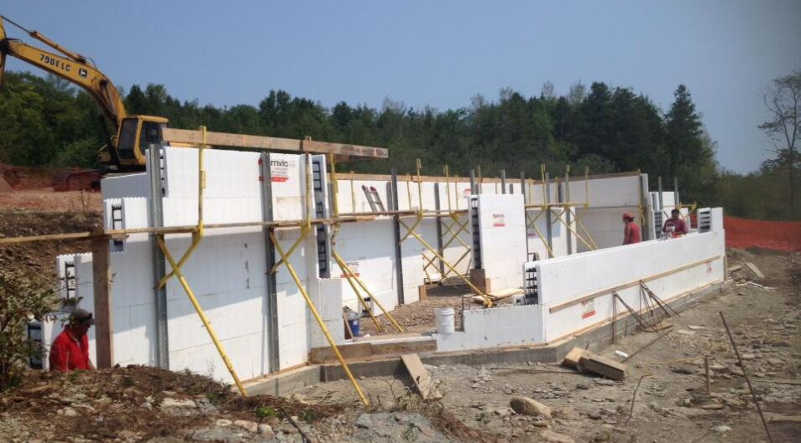
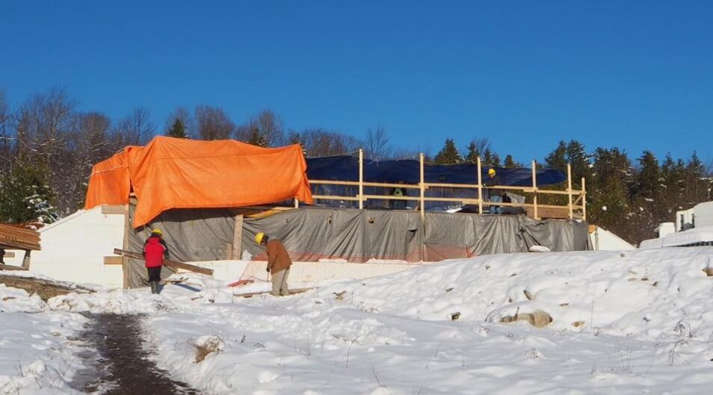

Slide 16
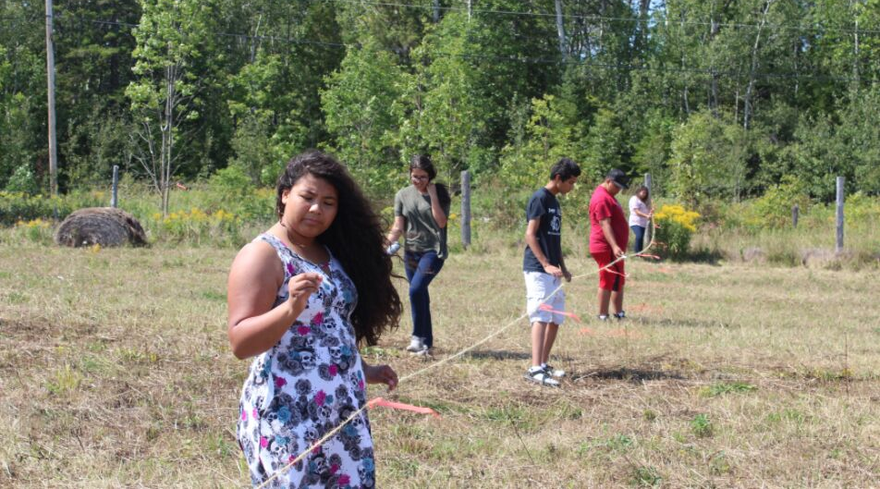
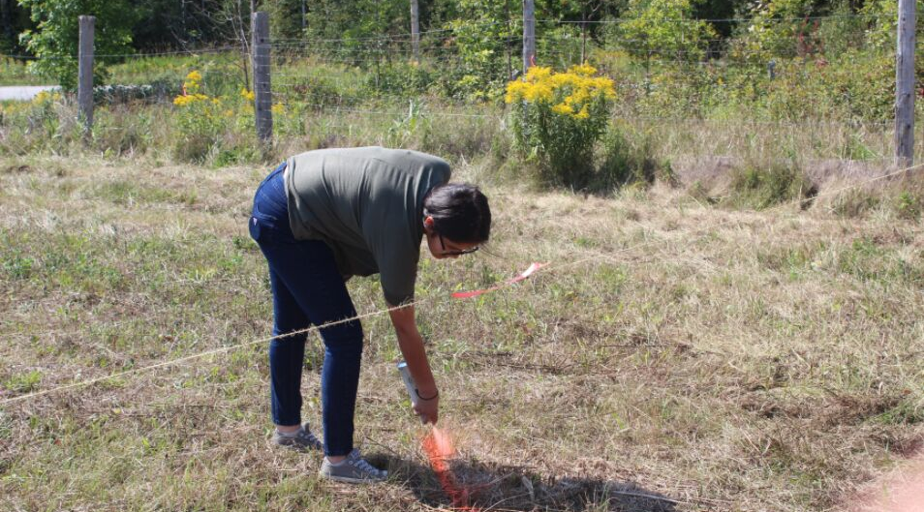
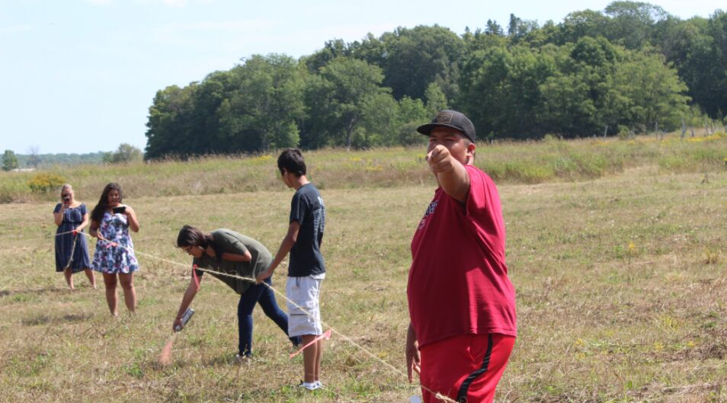
FRUIT TREES

Slide 17
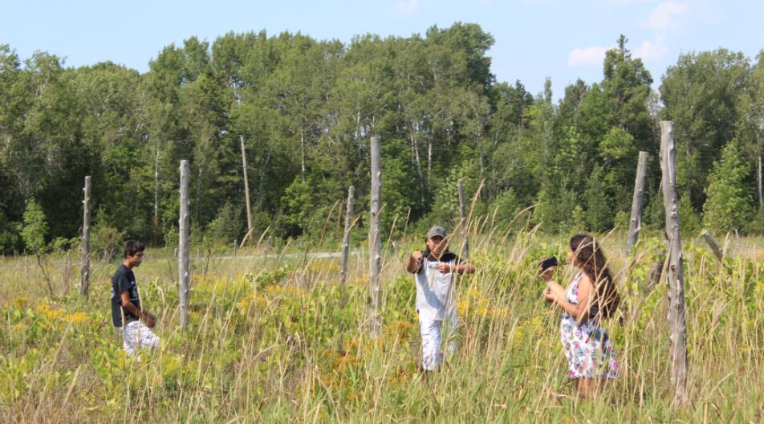
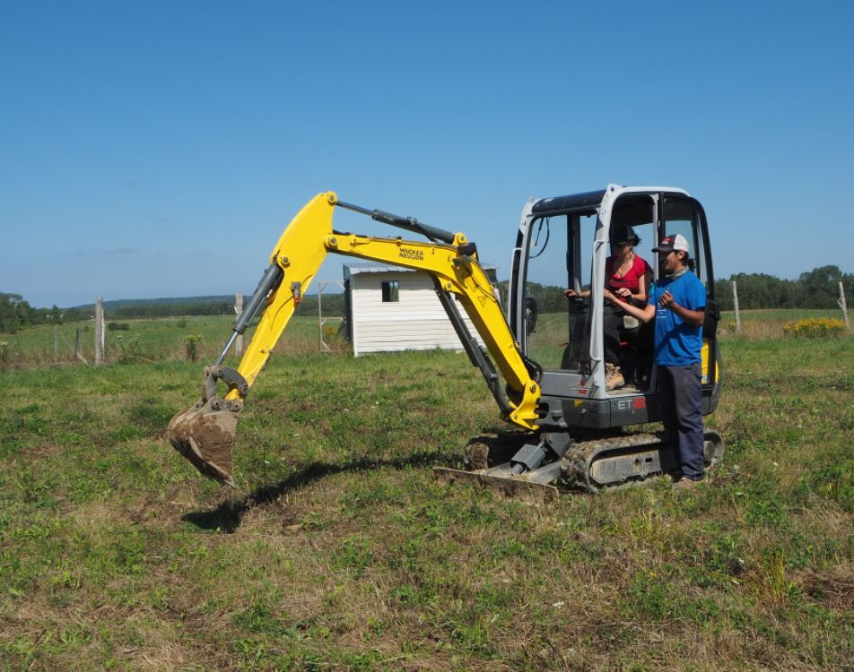
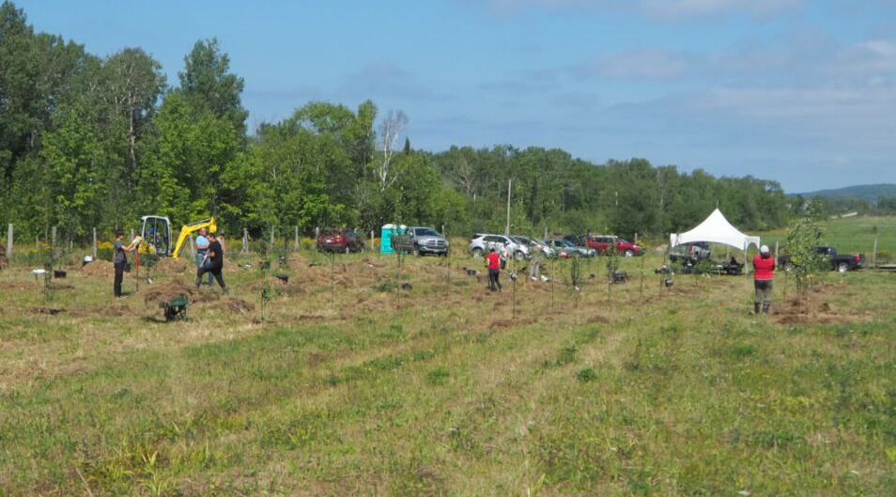
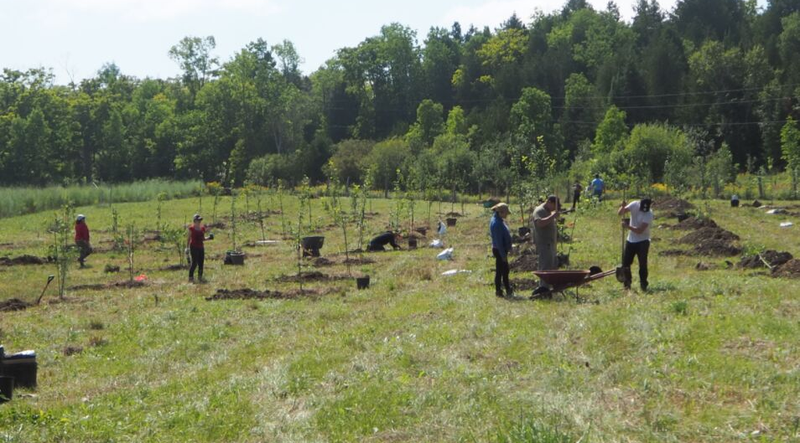

Slide 18
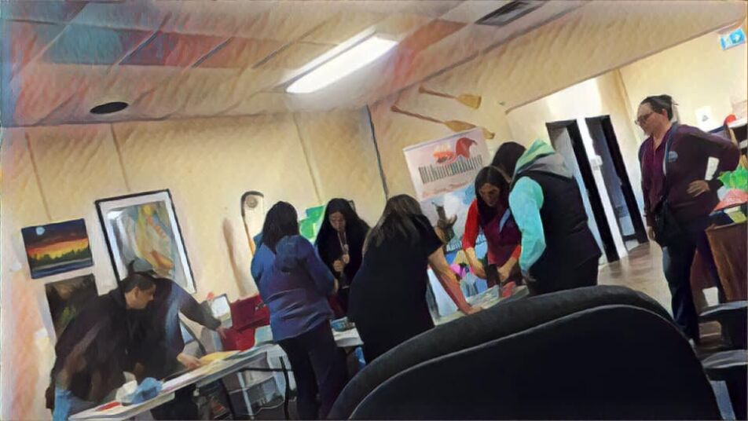
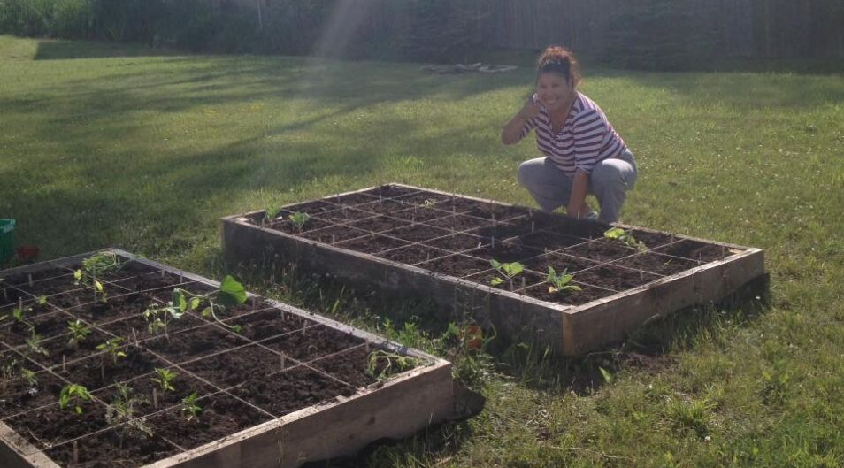
WIIKWEMKOONG GITIGAAN

Slide 19
TIPS FOR OTHERS
STARTING A COMMUNITY PROJECT
People must be passionate about the work
Need community support
Look for both internal and external partnerships
Plan your projects and how much you estimate them to cost
STARTING A COMMUNITY GARDEN
Find a central location for your gardens
In the first year plant easy crops (i.e. root crops)
Grow wants familiar to your community
Need a central person to manage gardens (if all volunteers)
OTHER THINGS WE'VE LEARNED
Expect to fundraise for your projects
Expect a lot of failure and denials
Keep moving forward

