Slide 1
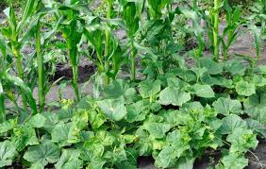
Agriculture and Food Our OMAFRA Relationship Regional Round Table Sessions May 2019 Sault Ste. Marie and Rama
Notes:
Welcome to the Agriculture and Food Roundtable. Thanks for taking the time to travel here today to join us for the second Agriculture and Food Roundtable.
Today we have George Ferreira of OMAFRA in attendance and George will be speaking to us about the programs and services offered by OMAFRA.

Slide 2
The OMAFRA/AN TPA
Establishment of a relationship in 2016
Goal: To provide OMAFRA and the Anishinabek communities with education, awareness, and technical and policy support concerning the Province’s initiatives
Includes Agriculture, Aquaculture and Food Processing
Provide opportunities for AN Communities to provide feedback on proposed policy, programs, legislation and regulations
Explore AN community involvement in education and awareness, economic development and environmental stewardship as it relates to the agri-food system
Notes:
The Anishinabek Nation initiated a relationship with OMAFRA in 2016. The Round Table sessions provide an excellent opportunity for OMAFRA and members of the Anishinabek Nation to discuss a variety of agricultural topics but their primary goal is to educate, increase awareness and make available technical and policy support to our communities with regard to the Province’s initiatives. The file includes Agriculture, Aquaculture and Food processing and we would like to focus future efforts on increasing education and awareness, economic development and environmental stewardship as it relates to the agri-food system.

Slide 3
Anishinabek Nation Regions
Notes:
Our meetings follow a Regional framework model-in that each member community attends a table corresponding to their region
Purpose is to engage with and benefit from development of agricultural and aquaculture initiatives in AN territory
Opportunity for information exchange, identification of issues of concern and development of solutions to challenges
Opportunity to meet with OMAFRA staff and exchange information and ideas

Slide 4
What is OMAFRA’s Mission?
Growing Ontario’s agri-food sector and supporting rural communities, helping to create a stronger economy for the Province.
What do AN communities have in common with these goals?
A) We eat food!
B) Many of our communities are rural in nature
C) We want to grow our economies
D) We have growing populations
So why not do agriculture?
Notes:
According to OMAFRA’s website, their mission is to grow Ontario’s agrifood sector and support rural communities which will in turn create a stronger economy for the Province.
What does the Anishinabek Nation have in common with OMAFRA? We eat food, many of our communities are rural in nature, and we have growing populations. With that there is a need to grow our economies.

Slide 5
What is OMAFRA’s Mission?
Rural Economic Development and Agriculture Economic Development
We deliver a suite of economic development and agricultural development programs, resources and tools.
We enable economic development in rural economies, agriculture and food sectors through facilitating, coordinating and delivery of appropriate advisory services, resources, programs and information to our clients.
We transfer agricultural knowledge to our clients through partnerships and coordinated tool and program delivery.
We support local farmers and businesses through marketing and promotional efforts to help consumers choose fresh food close to home (Foodland Ontario)
Corporate and Client Services
We provide call centre and regionally-based administrative services and supports to Ministry program and resources across rural Ontario.
Get agriculture, food and rural
info with ONE number
1-877-424-1300
Responding to farm, agri-business and rural business inquiries.
With experience and backgrounds in agriculture and agri-business, the centre's agents are available to answer questions, provide information to help you make decisions, and if needed, put you in touch with one of our experts.

Slide 6
OMAFRA’S INDIGENOUS ENGAGEMENT STRATEGY
Recognize that building capacity and relationships takes time;
Increase effort and capacity (resources) over time in response to government objectives and Indigenous community interests related to OMAFRA priorities;
Undertake Indigenous engagement on OMAFRA priorities;
Expand agri-food economic development (and food security) opportunities of Indigenous communities and;
Build internal knowledge and capacity.

Slide 7
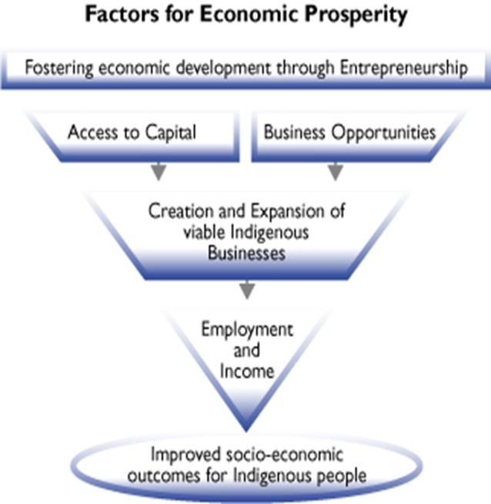
OMAFRA Indigenous Support
Many of Ontario’s Indigenous communities face food insecurity, health and economic development challenges that OMAFRA is positioned to help address:
In Northern communities lack of access to healthy food is associated with numerous health concerns.
Support for food production, processing and business development.
Support for improved marketing of Indigenous food products which are in demand.
OMAFRA has an opportunity to build on our existing, relationships, using existing services, to support the expansion of Indigenous agri-food initiatives.
Source: Indigenous and Northern Affairs Canada, 2017–18 Departmental Plan

Slide 8
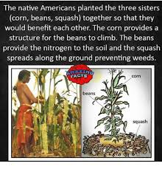
History of Indigenous Agriculture
The science or practice of farming, including the cultivation of the soil for growing of crops and the rearing of animals to provide food, wool and other products.
The history of Anishinabek culture includes farming.
Notes:
Historically indigenous people survived by hunting, fishing gathering and growing their own food. People also used plants for medicine. When I have spoken to elders from communities their way of life was to gather blueberries, tap maple trees, gather cranberries and also to grow food. Many people had gardens and grew all the food required to feed their families. But when people got put onto reserves they could no longer access areas that they traditionally used.
The elders told me they used to pick blueberries and trade them for lard, flour and tea. With the European introduction came the five whites: white sugar, white flour, salt, milk and lard. These were not the traditional foods of the Anishinabek. They caused illness. The foods from nature were gotten away from. The foods that acted as medicines were gotten away from. People did less and less gathering, hunting and cultivating.

Slide 9
Video: History of Indigenous Farming

Slide 10
It all goes back to the lands where we farm…
Land tenure of farming
Traditional farming-was done on treaty land, traditional lands
Existing farming is done on reserve lands and on private lands (in treaty and traditional territories)
Existing aquaculture is done on the beds of rivers and lakes which First Nations have never given up the rights to, the Great Lakes being an example
Where can we farm? Where should we farm?
Notes:
Barrier Number 1: The elder Gordon Waindubence told us at the last meeting in North Bay-farmlands were taken away and we were put on reserves where land suitability for farming may be limiting.
This is one barrier to farming. But this should not stop us. Lands that are marginal for farming can be improved and not all types of farming require Class 1 Agricultural Lands.
The second is those living on reserves may not have enough wealth to buy private lands. Farming does not currently take place on Crown lands with the exception of cage aquaculture taking place in the Great Lakes.
This is one barrier OMAFRA should be aware of.

Slide 11
OMAFRA Initiatives
OMAFRA Local Food Approach
Pollinator Health Action Plan
Canadian Agricultural Partnership (CAP)
Environmental Farm Plan
Indigenous Agriculture and Food Systems Initiative
CAP for Organizations and Collaborations
Other Federal Funding Programs
Notes:
This slide provides a bit of an overview of the various OMAFRA initiatives that we are going to talk more about here today.

Slide 12
OMAFRA’s Local Food Approach
Access. Availability. Awareness.
The Local Food Act (2013) supports colleges, universities, hospitals and municipalities to procure local food.
Support Local Food Hubs (aggregators) to connect local food businesses to potential new markets
Encouraging the buying and consumption of local foods to create jobs and economic growth.
Notes:
Food Land Ontario is a consumer promotion program to support consumption of fresh Ontario produce and processed agricultural foods. Promotion of great taste, nutrition and economic benefit of buying Ontario food to grocery shoppers.

Slide 13
Agriculture Development Branch
Agriculture Development Branch (ADB) houses OMAFRA’s technical specialists, advisory and support services located across Ontario that assist the ministry in meeting its economic development, protection, assurance and stewardship commitments.
The Branch has 6 units along two business areas:
Crops: Field Crops; Greenhouse, Agroforestry and Specialty Crops; Horticulture Crops; Horticulture Technology
Livestock: Beef Cattle, Sheep, Goats, Alternative Livestock and Aquaculture; Dairy Cattle, Swine and Poultry

Slide 14
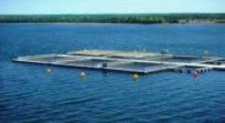
OMAFRA’s Resources
Ontario Aquaculture Production
• Rainbow Trout production - 5,530 metric tonnes (mt).
• Other Species (tilapia, arctic charr) production - 370 mt.
• Total farm gate value $34.0 million.
• Economic contribution - $110 million.
• Robust environmental oversight of industry.
Open Water Net Pens
• 85% of total trout production (4,700 mt).
• 12 net pen farms, 7 are Indigenous operations.
• 2 years of environmental investigation and a 3rd year for a decision on whether an Aquaculture License will be
granted by MNRF.
Land Based
• 1200 mt of land-based aquaculture production.
830 mt trout (includes fingerlings), most of rest is tilapia.
• 205 land-based Aquaculture Licenses.
Notes:
Food Land Ontario is a consumer promotion program to support consumption of fresh Ontario produce and processed agricultural foods. Promotion of great taste, nutrition and economic benefit of buying Ontario food to grocery shoppers.

Slide 15
OMAFRA’s Resources

Slide 16
Video: Aquaculture

Slide 17
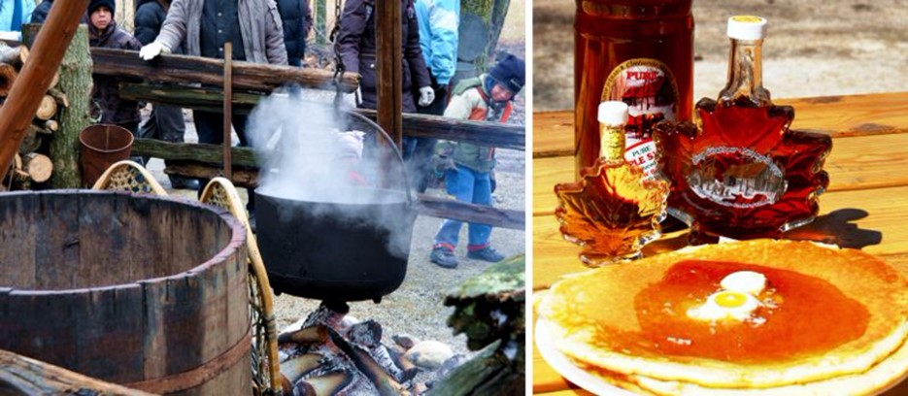
OMAFRA’s Resources
Maple Syrup
OMAFRA prepares and disseminates educational material for producers regarding requirements legislated by Regulation 119/11 of the Food Safety and Quality Act, 2001 which includes labeling, grade standards and adulteration.
Production information is supplied by the Ontario Maple Syrup Producers Association including:
A list of maple equipment suppliers
Buyers of bulk maple syrup
Wholesalers of maple syrup
The Promotion Store
How to become an OMSPA member

Slide 18
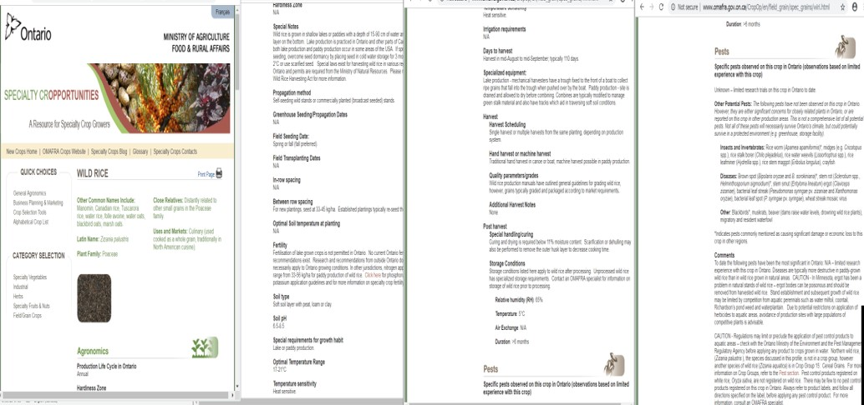
OMAFRA’s Resources
Wild Rice

Slide 19
OMAFRA’s Resources
Honey
Apiculture Table of Contents
Regulation of the Beekeeping Industry
Infosheets
Reports
Resources & Services
Online Registration Renewals - Ask OMAFRA Portal
The Ontario Bees Act is the legislation that regulates beekeeping in Ontario. Its main purpose is to protect the health of honey bees, particularly from pests and diseases. The act requires that anyone who owns or is in possession of honey bees to register with the Apiary Inspection Program.
The Ontario Ministry of Agriculture, Food and Rural Affairs (OMAFRA) Apiary Program conducts field inspections for the presence of honey bee diseases and pests, provides advisory and issues permits to beekeepers.

Slide 20
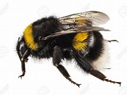
Pollinator Health Action Plan-3 Measures
Apiary Inspection Program-Ontario Bees Act regulates honey bees and beekeeping in Ontario
This regulation protects honeybees from pests and diseases. Apiaries must register with Apiary Inspection Program.
Bee Mortality Insurance Program-Production Insurance-protects Ontario producers from colony losses during overwinter. Requires that you have a minimum of 50 colonies that overwinter in Ontario
Coverage is through Agricorp
Notes:
Inspector will come and inspect your hives. Would like to identify any existing AN bee farmers. Already know 1 .where are there more?

Slide 21
OMAFRA’s Resources
Specialty Crops
Agroforestry (Maple, Christmas Trees, Tree Nuts)
Apiculture
Ginseng
Greenhouse Crops
Hemp
Herbs
Hops
Nursery and Landscape
Specialty Cropportunities - A resource for specialty crop growers
Tobacco
Turf
On-Farm Food Safety
Hemp in Ontario
Infosheets and Factsheets
Growing Industrial Hemp (Order No. 00-067)
Growing Non-traditional Crops in Ontario (Order No. 09-043W)
Minor Use Program
Newsletter Articles for Weed Management in Hemp
Newsletter Article Index for Weed Management: Application Technology
Newsletter Article Index for Weed Management: Weed Biology
Newsletter Article Index for Weed Management: Other Information
Using Pesticides in Ontario
Industrial Hemp Regulations
Frequently Asked Questions about Hemp and Canada's Hemp Industry
Resources and Services
Crop Advisory Staff
Crop and Pest Updates
Subscribe to OMAFRA Podcasts
Laboratories for Leaf Analysis
Accredited Soil Testing Labs
Pesticide Application and Safety
Sources of Crop Inputs
Crops Updates
Sound Advice - Audio Crop Updates
Crop and Pest Updates
Subscribe to OMAFRA Podcasts

Slide 22
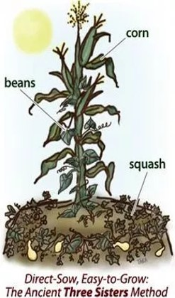
OMAFRA’s Resources
Organics
Organic farming is a method of crop and livestock production that involves much more than choosing not to use pesticides, fertilizers, genetically modified organisms, antibiotics and growth hormones. The general principles of organic production include:
protect the environment, minimize soil degradation and erosion, decrease pollution, optimize biological productivity and promote a sound state of health
maintain long-term soil fertility by optimizing conditions for biological activity within the soil
maintain biological diversity within the system
recycle materials and resources to the greatest extent possible within the enterprise
provide attentive care that promotes the health and meets the behavioural needs of livestock
prepare organic products, emphasizing careful processing, and handling methods in order to maintain the organic integrity and vital qualities of the products at all stages of production
rely on renewable resources in locally organized agricultural systems

Slide 23
OMAFRA’s Resources
Community Gardens
Urban agriculture refers to food production in urban areas, whether it is for personal consumption, commercial sale, education or therapy. It can take a variety of forms, including:
Gardening and livestock raised in backyards
Container gardening on balconies or rooftops
Community gardening and city allotments
Ideal resource for small scale food security projects or introduction to agriculture.
an Agriculture
Finding Space
Container Gardening
Community Gardening
Rooftop Gardening
Soil Quality
Composting
Growing Vegetables
Growing Herbs
Growing Fruit
Raising Livestock and Poultry
Fish
Honey Bees
Poultry
Rabbits
Organic Production
Dealing with Wildlife
Selling Your Products
Relevant Legislation and Regulations

Slide 24
Video: Fort Hope Farm

Slide 25
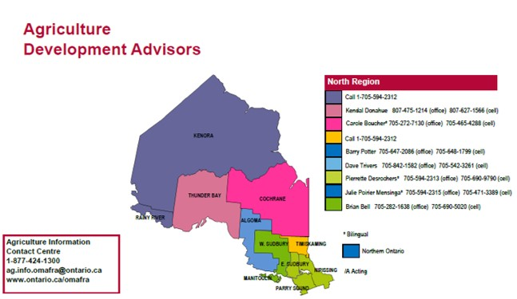
OMAFRA’s Resources

Slide 26
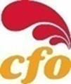
Artisanal Chicken
Enabling Small, Independent, Locally-Based Family Fars
600 to 3,000 birds per annum without quota
Application and target-market based
The program is application based and applicants have to describe their business plan including discrete local markets and business partners.
They can sell off-farm (programs are in place to ensure food safety, animal care and biosecurity) to reduce risks

Slide 27
Landscape of Indigenous Agri-Food Supports
Indigenous Farmers, Food Businesses, Organizations & Communities
Funding
Financing
Tech Transfer
Business Training & Intelligence
NODP
EODF
IEDF
FedNor
NOHFC
BCFP
IAO
IAFSI
AAFC
EDGP
CAP
Trillium
RPGP
RED
CORDA
IAPO
BDB
IAPO
CFDC
AgScape
REDB
AAFC
Banks
Credit
Unions
OMAFRA
ADB
Ontario
ADB
EMB
Federal
REDB
(North)
4H /MGO
U of G
Other
Notes:
AAFC: The objective of the Indigenous Agriculture and Food Systems Initiative (IAFSI)is to increase economic development opportunities of Indigenous Peoples and communities in Canada. This initiative will support Indigenous communities and entrepreneurs who are ready to launch agriculture and food systems projects and others who want to build their capacity to participate in the Canadian agriculture and agri-food sector.
IAO
The Indigenous Economic Development Fund (IEDF): $10 million
The Business and Community Fund Program (BCFP)
The Economic Diversification Grant Program (EDGP)
The Regional Partnership Grant Program (RPGP)
FedNor
Northern Ontario Development Program (NODP)
The Eastern Ontario Development Fund gives money to businesses, municipalities and not-for-profit organizations for economic development in eastern Ontario. The fund supports projects that: create jobs, encourage innovation, collaboration and cluster development and attract private sector investment

Slide 28
Canadian Agricultural Partnership: Businesses
A 5-Year Federal/Provincial/territorial initiative to increase competitiveness, prosperity and sustainability of agriculture and agri-food products sector.
Key Outcomes: Economic Development, Environmental Stewardship, Protection & Assurance
Administered by the Ontario Soil and Crop Improvement Association
Who can Apply: Any established farm business (New Producers, Producers, Processors and Other Businesses
The program is a cost-share program so some of your own cash is required to start the business.
Examples of funded activities include financial analysis, business plans and marketing plans.

Slide 29
CAP: Organizations and Collaborations
The Agricultural Adaptation Council administers the CAP program to organizations and collaborations.
Only not for profit organizations are eligible to apply as the lead applicant.
A collaboration is a combination of two or more legally recognized entities in agriculture and/or agri-food products located in Ontario.
Collaboration members can include businesses and academic/research institutions.
Cost share funding covers between 50 and 75% of projects.
In kind contributions are eligible and can include paid positions, unpaid volunteers, equipment and materials as well as use of land and facilities.

Slide 30
What is an Environmental Farm Plan
Completion of an Environmental Farm Plan (EFP) is mandatory for many of the cost-share programs under CAP. The plan is an assessment prepared by farm families to increase environmental awareness in up to 23 different areas of your farm. Through the EFP areas of environmental concern are identified and realistic action plans are developed to improve environmental conditions. The ERP can then be used in conjunction with the cost share programs to begin implementation of the action plans. You can prepare your plan through an in person 2-day workshop put on by the Ontario Soil and Crop Improvement Association. Some topics examined as part of an EFP include:
Soil type and potential for surface and groundwater contamination
Your Well
Storage of chemicals and fertilizers
Farm waste management and manure storage
Disposal of livestock mortalities
Waste and energy efficiency
Wetlands and floodplains
Woodland and wildlife

Slide 31
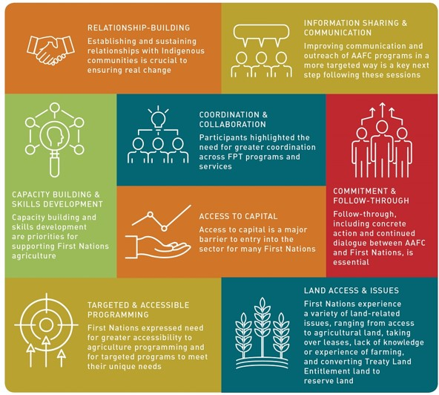
Indigenous Agriculture and Food Systems Initiative
A five year 8.5 million initiative to support Indigenous communities and entrepreneurs ready to launch agriculture and food systems projects and build capacity in the agriculture and agri-food sector. (Agriculture & Agrifood Canada)
Supports efforts to produce fresh, healthy food in and for Indigenous communities including food systems development.
Provides opportunity to share agricultural knowledge and marketing expertise.
Provides skills training to help an Indigenous community or organization establish or scale up an agricultural operation.
Eligible applicants include: Indigenous communities, businesses, not-for-profits, community organizations, associations, co-operatives and institutions, partnerships and joint ventures.

Slide 32
Indigenous Agriculture and Food Systems Initiative
Maximum funding: $500,000 per project, per year
Cost sharing: AAFC may fund up to 90%
Eligible costs include administration, salaries and benefits, capital assets and costs related to the planning and design of infrastructure, contracted services, travel and other direct project costs
Two Streams:
Community readiness and pre-development support activities
Supporting Indigenous agriculture and food systems projects

Slide 33
Indigenous Economic Development Fund
95 million over 10 years (Program of Jobs and Prosperity Fund)
A) Business and Community Fund-grants and loans to ensure viable business initiatives proceed
B) Economic Diversification Grant-supports planning for promising economic opportunities
C) Regional Partnership Grant-supports projects focused on improving access to business financing and skills training
More information on each funding opportunity has been requested.

Slide 34
Indian Agricultural Program of Ontario
Farming and business financing
Farm advisory services
Aboriginal start-up and expansion (up to $200,000 in financing and 20,000 in grants) Aboriginal Economic Development Fund
Beginning farmer program (16-40 years of age)
-workshops and training
-start-up financing

Slide 35
Landscape of Indigenous Agri-Food Supports

Slide 36
APPENDICES

Slide 37
Pollinator Health Action Plan
New Neonicotinoid regulation for growers of corn and soybeans (began in July of 2015)
Provincial government is responsible for classifying pesticides and regulating use/sale/transportation/storage/disposal.
Treated seeds are those coated with a pesticide.
New Class of pesticides-Class 12 for corn and soybeans treated with neonicotinoid insecticides
Intent is to ensure farmers only use this seed when there is a demonstrated pest problem and if they have taken a course in Integrated Pest Management and if they have completed a Pest assessment report
Notes:
A Neonictinoid is an agricultural insecticide similar to nicotine. Studies have shown a link between neonictinoids and bee mortalities in the intense corn growing regions of Canada during planting of corn and soybeans. Neonictinoids are toxic to invertebrates.
Over the past few years there have been increasing reports of high overwintering losses and challenges in maintaining bee colony health both in Canada and abroad (Health Canada). Varroa mites and honeybee viruses may also impact on bee health. Bees can die from long harsh winters and a combination of factors. The intent of the new regulation is to limit the use of neonictinoids to situations where they are warranted due to pest infestation.

