Slide 1

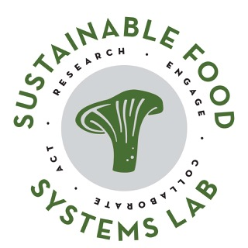

By, For, With Indigenous People,
Communities & Organizations
Jessica Mclaughlin
Indigenous Food Circle Coordinator
indigenouscircle@lakeheadu.ca
Dr. Charles Levkoe
Canada Research Chair
in Sustainable Food Systems
clevkoe@lakeheadu.ca
Notes:
Indigenous Food Circle was created as a response to a lack of engagement with the Indigenous population throughout the creation of the Food Strategy.
A coalition of 22 indigenous led and serving organizations
Aims to better understand and promote Indigenous perspectives and experiences around food.
the Circle uses food as a tool for reconciliation and resurgence by creating the space to reclaim and weave Indigenous knowledges into the Thunder Bay and region’s food systems.
to develop the capacity of Indigenous peoples to articulate and respond to relevant challenges and opportunities and to improve programming and policy

Slide 2

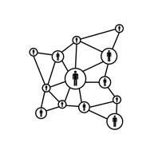




Indigenous Food Circle
Key Priorities
Develop a regional, intergenerational networks to support connections through food systems
Improve Indigenous food security
Support Indigenous food sovereignty
Support the resurgence of Indigenous food networks across the region
Establish meaningful relationship with settlers through food

Slide 3

Indigenous Food Circle Members
Education
Northern Nishnawbe Education Council
Shkoday Abinojiiwak Obimiwedoon
Keewaytinook Okimakanik
Matawa KKETS
Denis Franklin Cromarty
Lakehead University Food Council
Lakehead University
Confederation College
Social Service
Shelter House
Thunder Bay Indigenous Friendship Centre
Northwestern Ontario Women’s Centre
Regional Food Distribution
Thunder Bay and Area Food Strategy
Eco Superior
Health
Anisnawbe Mushkiki
Ka-Na-Chi-Hih
Wequedong Lodge
Thunder Bay District Health Unit
Thunder Bay Regional Health Sciences Centre
Political
Nishnawbe Aski Nation
Anishnabek Nation
Ontario Native Woman’s Association
Fort William First Nation
Metis Nation of Ontario

Slide 4
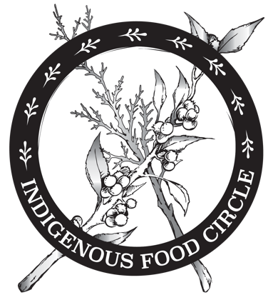
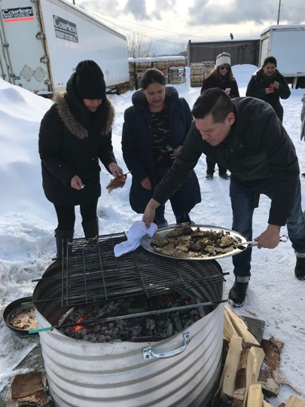
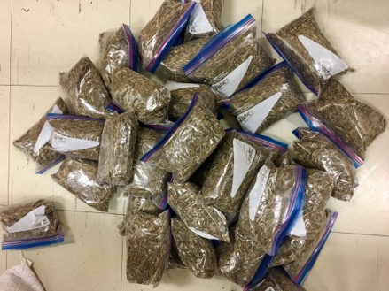
Food Sovereignty is the right of peoples to healthy and culturally appropriate food produced through ecologically sound and sustainable methods, and their right to define their own food and agriculture systems.
~ La Via Campesina
Notes:
Evolved as a critical reaction to the experiences of peasant farmers and indigenous peoples
Food Sovereignty is the right of peoples to healthy and culturally appropriate food produced through ecologically sound and sustainable methods, and their right to define their own food and agriculture systems.
Indigenous FS is premised on the idea that all parts of Indigenous food systems are inseparable and ideally function in healthy interdependent relationships that transfer energy through indigenous ecosystems and economies.
Indigenous food sovereignty activists stress the importance of decolonization, self-determination and the inclusion of fishing, hunting and gathering as key elements of a food sovereignty approach to sustainable food systems in Canada, and highlight the complexity of issues of sovereignty, authority, individual and collective rights, equity, culture and (re)distribution of land and other resources
Challenges present day industrial agriculture-based economy, which has been developed and industrialized by settlers through the process of colonization.
both what our food system should achieve and the process which we should achieve it
immediate needs such as food insecurity and diet related disease can be addressed in the short term, while working to empower communities to lead deeper food system transformation over the long term
highlights the need for those that produce, harvest and eat food to have decision making power – people not corporations or settler governments
puts control of productive resources (land, water, seeds, natural resources) in the hands of people
builds on traditional knowledge and uses research to support and pass this knowledge to future generations
fundamentally challenges power, inequality and the logic of settler-colonialism that takes power away from Indigenous people and First Nations

Slide 5
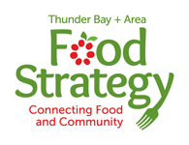







The Thunder Bay and Area Food Strategy is committed to creating a healthy, equitable, and sustainable food system that contributes to the economic, ecological, and social well-being and health of the city of Thunder Bay and Area.
Notes:
The beginning... Why the work started happening...

Slide 6
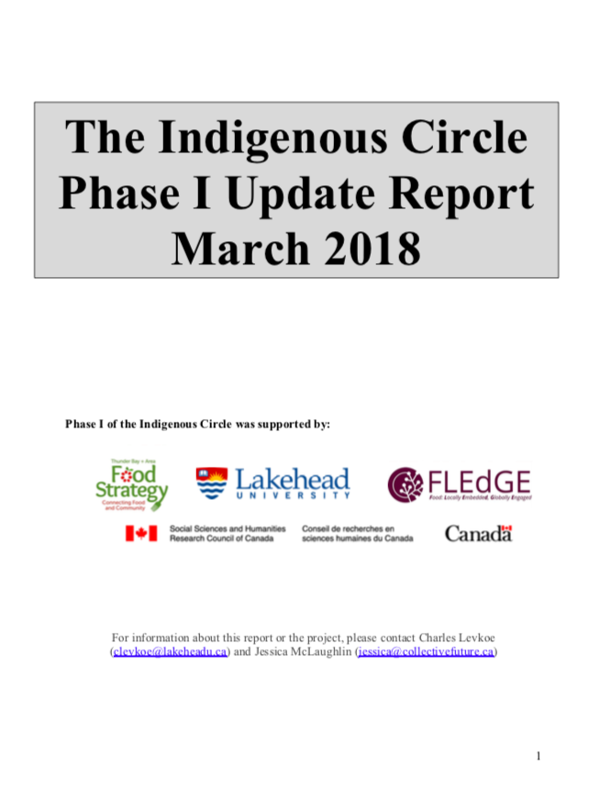
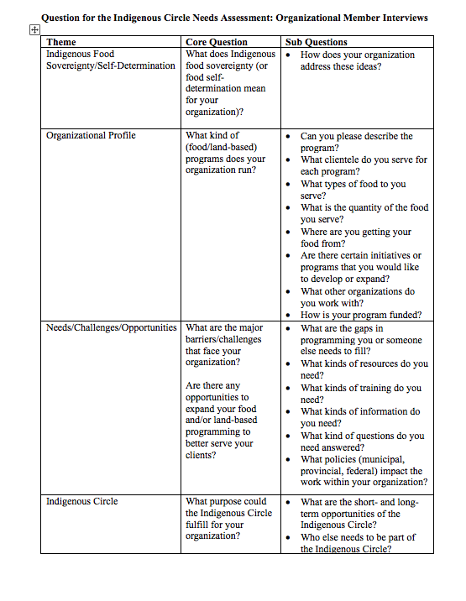

Notes:
The progression!! It would be nice to have a time line slide at some point

Slide 7

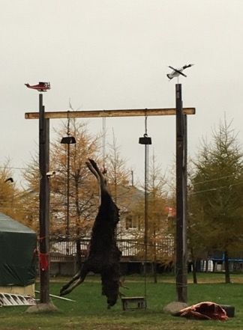
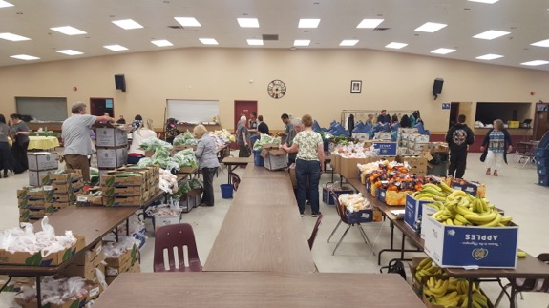
Indigenous Food Circle
Needs Assessment Themes
Activities
Ecosuperior & NAN toolkit
LU collaborations on research
Good Food Box
Cultural spaces
IFC Value
Funding support
Advocacy
Network support (in the region and beyond)
Information and Training (research, education, workshops)
Keep focus on broader vision of Food Sovereignty
Liaison between Indigenous and settler organizations
Needs and Barriers
Wild game/traditional food access
Cultural sensitivity training (anti-oppression)
Sustainable Funding (capacity)
Infrastructure (kitchen, outdoor space)
Training (preserving, preparing, gardening)
Information/research
Elders and knowledge keepers
Networks and collaborations
Notes:
What we just accomplished …

Slide 8
Regional Intergenerational Collaboration and Networking
Knowledge & Sharing
Traditional Teachings
Food Soveringty and Self Determination
Food Access & Advocacy
Barriers to accessing wild game
Understanding barriers in the food system
Cultural Safe Space
Physical Cultural Space in the City of TBAY (public spaces)
Training and Settler Awareness
Tools and Resources
Sustainability of the Land
Anti-opression work
Dismantling racism within food system
Promotion of Indingenous/Non-Indigenous knowledge sharing
Navigation strategies to overcoming food insecurity
Organizational collaberation on barriers
Data base of people, places, histories of food in area
Promotion of Indigneous Food Knowledge
Notes:
The mtg on the 13th …
I want to talk about how we are formulating this process…how we are building the capacity of the org… the orgs… themselves and of peoples knowledge of food sov and security in the tbay and region… slow and steady…
And speak to the actions of each group…

Slide 9
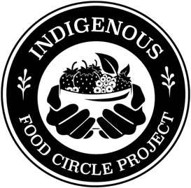
Indigenous Food Circle Projects
Notes:
This is where we talk about how the IFC can do quality consulting work from a really informed way...

Slide 10
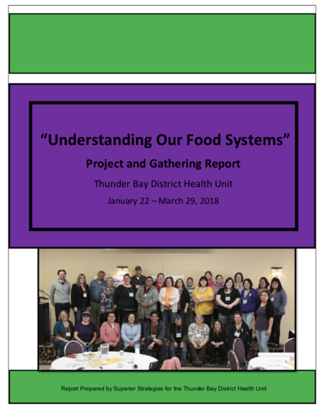


Understanding Our Food Systems Phase I
(Dec-March 2018)

Slide 11
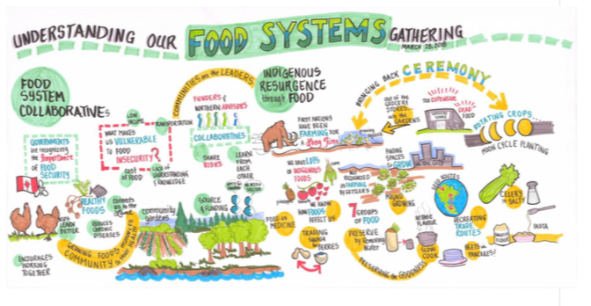
Understanding Our Food Systems - Phase I

Slide 12
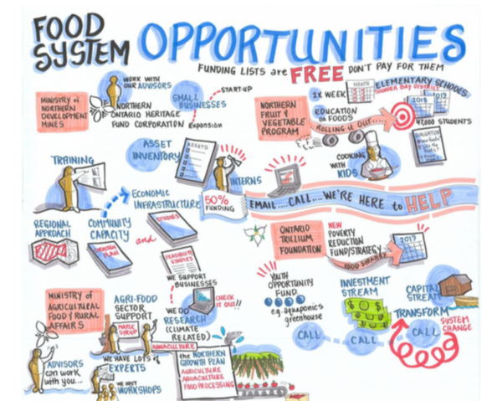
Understanding Our Food Systems - Phase I

Slide 13
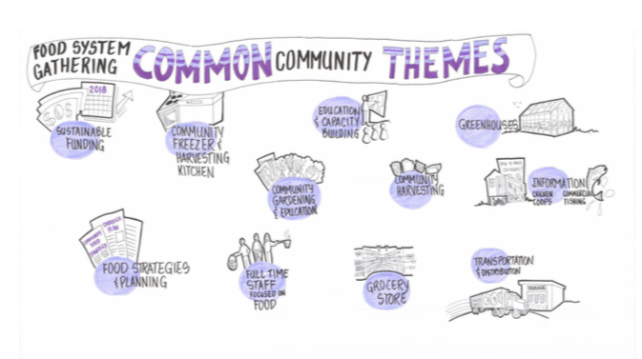
Understanding Our Food Systems - Phase I

Slide 14
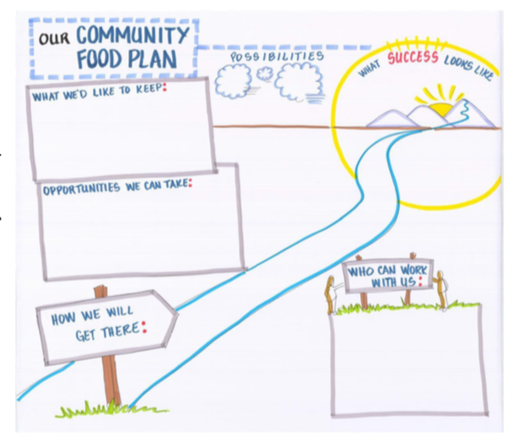
Understanding Our Food Systems - Phase I
Community Food Planning begins…

Slide 15

Understanding Our Food Systems - Phase II
(Sept-March 2019)

Slide 16
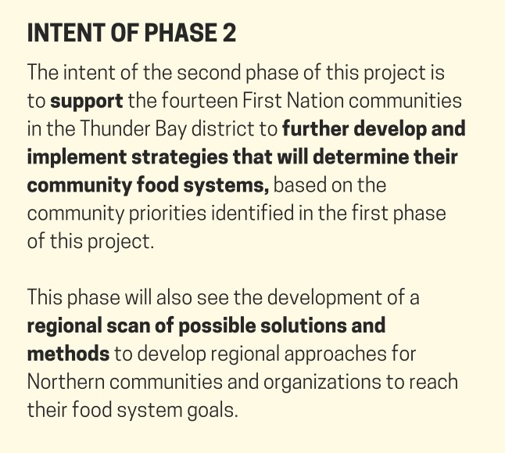
Understanding Our Food
Systems
- Phase II

Slide 17
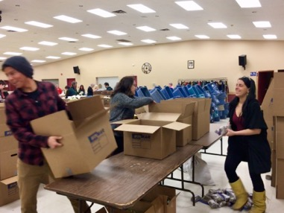
Community Visits (Findings)
Understanding Our Food Systems
- Phase II
Community Food Hub
Retrofitting/Infrastructure
Programming
Workshops
Food Storage
Community Store
Business Plan
Regional Food Sourcing
Cooperative Model
Food Production
Gardens
Greenhouses
Community Engagement
Food-Security
Good Food Box
Food Bank
Local Food Connection
Distribution & Transportation
Food Literacy Workshops
Community Nutrition
Cooking from Scratch
Using Food Production
Land-Based Initiatives
Wild Game Restrictions
Land Based Gatherings
Traditional Harvesting Skills
Environmental
Waste & Composting
Recycling
Management of Fisheries, Aerial Spraying, Moose

Slide 18
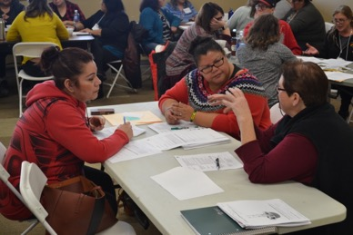
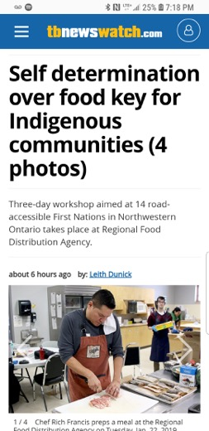

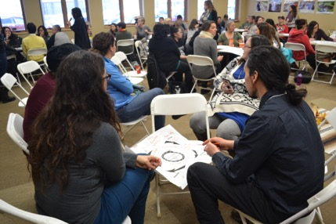
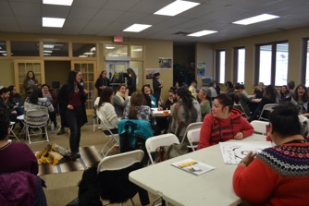
January Gathering
Understanding Our Food Systems
- Phase II
https://vimeo.com/327324485/613d8471ca
https://vimeo.com/327324793/f96669283d

Slide 19
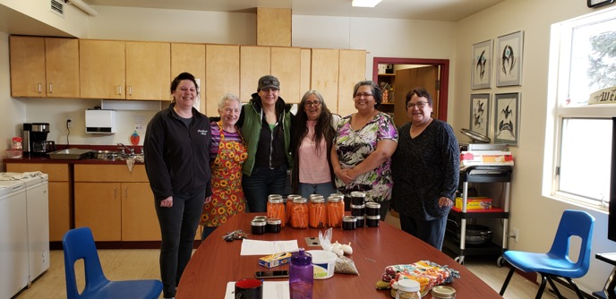
Understanding Our Food Systems
- Phase II
Approach
Engagement – Working for, and taking leadership from First Nations
Support – Identifying and providing knowledge and skills activities
Connection – Building and fostering relationships
Action/Knowledge Co-creation –Sharing experiences to develop new activities
Systems Lens – Contextualizing food systems work within larger political and socio-economic structures of oppression and colonization

Slide 20
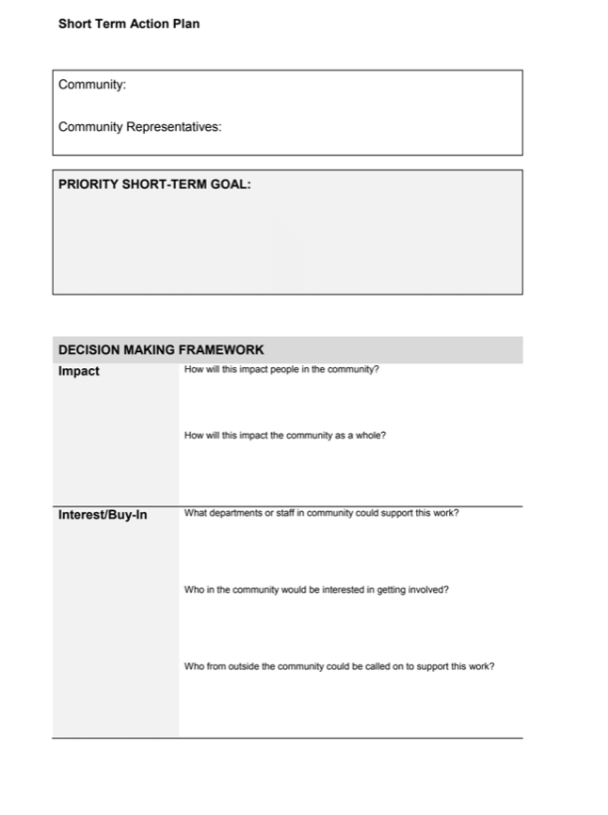
Understanding Our Food Systems - Phase II
Short Term Action Planning
Notes:
From community visits, continued support and conversations communities had identified priorities and initiatives (seen a few slides back) we asked for them to categorize them into short, medium and long term goals.
We utilized the time at the gathering to assist in planning their short term goal ($ to support) and of course the staff capacity and time to help implement. We invented with the help of Dr. Lana Ray (Flying Post First Nation/Red Rock Indian Band) the action planning template and the decision making framework tool to help communities prioritize and we supported them in which ever way we could while allowing them to take the initative to drive projects themselves.

Slide 21
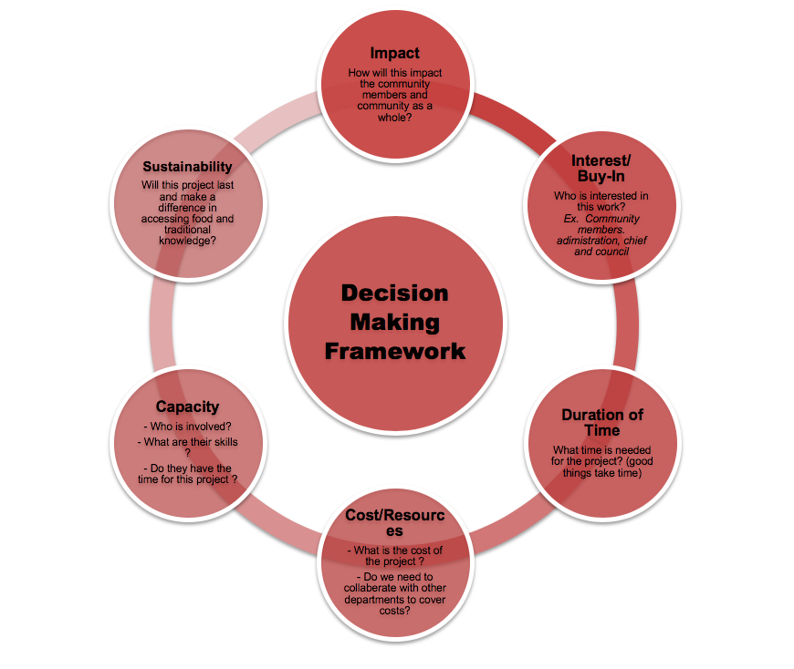
Understanding Our Food Systems
- Phase II

Slide 22
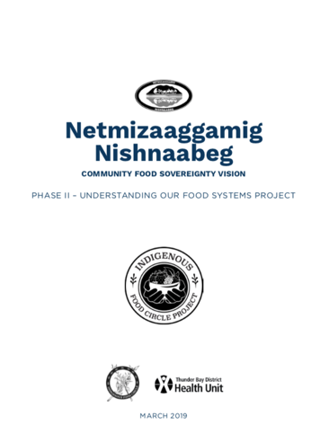
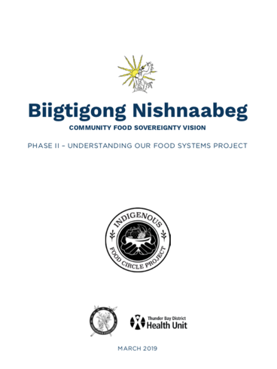
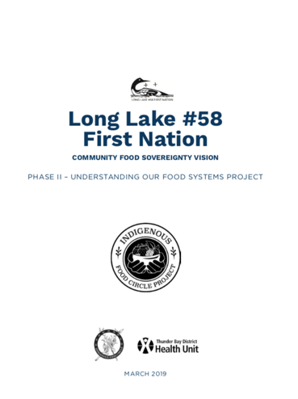
Community Food
Sovereignty Visions
Understanding Our Food Systems
- Phase II
Notes:
The overall approach to Phase II of the Understanding Our Food System project was a participatory, community-engaged, action-focused methodology that involved putting the fourteen First Nations at the centre of the project. We did this through the development of community food sovereignty visions.
(notes* why we did not call them plans)

Slide 23



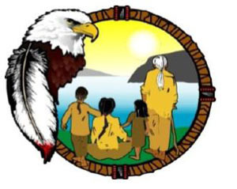




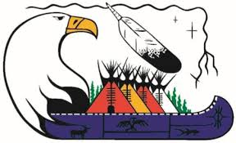





Actions in Communities

Slide 24
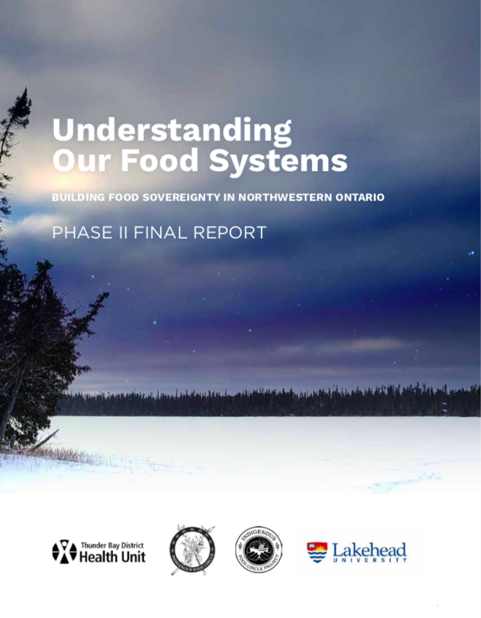

Slide 25

Next Steps . . .
Control of all research and projects by, for, and with Indigenous People, Communities & Organizations in the North
Establishment of a funding collaborative
Expand partnerships and collaborations
Develop new collaborative projects
Respond to organizational and community needs
Research on key issues
Support organizations and communities in their sovereignty visions

Slide 26
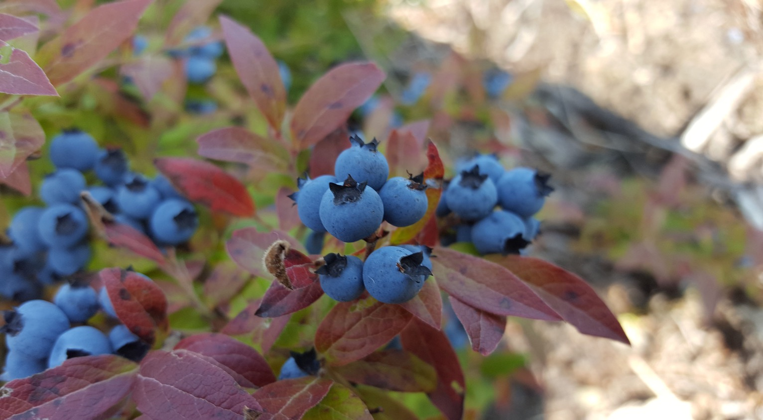
Chi Miigwech

