Slide 1
Aquaculture Opportunities in Ontario
Anishinabek Nation
Lake Huron Region Round Table
May 23, 2019
steve.naylor@dfo-mpo.gc.ca

Slide 2
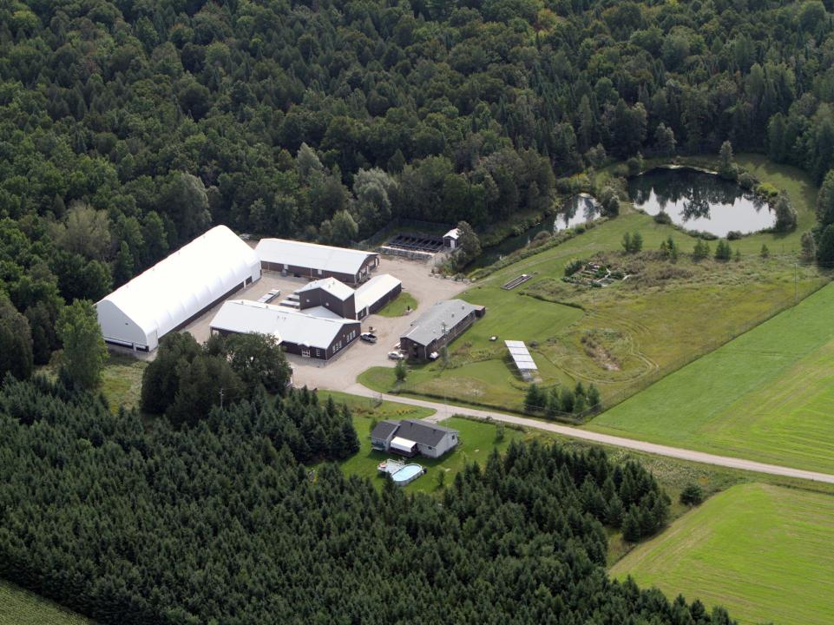
Alma Aquaculture Research Station
Getting Started in Aquaculture and Aquaponics – full day workshop, 4 times a year.
Next Workshop - June 6 (full)
marciach@uoguelph.ca
FN workshops – Nick Huber, nhuber@waubetek.com

Slide 3
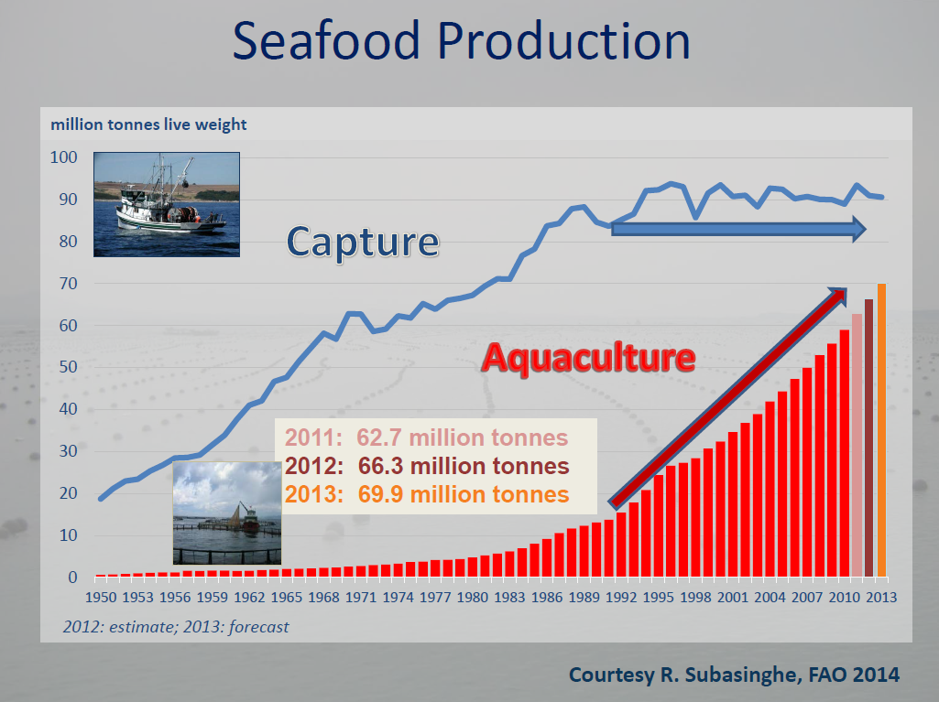

Slide 4

Why Aquaculture ?
Demand for seafood exceeds fisheries capacity
Represents a sustainable and healthy source of food
Provides a means to rehabilitate wild populations
10 years from now aquaculture will need to increase by 50% to supply the growing demand for seafood. There is no possibility to increase wild capture fisheries worldwide.

Slide 5
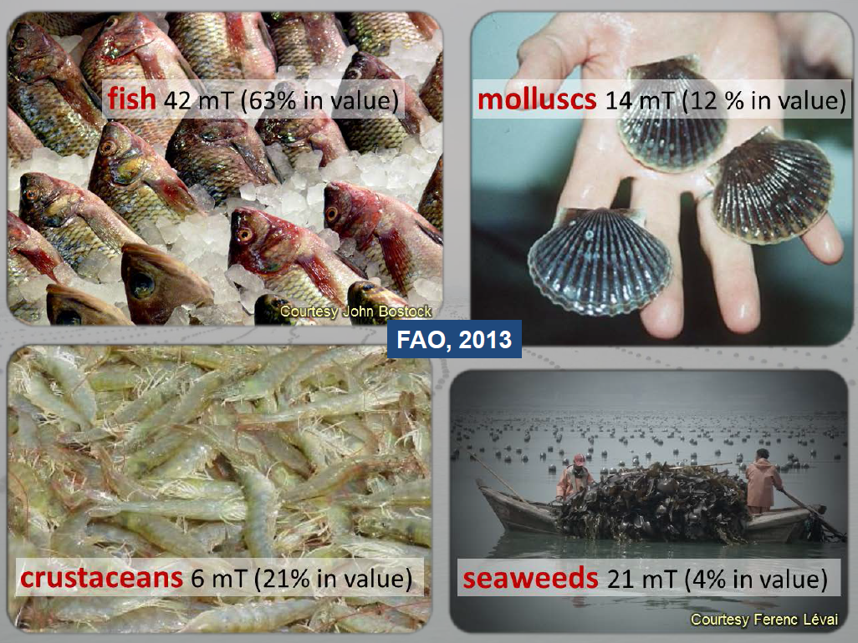

Slide 6


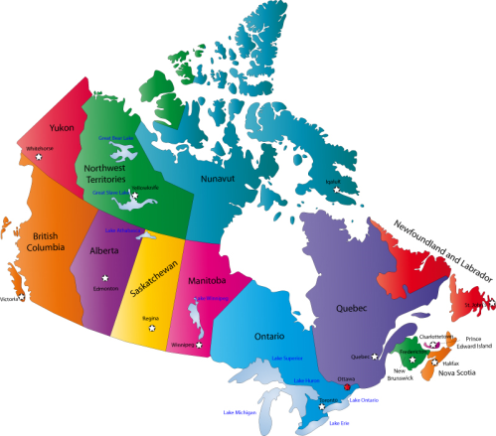


Regional Distribution of Aquaculture
Salmon (72%)
Salmon (76%)
Trout (4%)
Mussels (14%)
Oysters (6%)

Slide 7
Canadian Aquaculture
(farm-gate)
Tonnes
Value
Data taken from Statistics Canada.
Excludes production in Manitoba, Saskatchewan, and Alberta.

Slide 8
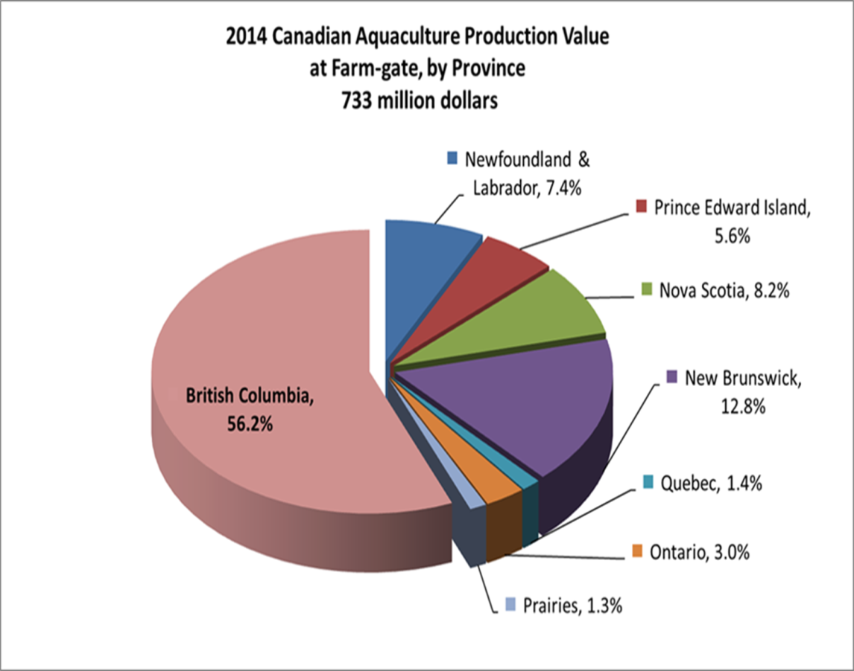
Output by Province
BC leads provinces
  54% of total output
  95% salmon
NB is second
  25% of total output
  98% salmon
NL & NS also mainly salmon producers
PEI mainly mussels
ON, QC & Prairies produce mainly trout

Slide 9
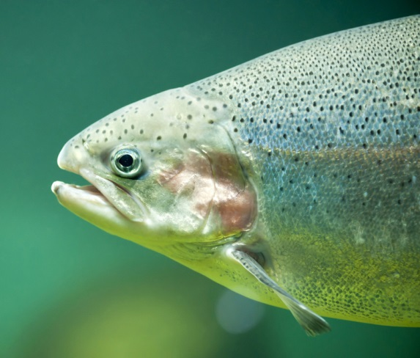
We raise these!
Introduced by fisheries managers into all the Great Lakes from the west coast
Genetically plastic, hardy
Small scale escapes not an issue
Naturalized

Slide 10
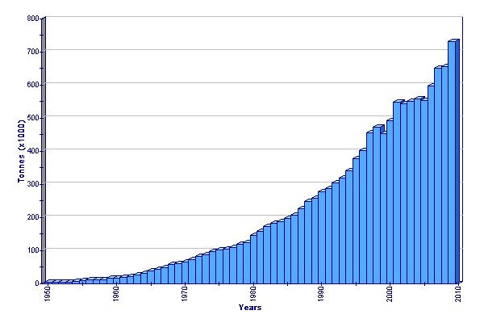
World Production of Rainbow Trout
2009 production of 732,432 tonnes (23% increase over 2006)
2011 production of 770,385 tonnes (31% increase over 2006)

Slide 11
2015 Top 10 Trout Producing Countries (million pounds)
FAO
Notes:
Iran and Turkey produce 43% of global trout production

Slide 12
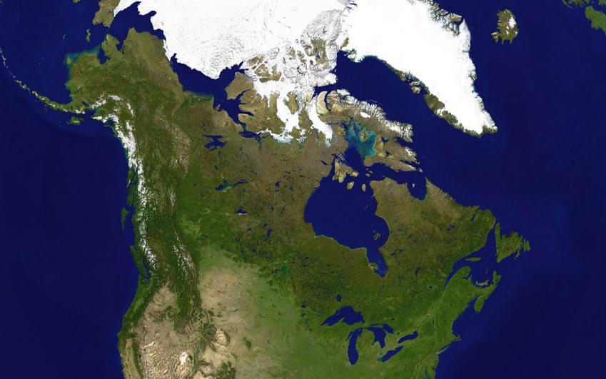
The abundant potential…
20% of the world’s freshwater,
Plentiful biophysical resources,
Developed culture technology,
Still not meeting domestic demand,
Substantial export potential with proximity to the U.S. market,
The industry has the experience, expertise and desire to support development.

Slide 13

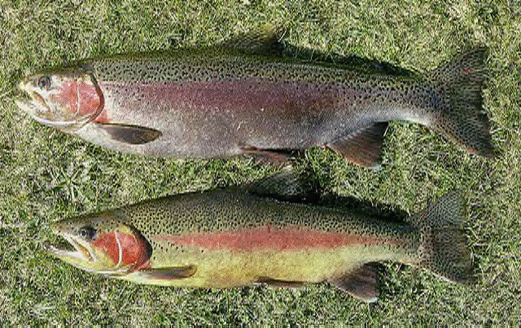
US trout imports - 90 % of 2017 Imports came from…
…relative to 2016: 10% down pounds
12% up dollars
NMFS
Notes:
74 % of product is fresh

Slide 14
Why Rainbow Trout?
Culture techniques, based on more than 100 years of research and practice, are well established;
Domesticated strains of trout have been bred to improve performance and yield;
Nutritional requirements are well defined and efficient commercial feeds are available from several suppliers;
Water temperatures and the biophysical resource base throughout much of Canada are near ideal for the species;
An established market exists for rainbow trout; and
Naturalized species in most parts of the country and thus poses little to no genetic threat to feral populations.

Slide 15
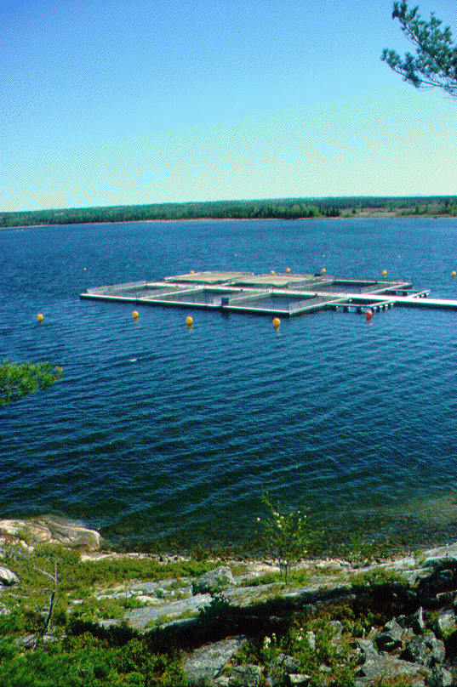
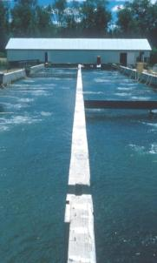
Distribution of Trout Farms in Ontario

Slide 16
Ontario Aquaculture Production
Moccia and Bevan, Aquastats, 2017

Slide 17
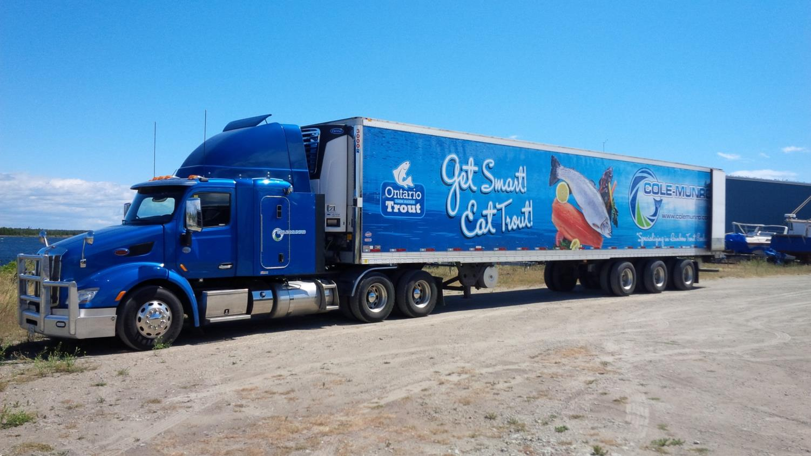
Ontario Aquaculture Association (formerly NOAA)

Slide 18
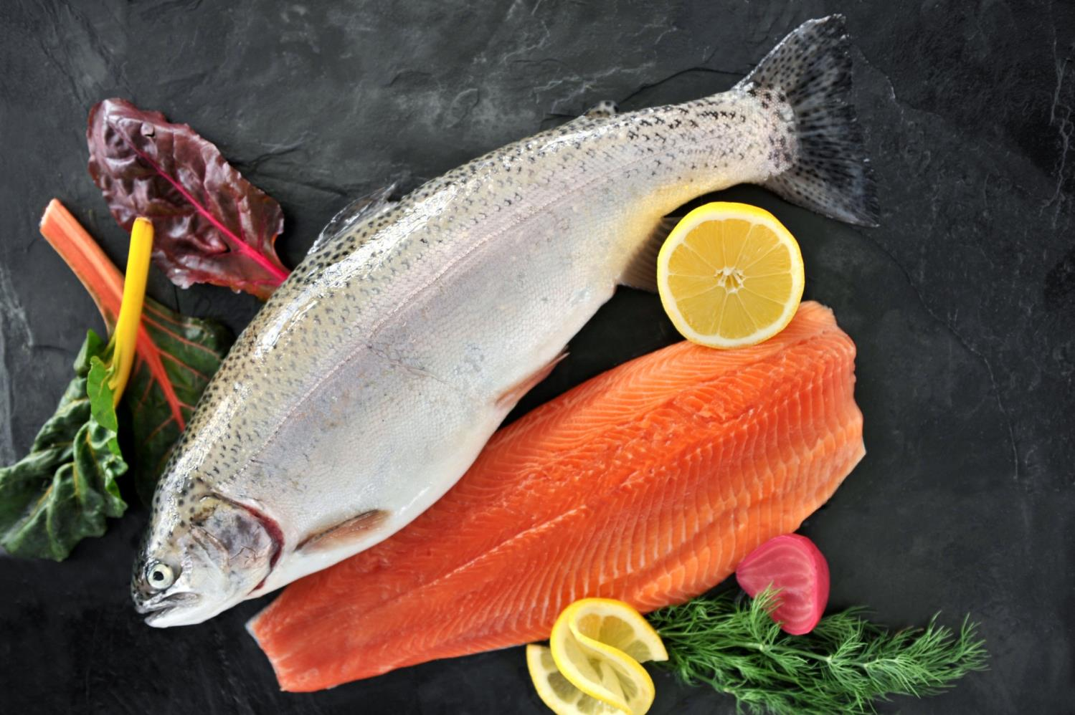

Slide 19
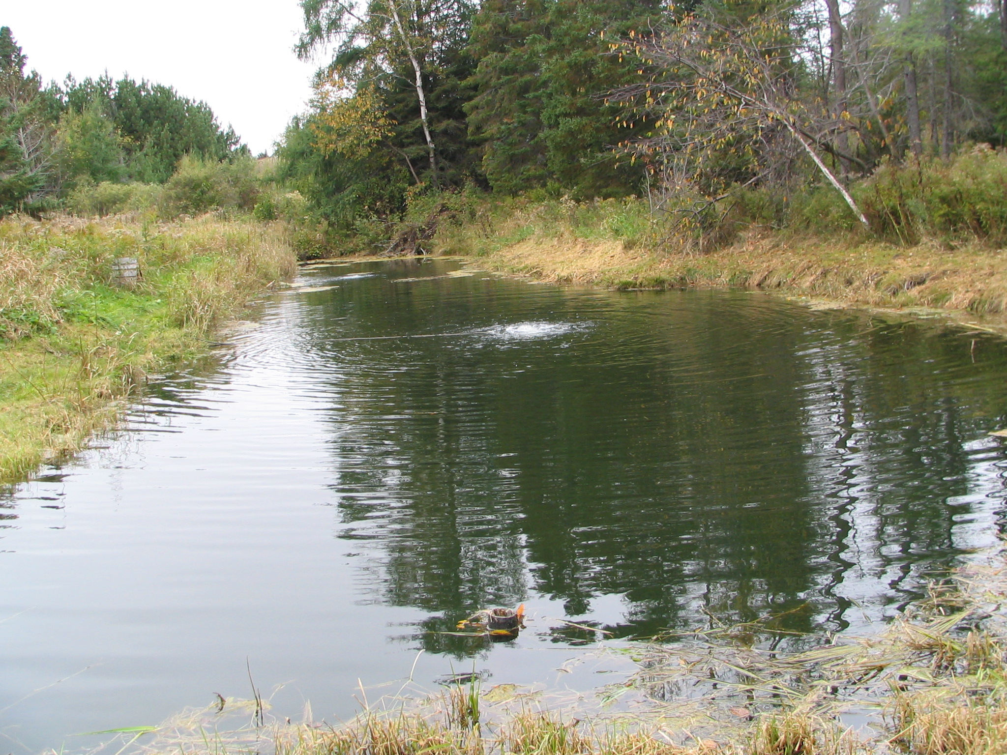
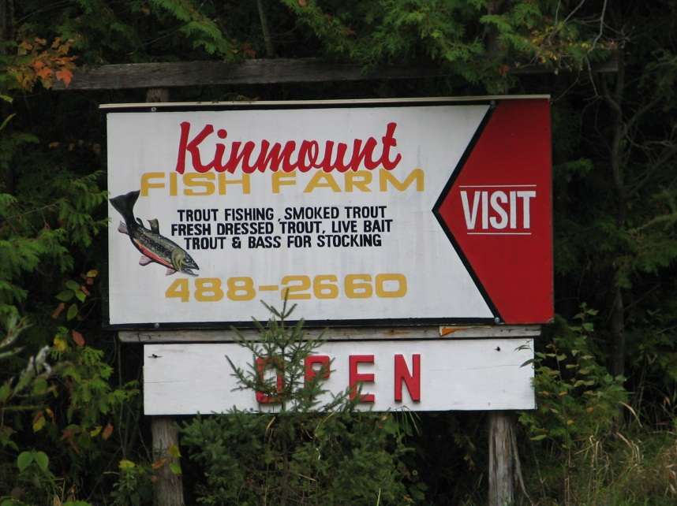

Slide 20
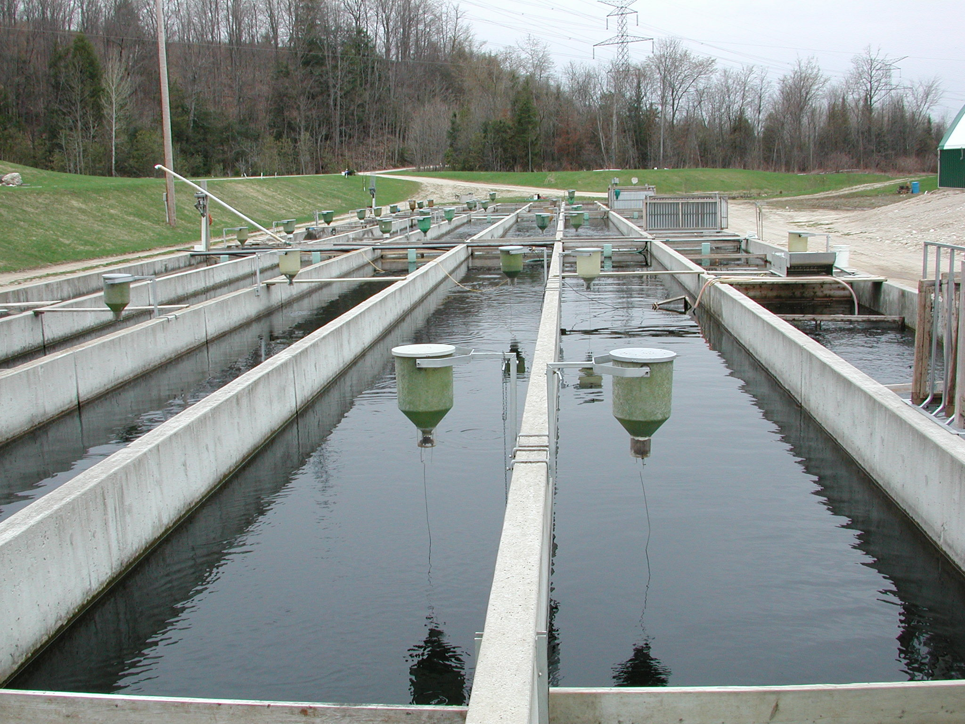

Slide 21
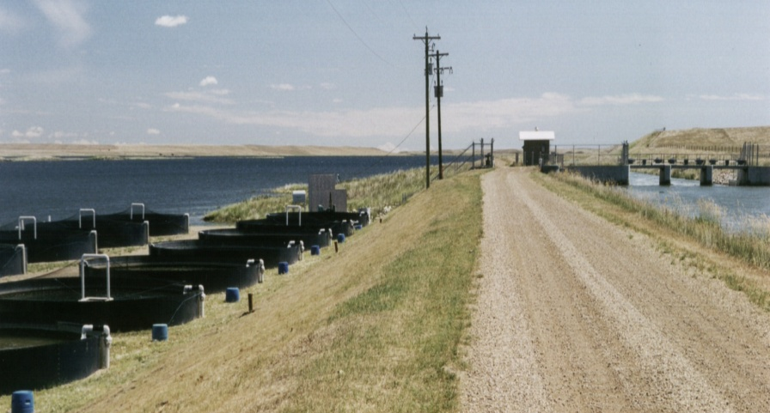
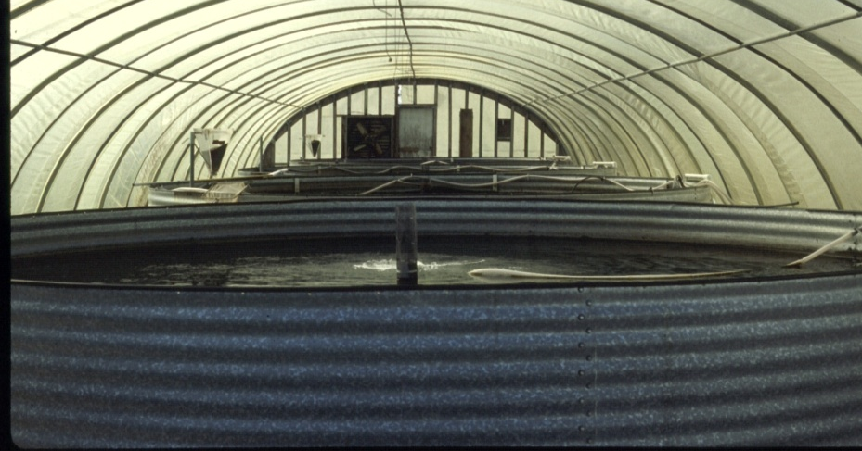
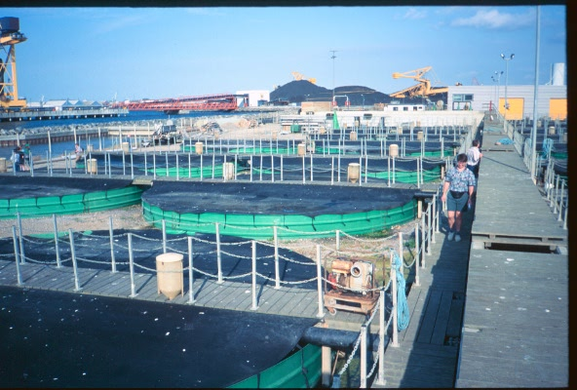
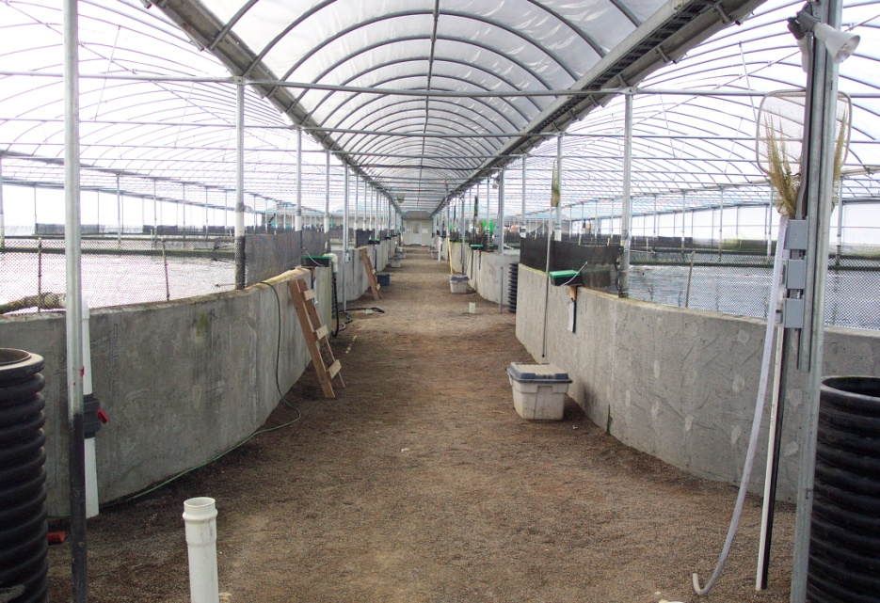
Circular Tank Culture

Slide 22

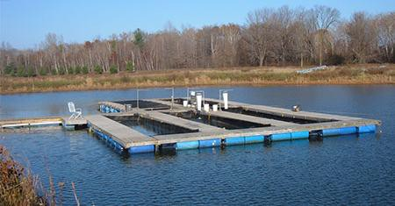

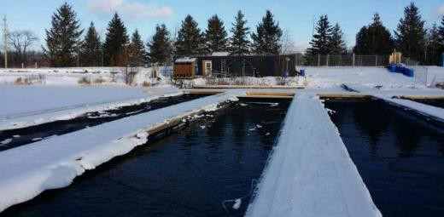

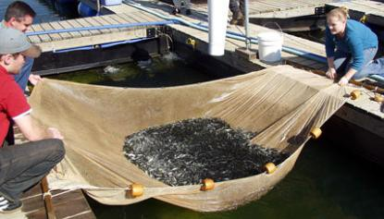

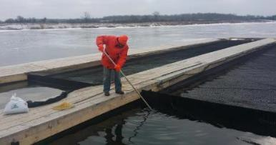


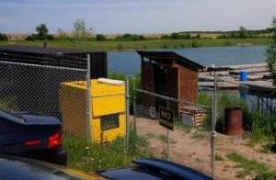
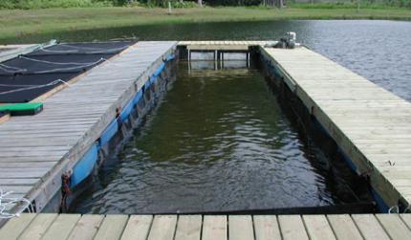
Floating Containment Systems

Slide 23
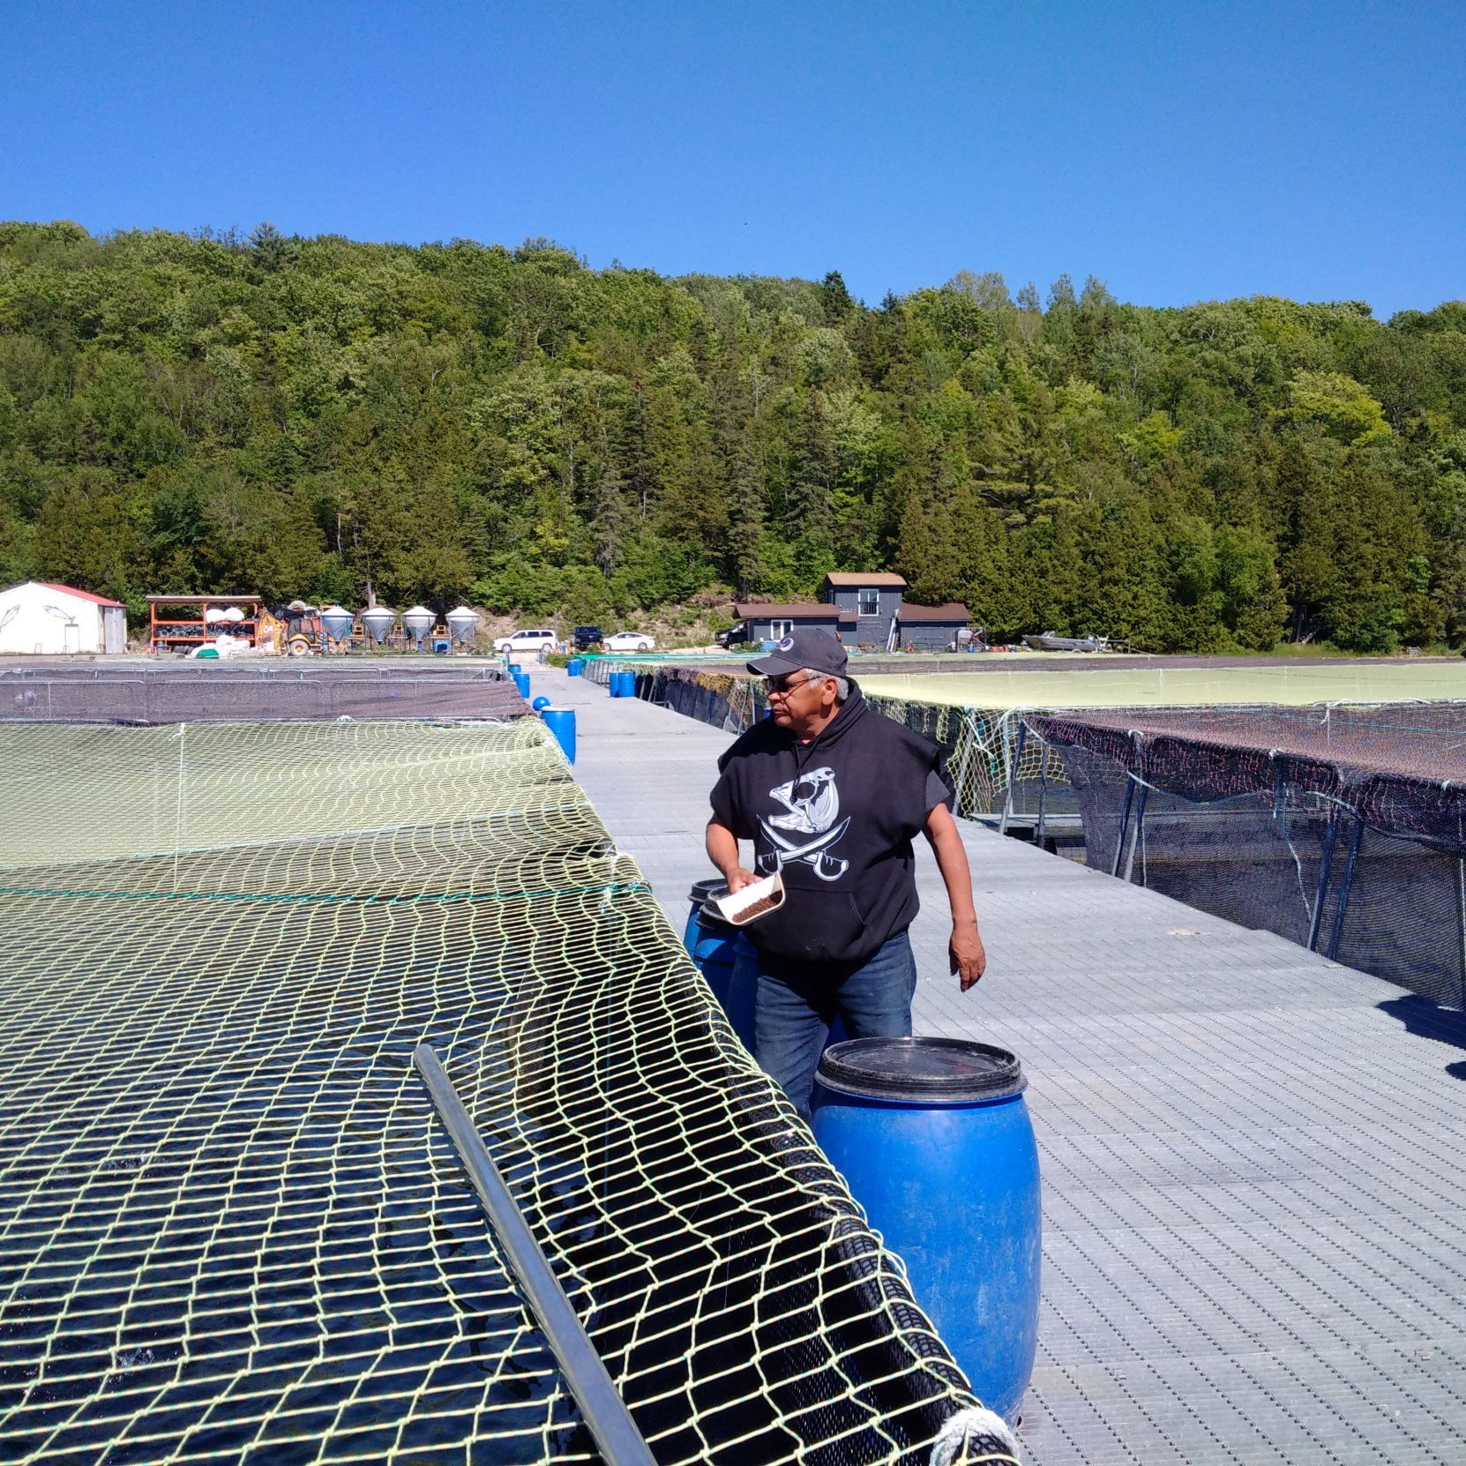
Most of our trout now come from Indigenous fish farms

Slide 24
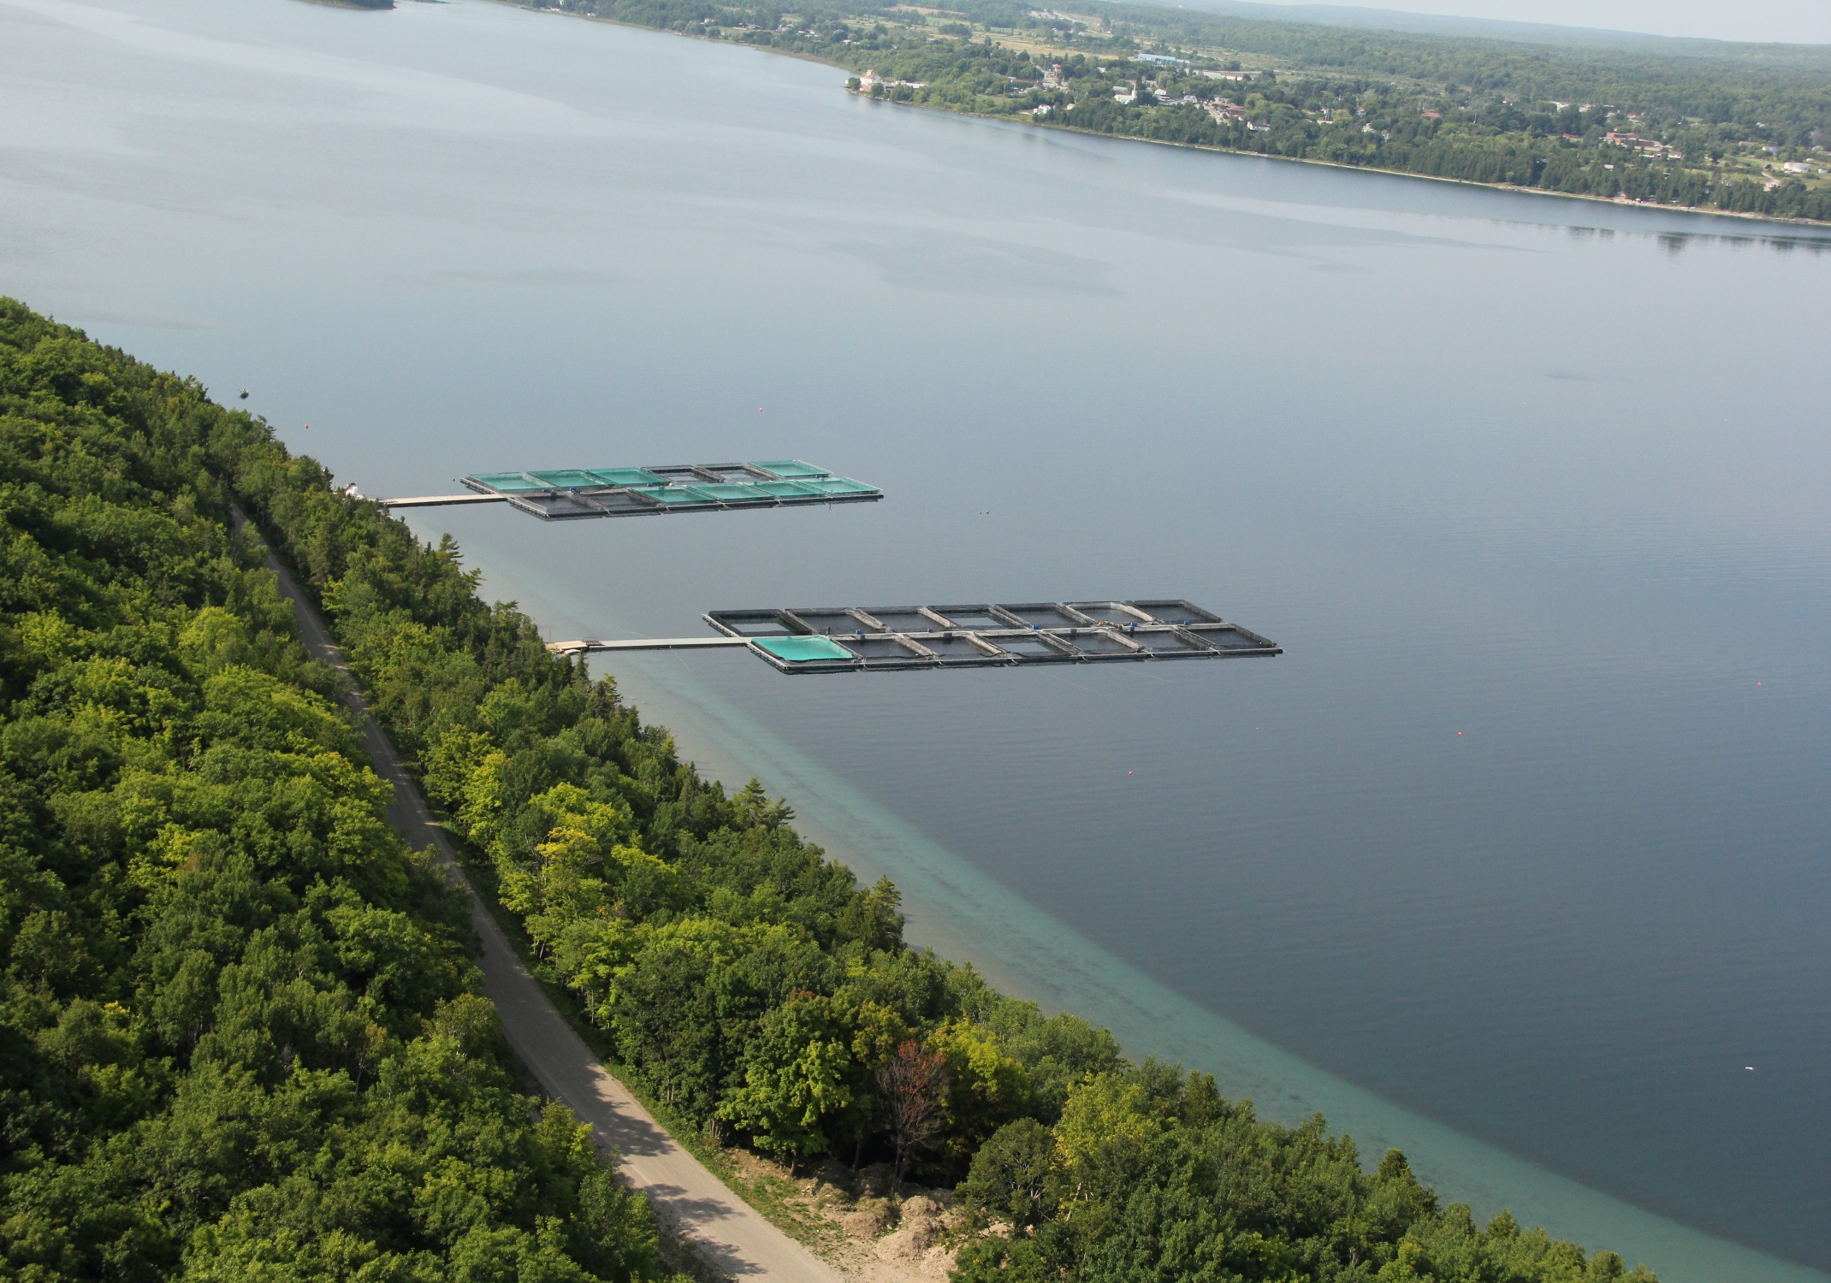

Slide 25

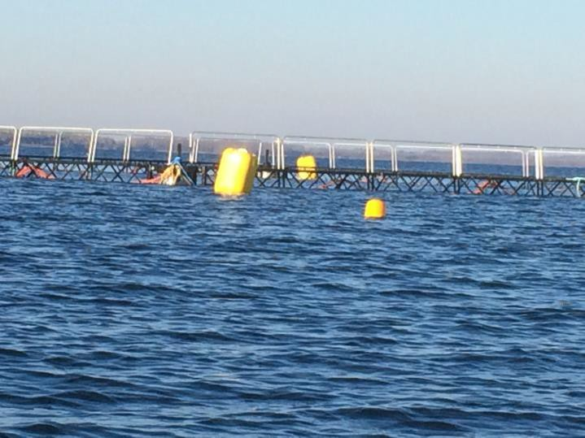
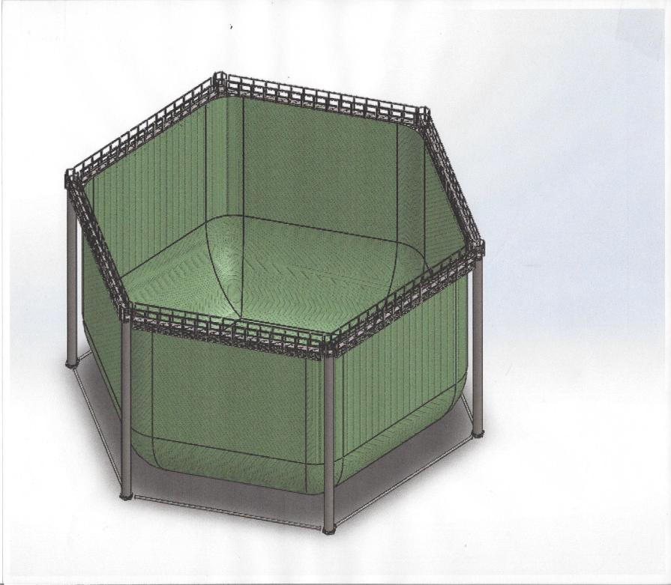
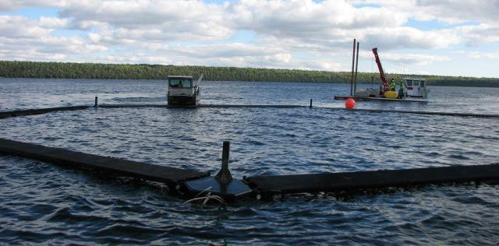
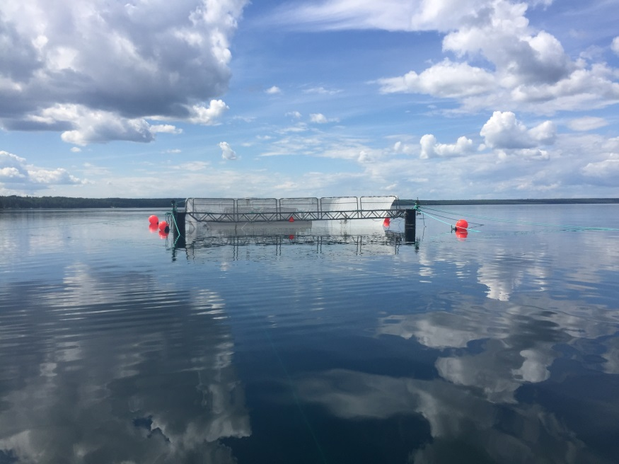
Net Pens for High Energy (cooler) Environments
stormsafesubmersible.com

Slide 26


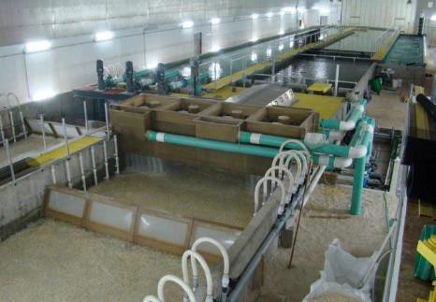



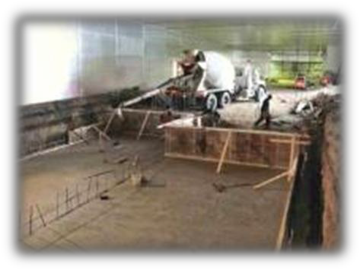
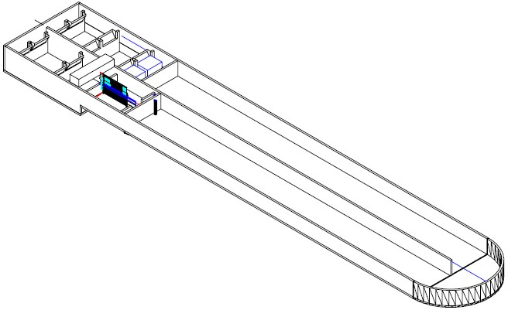
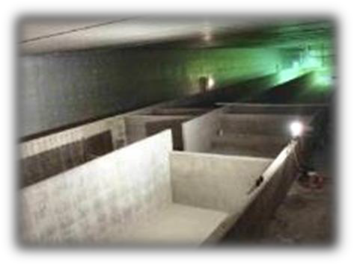
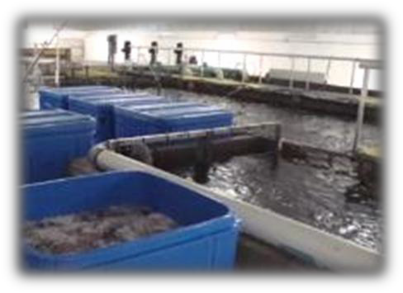

Canadian Model Aqua-Farm Program
Production
130-tonne rainbow trout farm
99% recirculation
Simple, low-head design
430 kg feed / day
Capital cost = ~$9,000 / mt

Slide 27





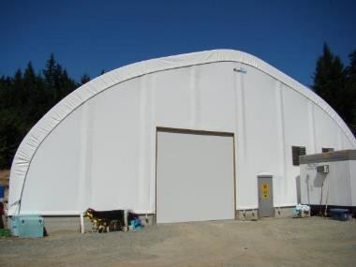

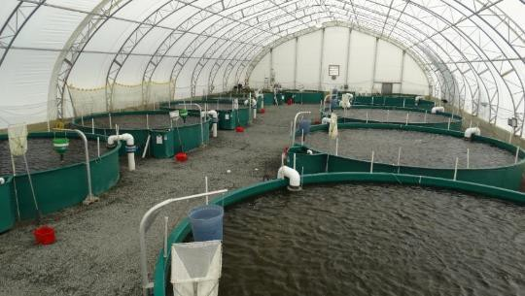

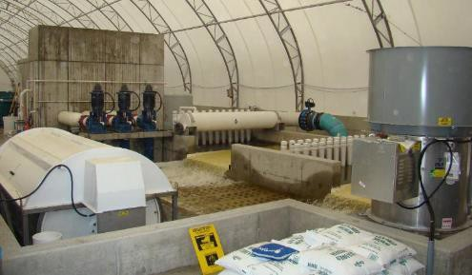
Canadian Model Aqua-
Farm Program
Aquafarms Inc.

Slide 28

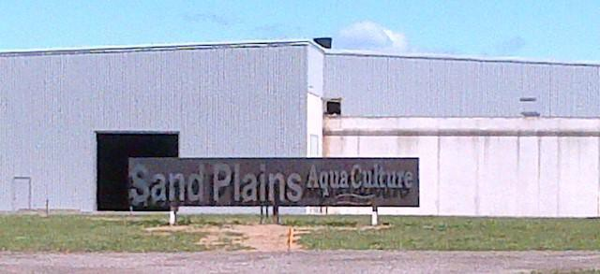

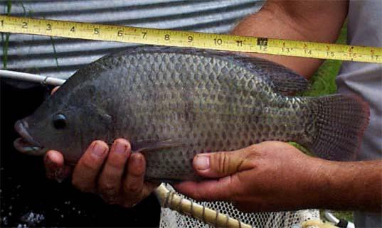

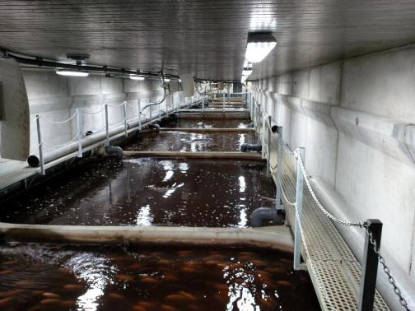

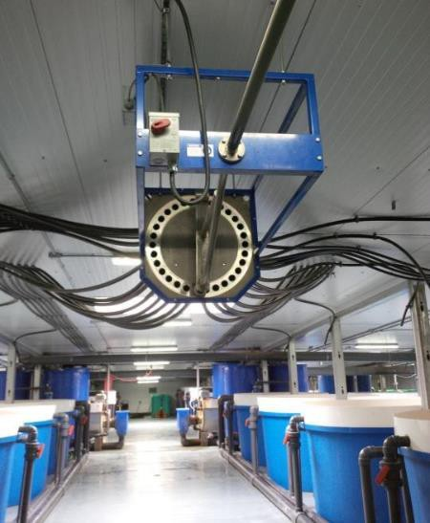

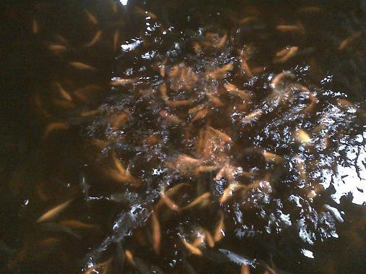

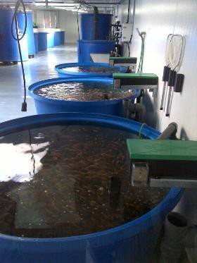
Sand Plains
AquaCulture

Slide 29

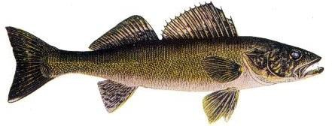
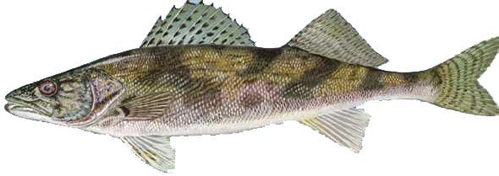
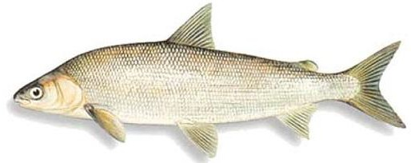
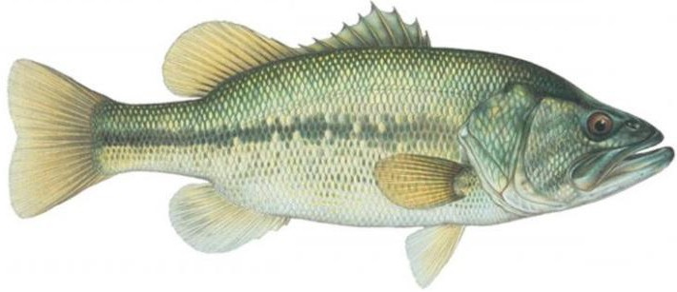


Potential “New” Species
Sturgeon
Walleye / Saugeye
Whitefish
Bass
Pacific White-legged Shrimp

Slide 30





Pacific White Shrimp

Slide 31



GTA live fish markets

Slide 32


Slide 33


Slide 34


Slide 35

Organic Aquaculture Production – Standards under CGSB

Slide 36


Moose Cree Aquaponics
Prepared by:
Canadian Aquaculture Systems Inc.
1076 Tillison Avenue
Cobourg, ON Canada K9A 5N4
+1 905 377 8501
www.canadianaquaculturesystems.com
Project Lead:
Moose Cree First Nation
22 Jonathan Cheechoo Drive, Box 190
Moose Factory, ON P0L 1W0
+1 705 658 4619 ext. 231
www.moosecree.com

Slide 37

Why Aquaponics?
Nitrate is a by-product in intensive aquaculture systems. It is also essential for plant growth
Coupled Systems
  Common water for fish and plants
De-coupled Systems
  Independent recirculation systems for fish and plants
  Nutrients transferred from fish to plants via digester
www.sfi.mtu.edu

Slide 38




Products
Fresh, farmed-raised fish and vegetables
Fresh rainbow trout*
  ~1,000 kilograms of fish / month
  250 kg per week
Leafy vegetables
  ~68,000 heads per year
  Lettuces, basil, chard, kale, herbs, etc.
Specialty Crops (in future)
  e.g. strawberries
  * The OMNRF has approved the culture of all-female, triploid rainbow trout at Moose Cree Aquaponics
Deep Water Raft Culture
Nutrient Film Technique

Slide 39




Moose Cree Aquaponics Facility

Slide 40
Summary
Moose Cree Aquaponics
  State-of-the-art 6,000 square foot aquaponic production system
  Production of 12,000 kg of fresh trout, 68,000 heads of leafy greens
  Ready market at competitive prices
  Sales revenue > $425,000 per year
  Total investment = $1.5 million
  Capital investment = Cdn $ 1.35 million
  Working Capital investment = Cdn $ 0.15 million
  EBITDA = 32.5%

Slide 41

Shawanaga First Nation Walleye Hatchery Overview

Slide 42
Shawanaga First Nation Walleye Hatchery Overview
SFN’s involvement in Walleye culture and restoration dates back to the late 1970’s.
Construction of a hatchery in 1996 allowed them to expand their efforts.
Now produce approximately 3 to 5 million walleye fry annually.
The fish culture program benefits from long-standing community support and is recognized as a valued opportunity to engage youth in various stages of the walleye collection, spawning and incubation processes which provides them with valuable experiences in fish culture and environmental management.

Slide 43
Shawanaga First Nation Walleye Hatchery Overview
Full buy in exists, this initiative is embraced by the community.
“River watchers” protect the river and walleye during the most critical time of the year.
Year on year this operation is self funded by the community.
Recent participants in NICFI to expand their existing hatchery

Slide 44
The process
Walleye come to mouth of river to spawn
Community members in accordance with chief and council will spear walleye, trying to coordinate each harvest with the hatchery staff.
Males/females are weighted, measured along with details about temperature, harvester so every details is recorded.
Males and females are prepped and cleaned for spawning (3 males to every 1 female).
Once spawning process is complete the fertilized eggs are transported by boat back to the hatchery.
Eggs will hatch in about 25 days at 10 degree water temperature.

Slide 45



Slide 46



Slide 47



Slide 48

Please contact for more information
Curtis Assance
EDO of Shawanaga First Nation edo@shawanagafirstnation.ca
705-366-2526
Stan Judge
Consultation Officer/hatchery manager
consultationofficer@shawanagafirstnation.ca
705-366-2526

Slide 49

New North Fisheries Overview

Slide 50
New North Fisheries Overview
Fall 2016- harvested lake whitefish roe, pilot project commenced.
College boreal hatched eggs, alma research station received the fry and on grew till fingerling stage.
Fingerlings entered at New north fisheries in manitowaning bay on June 23, 2017 at a weight of 5 grams, approximately 43,000 lake white fish.
June 01, 2018 a second cohort was entered at an average weight of 5 grams, approximately 60,000 lake white fish. (separate cage)

Slide 51
2016 year class
Fish performing very well.
Strong feeding behaviour and have consistently gained weight as expected.
Have experienced very low mortality (0.1% – 0.2%).
able to deal with higher then expected water temperatures (+20 degrees).
Ready to be split down to reduce density.
harvest SPRING 2019

Slide 52
Why Lake whitefish
Besides the fact they are extremely tasty………………….
Lake Erie lake whitefish, considered a fast growing strain requires 7 to 8 years to reach a weight of 4-5 lbs. New north is expecting to reach 4 lbs in 2 years from egg.
During the winter months, new north has received commitments from buyers between $5.25 to $7.00 / lbs.
Unlike rainbow trout, lake whitefish do not require access to the surface to regulate their air bladders, making them an ideal fish to culture in northern Ontario.
Lake whitefish are in decline, tougher to catch commercially, numbers are not what they were.
Taste tests have proven successful.
Culturing this species will no question reduce pressures on the wild stock.

Slide 53
Next steps to success for lake whitefish
Continually learn from pilot project, it’s a new species, need to learn the fish.
Start hatchery facility.
Domesticate lake whitefish-brood stock.
Establish other farms to increase production.
Ideally become a species as common as rainbow trout to culture.

Slide 54


Pictures

Slide 55
New North Fisheries Videos
https://www.youtube.com/watch?v=Bll5PDShDpQ
https://www.youtube.com/watch?v=yS-XwEWcaJI
https://www.youtube.com/watch?v=sKTOtpqVVMo
https://www.youtube.com/watch?v=h5I1RBCHSHo

Slide 56
Micro-Hatcheries Inc.
WE ARE HATCHING FOR our Future

Slide 57

School Micro Hatchery Programs
Atikameksheng First Nation, Anishinabek Youth Centre

Slide 58

Algonquin Road Public School student using Trinocular microscope with 14 megapixel camera used for taking pictures and videos

Slide 59

This is a video of the heartbeat of an 11 day old walleye larva still inside the egg.
As my friend Chad Boisoneau (Chief of Mattagami First Nation) would say.
We are Hatching for Our Future.

Slide 60

Photo taken via one our camera equipped digital microscopes, of a walleye embryo developing
in an egg. Note the two eyes and heart development.

Slide 61

Photo of a newly hatched walleye fry surrounded by unhatched eggs. Note the first life stages of a free swimming fry, including the eye, digestive system, egg sac and tail. Our hatcheries act as community learning centres where area students are able to experience these biological life experiences firsthand and learn all about how the Micro-Hatcheries Inc. undertakes on behalf of the community, stewardship of the areas fishery resource.

Slide 62

Lakeview School 5,000 Hatched Brook Trout Larvae still in Micro-Hatchery
Notes:
5.000 Brook Trout Laval waiting to be realest

Slide 63

Cochrane Public School Grade 2 class learning how they will be
realising their brook trout Larvae

Slide 64












Mattagami First Nation Students Students releasing their
Mary Jane Naveau Memorial School Brook Trout Larvae for the first time
Student from Pontiac School Algonquin Road Public School student using
with (School Micro-Hatcheries) Trinocular microscope with 14 megapixel camera
used for taking pictures and videos
M’chigeeng First Nation Lakeview School this is a walleye egg you can see
The head, eyes and tail of the embryo
2 headed brook trout still inside the egg
Fond by grade 2 students using their microscope provided with School Micro-Hatcheries Programs
Lakeview School 5,000 Hatched Brook Trout Still in Micro-Hatchery Student at Lakeview School using Microscope
Camera to video brook trout
Cochrane Public School Grade 2 class Grade 2 class releasing in local lake
their Brook trout Larval
Cochrane Public School
Grade 2 student using trinocular microscope to see brook trout embryo inside of egg
Cochrane Public School students poring 6,000 brook trout egg into their School Micro-Hatchery
SAGAMOK ANISHNAWBEK Grade 8 Students from Biidaabiin Kinoomagegamik School are have another successful Brook Trout Hatch using their School Micro Hatcheries Programs hatchery.
Micro-Hatcheries Inc. also builds walleye hatcheries that are
capable of hatching as many as 4,000,000 walleye eggs
ANALYSIS/DISCUSSION/KEY FINDINGS
This particular project does not lend itself to in-depth analysis in a scientific sense, given that it is intended to be educational and experiential. However, a qualitative analysis of the activity suggests that the children in all schools are very engaged in all stages of hatchery activity. The microscopes provided are capable of computer connection and white board display. Clearly there were students in each class who are more interested than others. Although all of the hatcheries are housed in specific classrooms, all classes in the schools are able to have some exposure to the project basics and equipment.

Slide 65

Student from Wikwemikong Wasse Abin Pontiac School grade 6 class
stocking walleye fry
Notes:
Student from Wikwemikong Wasse Abin Pontiac School grade 6 class stocking walleye fry

Slide 66

This is a picture of Brunswick House First Nation's 6 bell jar Walleye Hatchery with 1.5 million walleye eggs.
Great job, I am very proud of my friend Bruce Golden and the community of B.H.F.N.

Slide 67

Northern Integrated Commercial Fisheries Initiative

Slide 68
Indigenous Communities are Poised for Growth
The Aquaculture Sector in Central Canada is ready for expansion.
Aboriginal Communities are in a unique position to benefit from sustainable aquaculture development due to their aquatic resources, rights, and special access to aquaculture development sites.

Slide 69
Northern Integrated Commercial Fisheries Initiative (NICFI)
NICFI has been developed to assist;
Indigenous groups grow self-sustaining community-based commercial fishing enterprises.
Create opportunities for Capacity building.
Generate Indigenous employment opportunities.
Increase long-term Indigenous participation in commercial fisheries and diversification related activities.
Eligible projects will be aimed at communal commercial fishing enterprises and aquaculture development with focus on business development planning, advice and training.

Slide 70
NICFI_Aquaculture Development Source
Under NICFI, the NICFI Aquaculture Development Source was created to provide direct support to Aboriginal Communities and Groups to develop sustainable aquaculture operations.
Project activities eligible may include but not limited to;
Expansion or upgrades to existing marine finfish, shellfish, or freshwater land-based or open net pen aquaculture facilities.
Equipment, gear and infrastructure for new or expanded aquaculture operations.
Acquisition of an existing aquaculture operation.
Business plans, feasibility studies and environmental assessments and studies.
Other aquaculture operations start-up costs funded on a one-time basis.

Slide 71
NICFI_Aquaculture Development Source
Officially launched and established in April 2019, program will be around for at least another 4 years.
Funded & administered by DFO.
Facilitated and co-delivered by Waubetek for Central Canada (Ontario, Manitoba, Saskatchewan and Alberta).
Aquaculture development support and expertise will continue through the Aquaculture Development Officer position.
NICFI has its own pool of funds to draw from, the East and West coast have their own.

Slide 72
“Soft Launch”
NICFI Aquaculture Development Source
Activities supported
Range of species related to projects
Equipment & Infrastructure
Expansion of existing operations
Feasibility studies
Detailed designs
Community engagements
Business plans
Partnership developments
Facility tours and travel
Rainbow Trout
Arctic Charr
Walleye
Lake Sturgeon
Lake Whitefish
Pacific White Shrimp

Slide 73
NICFI_Aquaculture Development Source
Project activities that are not eligible for NICFI Aquaculture Development Source funding;
Working capital projects.
Scientific studies.

Slide 74
Waubetek’s Aquaculture Services
Assist in identifying new or expanding opportunities.
Identify new innovations, best practices and approaches.
Advisory on the implementation of early-stage aquaculture business development plans.
Identify joint venture opportunities and partnerships.
Advisory services specific to aquaculture related fisheries and support.
Assist with flagship business development projects.
Assist with business improvement projects.
Host and participate in Aquaculture workshops.

Slide 75
Types & Forms of Aquaculture
Open Net Pen
Land based (RAS, Flow through systems, Pond Culture)
Rehabilitation
Put and Take/Pay to fish
Aquaponics
Commercial/Commodity/Live Markets
R&D
Niche (Organics)
Supplying Fingerlings to the on growers
Food Security

Slide 76
Main Focus
This program is designed to allow the Aquaculture Development Officer to be a resource, asset and ally which can provide support for nearly any aquaculture related activity within any stage (pre-development-post operational).
Main focus is to ensure the best interest of the community is always acknowledged and to ensure all projects are feasible and sustainable.
free resource for the Communities, Individuals and Groups

Slide 77
Contact Information
Nicholas Huber
Aquaculture Development Officer
nhuber@waubetek.com
(705)285-4275 or (519)-476-0630

Slide 78

Thank you for the Invitation

